Slide 1
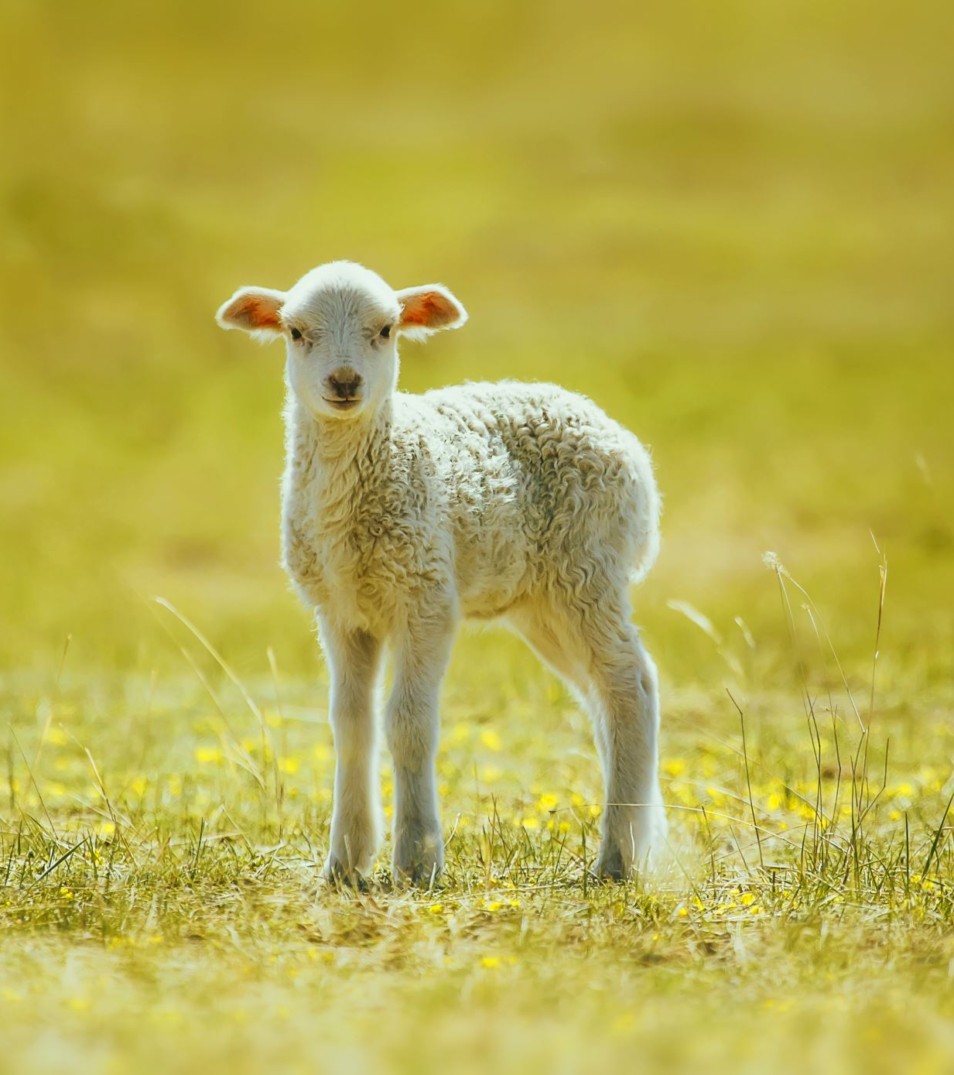
MARY HAD A LITTLE LAMB
MATTHEW 1: 18-25

Slide 2
I. MARY’S LAMB WAS A SPECIAL LAMB
A. HIS CONCEPTION WAS SPECIAL

Slide 3
I. MARY’S LAMB WAS A SPECIAL LAMB
B. HIS CONDUCT WAS SPECIAL
MIRACLES
MESSAGES
METHODS

Slide 4
I. MARY’S LAMB WAS A SPECIAL LAMB
C. HIS CLAIM WAS SPECIAL
TO BE THE SON OF GOD
TO BE GOD

Slide 5
II. MARY’S LAMB WAS A SACRIFICIAL LAMB
A) HE WAS A SPOTLESS LAMB
B) HE WAS A SUBMISSIVE LAMB

Slide 6
II. MARY’S LAMB WAS A SACRIFICIAL LAMB
C) HE WAS A SACRIFICIAL LAMB

Slide 7
III. MARY’S LAMB IS A SAVING LAMB
A) HE HAS THE POWER TO SAVE SINNERS
B) HE HAS THE POWER TO SECURE THE SAINTS
HE CAN CLEANSE SIN
HE CAN CONVERT SOULS
HE CAN CHANGE SINNERS
“Therefore, if anyone is in Christ, the new creation has come: The old has gone, the new is here!
– 2 Corinthians 5:17

Slide 8
Do you know Mary’s Little Lamb?

