Slide 1
MIRACLE OF MIRACLES
Text:
Matthew 25:34

Slide 2
The Creation of Adam by Michelangelo in the Vatican's Sistine Chapel

Slide 3
Could There Ever Be Anything Else to Match the Mind-boggling Miracles of Creation Which Were Mostly Spoken into Existence?

Slide 4
I. BEFORE THE FOUNDATION OF THE WORLD - Preordained
“He (Jesus Christ - 1:13) was chosen before the creation of the world, but was revealed in these last times for your sake.”
I Peter 1:20

Slide 5
I. BEFORE THE FOUNDATION OF THE WORLD - Preordained
“just as he chose us in Christ before the foundation of the world to be holy and blameless before him in love.”
Ephesians 1:4

Slide 6
I. BEFORE THE FOUNDATION OF THE WORLD - Preordained
“Then the King will say to those on his right, ‘Come, you who are blessed by my Father; take your inheritance, the kingdom prepared for you since the creation of the world.”
Matthew 25:34

Slide 7
I. BEFORE THE FOUNDATION OF THE WORLD - Preordained
“For you have been born again, not of perishable seed, but of imperishable (not of corruptible seed, but of incorruptible - KJV), through the living and enduring word of God.”
I Peter 1:23

Slide 8
Many Vital Decisions Were Made Before this World Was Even Created.
1. The Plan of Salvation
2. The Only One who could die so our sins could be forgiven
3. The Suffering of Jesus was already decided upon - Hebrews 4:3
4. The Names of Those Who Would Be Redeemed Were Already Written down in the Lamb’s Book of Life - Revelation 17:8 NKJV

Slide 9
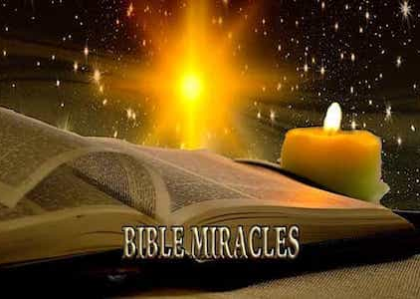
A miracle can be described as an event that involves the direct and powerful action of God, transcending the ordinary laws of nature and defying common expectations of behaviour.

Slide 10
There are 83 miracles listed in
the Old Testament (most in the
Book of Exodus)
and
81 listed in the New Testament (most in the Book of Acts).

Slide 11
Luke 2:22-35;
After they had heard the king, they went on their way, and the star they had seen when it rose went ahead of them until it stopped over the place where the child was. 10 When they saw the star, they were overjoyed. 11 On coming to the house, they saw the child with his mother Mary, and they bowed down and worshiped him. Then they opened their treasures and presented him with gifts of gold, frankincense and myrrh.
Matthew 2:9-11

Slide 12
III. A MIRACULOUS GIFT FOR EVERYONE - Panoptic “showing or seeing the whole at one view.”
“After this, he went down to Capernaum with his mother and brothers and his followers.”
John 2:12

Slide 13
III. A MIRACULOUS GIFT FOR EVERYONE - Panoptic “showing or seeing the whole at one view.”
“Isn’t this the carpenter? Isn’t this Mary’s son and the brother of James, Joseph, Judas and Simon? Aren’t his sisters here with us?’ And they took offense at him.”
Mark 6:3

Slide 14
III. A MIRACULOUS GIFT FOR EVERYONE - Panoptic “showing or seeing the whole at one view.”
“Yet to all who did receive him, to those who believed in his name, he gave the right to become children of God.”
John 1:12

Slide 15
III. A MIRACULOUS GIFT FOR EVERYONE - Panoptic “showing or seeing the whole at one view.”
“I seek not to please myself but him who sent me.”
John 5:30

