Slide 1
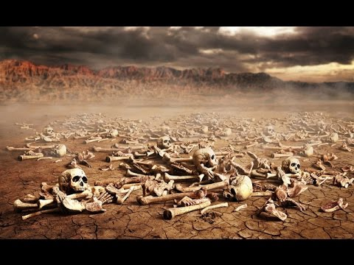
MISSION IMPOSSIBLE: RAISING THE DRY BONES
EZEKIEL 37:1-14

Slide 2
I. A SHOCKING REVELATION
(A) HE SAW DEATH
“…DEAD IN TRESPASSES AND IN SINS,”
EPHESIANS 2:1

Slide 3
I. A SHOCKING REVELATION
(B) HE SAW DEVASTATION
“THERE IS NONE THAT DOETH GOOD, NO, NOT ONE.”
ROMANS 3:12

Slide 4
I. A SHOCKING REVELATION
(C) HE SAW DEFEAT
“BEHOLD, THEY SAY, OUR BONES ARE DRIED, AND OUR HOPE IS LOST…”

Slide 5
II. A SOLEMN RESPONSIBILITY
(A) HE WAS COMMANDED TO PREACH
“PROPHESY TO THESE BONES AND SAY TO THEM, “DRY BONES, HEAR THE WORD OF THE LORD!”
EZEKIEL 37:4

Slide 6
II. A SOLEMN RESPONSIBILITY
(B) HE WAS COMMANDED TO PRAY
“BREATHE UPON THESE SLAIN, THAT THEY MAY LIVE!”
EZEKIEL 37:9

Slide 7
III. A SUPERNATURAL RESURRECTION
(A) HOW THEY WERE ACTIVATED
“THEY LIVED!”

Slide 8
III. A SUPERNATURAL RESURRECTION
(B) HOW THEY WERE ANIMATED
“THEY STOOD UP UPON THEIR FEET!”

Slide 9
III. A SUPERNATURAL RESURRECTION
(C) HOW THEY WERE ASSOCIATED
“…AN EXCEEDINGLY GREAT ARMY.”

Slide 10
III. A SUPERNATURAL RESURRECTION
(D) HOW THEY WERE ASSURED
“AND I WILL PUT MY SPIRIT IN YOU, AND YOU SHALL LIVE, AND I WILL PLACE YOU IN YOUR OWN LAND.”

Slide 11
WHEN YOU LOOK AT THE WORLD, WHAT DO YOU SEE?

