Slide 2
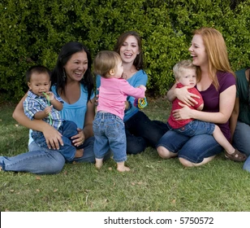
MOMS

Slide 3
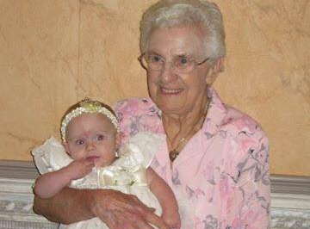
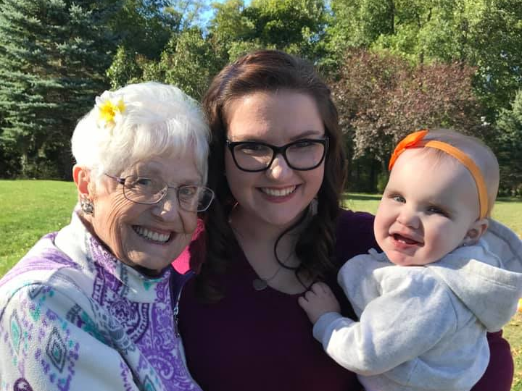
GRANDMAS

Slide 4
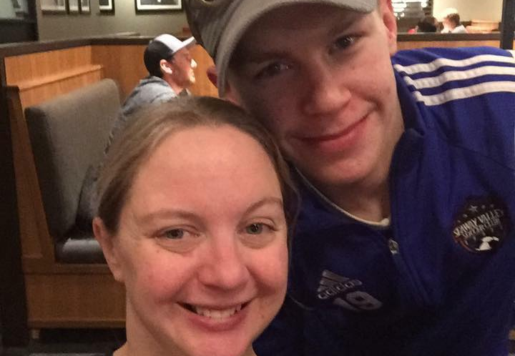
AUNTIES

Slide 6
WHAT’S YOUR OCCUPATION? - Darlene Jones Sanders

Slide 7
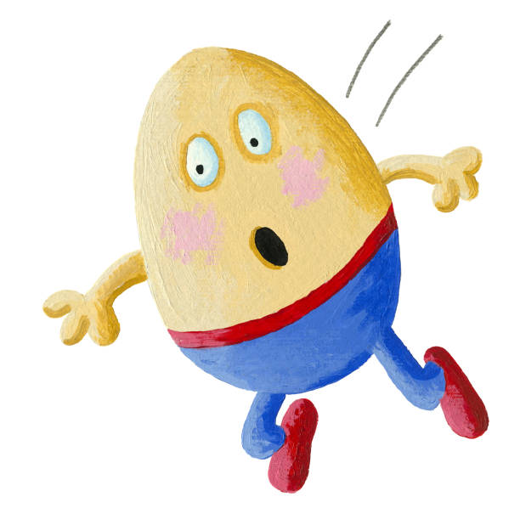
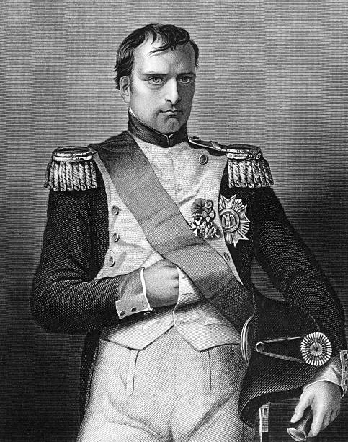
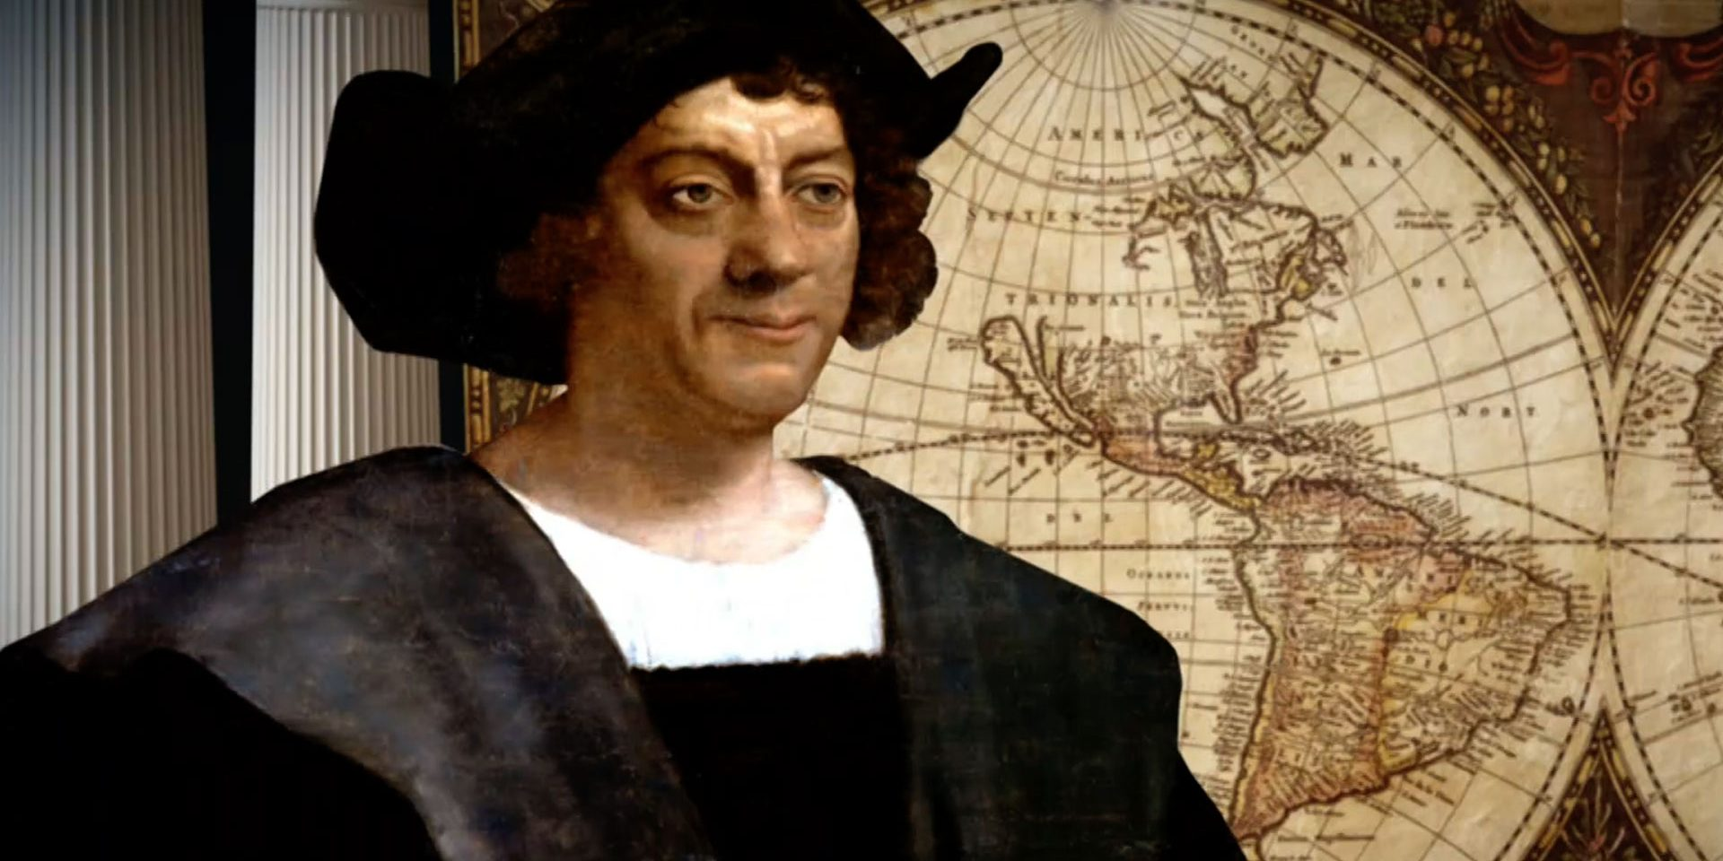
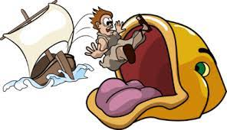
What some mothers could have said…

Slide 9
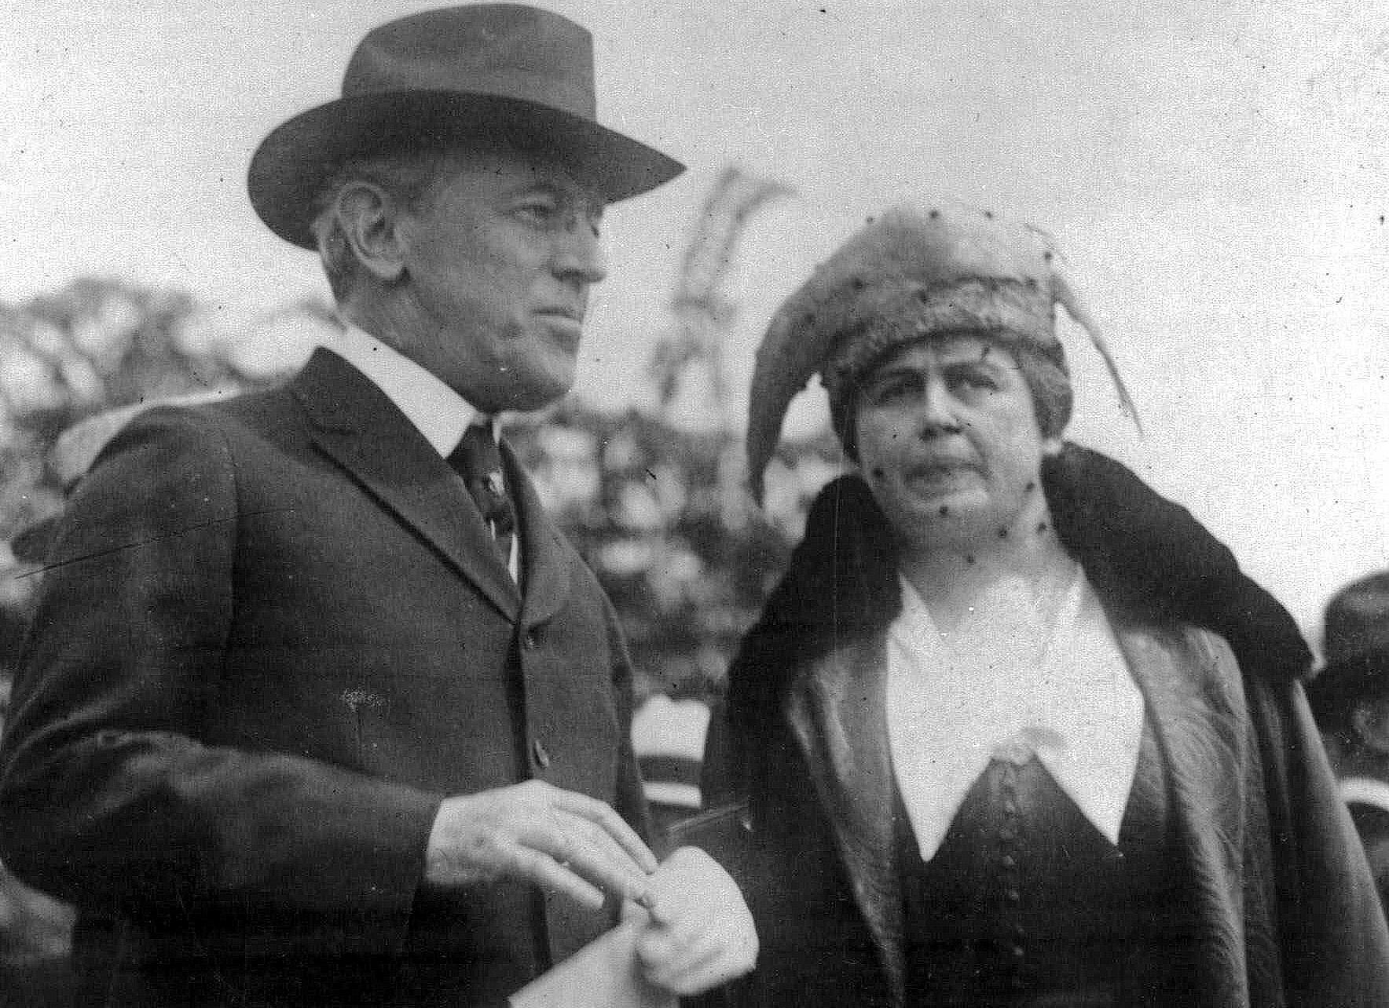
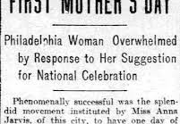

Slide 10
Anna didn’t want Mother’s Day to be all about expensive gifts or fancy flowers…just a day to tell your mom that you love and appreciate her

Slide 14
…self control should be the control system in our hearts for all the other fruit of the Spirit!

