Slide 1
MUSTS IN THE MASTER’S LIFE
Text: John 4:4; 3:14; I Corinthians 15:25

Slide 2
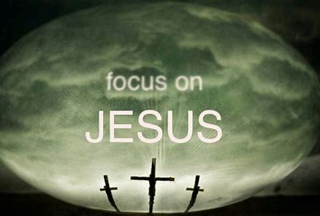
I. THE MUST OF SERVICE (John 4:4)
“For even the Son of Man did not come to be served, but to serve, and to give his life as a ransom for many.”
Mark 10:45

Slide 3
I. THE MUST OF SERVICE (John 4:4)
“If anyone wants to be first, he must be the very last, and the servant of all.”
Mark 9:35

Slide 4
I. THE MUST OF SERVICE (John 4:4)
“You know that those who are regarded as rulers of the Gentiles lord it over them, and their high officials exercise authority over them.
43. Not so with you. Instead whoever wants to become great among you must be your servant,
44. and whoever wants to be first must be slave of all.”
Mark 10:42-44

Slide 5
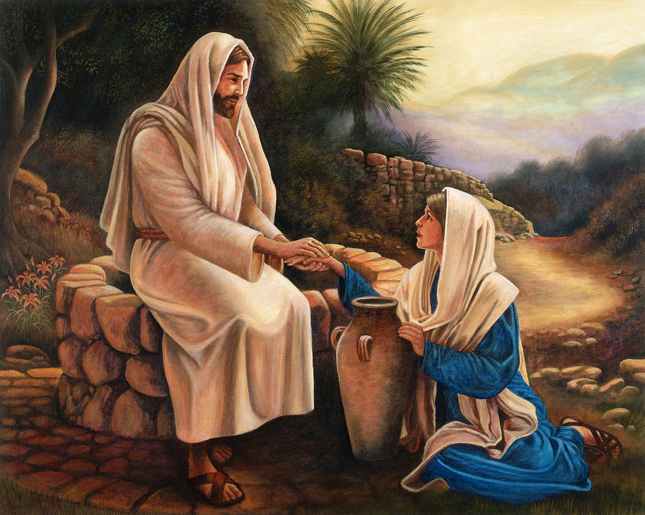
I. THE MUST OF SERVICE (John 4:4)
“Now he had to (must needs - KJV) go through Samaria.”
John 4:4

Slide 6
I. THE MUST OF SERVICE (John 4:4)
“But he said to them, ‘I have food to eat that you know nothing about . . . ‘
34. ‘My food,’ said Jesus, ‘is to do the will of him who sent me and to finish his work.’”
John 4:32,34

Slide 7
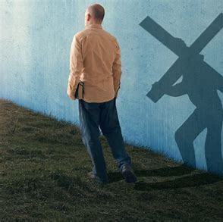
II. THE MUST OF SACRIFICE (John 3:14)
“If anyone would come after me, he must deny himself and take up his cross daily and follow me.”
Luke 9:23

Slide 8
II. THE MUST OF SACRIFICE (John 3:14)
“We have left everything to follow you!”
29. ‘I tell you the truth,’ Jesus replied, ‘no one who has left home or brothers or sisters or mother or father or children or fields for me and the gospel
30. will fail to receive a hundred times as much in this present age (homes, brothers, sisters, mothers, children and fields -- and with them, persecutions) and in the age to come, eternal life.’”
Mark 10:28-30

Slide 9
II. THE MUST OF SACRIFICE (John 3:14)
“Just as Moses lifted up the snake in the desert, so the Son of Man must be lifted up.”
John 3:14
“Christ redeemed us from the curse of the law by becoming a curse for us, for it is written: ‘Cursed is everyone who is hung on a tree.’”
Galatians 3:13

Slide 10
III. THE MUST OF SOVEREIGNTY (I Corinthians 15:25)
“Then the end will come, when he hands over the kingdom to God the Father after he has destroyed all dominion, authority and power.
25. For he must reign until he has put all his enemies under his feet.
26. The last enemy to be destroyed is death.”
I Corinthians 15:24-26

Slide 11
III. THE MUST OF SOVEREIGNTY (I Corinthians 15:25)
“1:13 To which of the angels did God ever say, ‘Sit at my right hand until I make your enemies a footstool for your feet?’ . . .
2:5 It is not to angels that he has subjected the world to come . . .
Hebrews 1:3, 2:5

Slide 12
III. THE MUST OF SOVEREIGNTY (I Corinthians 15:25)
7. You made him a little lower than the angels; [service] you crowned him with glory and honor
8. And put everything under his feet.’ In putting everything under him, God left nothing that is not subject to him [sovereignty]. Yet at present we do not see everything subject to him.
9. But we see Jesus, who was made a little lower than the angels, now crowned with glory and honor because he suffered death [sacrifice], so that by the grace of God he might taste death for everyone.”
Hebrews 2:7-9

Slide 13
III. THE MUST OF SOVEREIGNTY (I Corinthians 15:25)
“KING OF KINGS AND LORD OF LORDS”
Revelation 19:16

