Slide 1
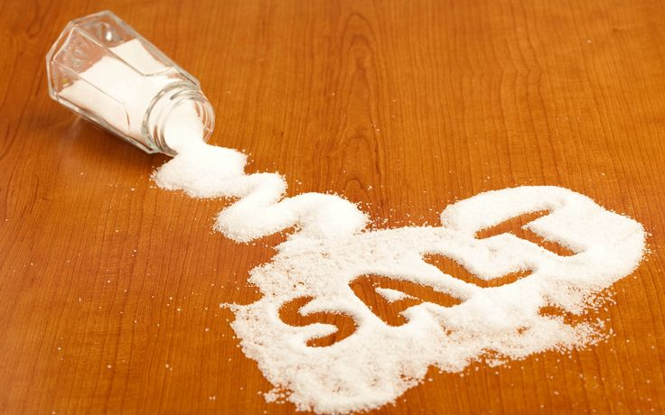
THE SERMON ON THE MOUNT SERIES “MAINTAINING OUR SALTINESS”
Text: Matthew 5:13

Slide 2
“You are the salt of the earth. But if the salt loses its saltiness, how can it be made salty again? It is no longer good for anything, except to be thrown out and trampled by men.” Matthew 5:13

Slide 3
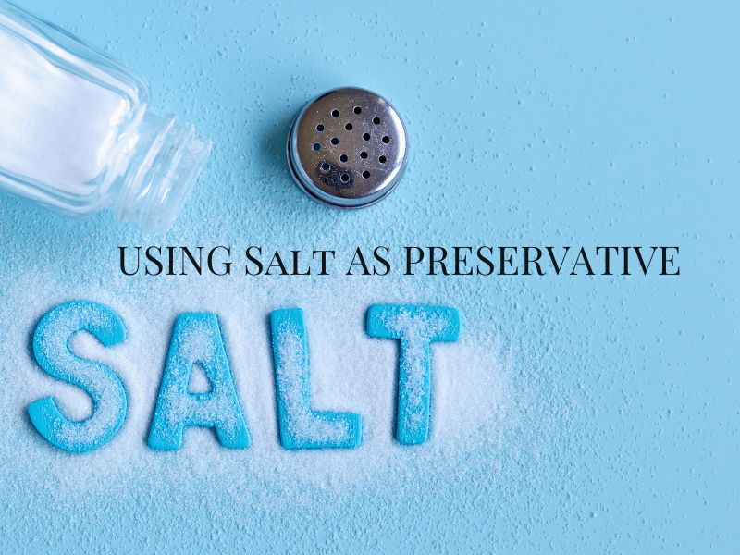
I. THE PURPOSE OF SALT
A. Its Preserving Effect
“an everlasting covenant of salt”
Numbers 18:19

Slide 4
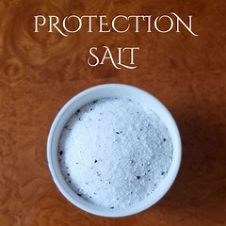
I. THE PURPOSE OF SALT
B. Its Protective Effect

Slide 5
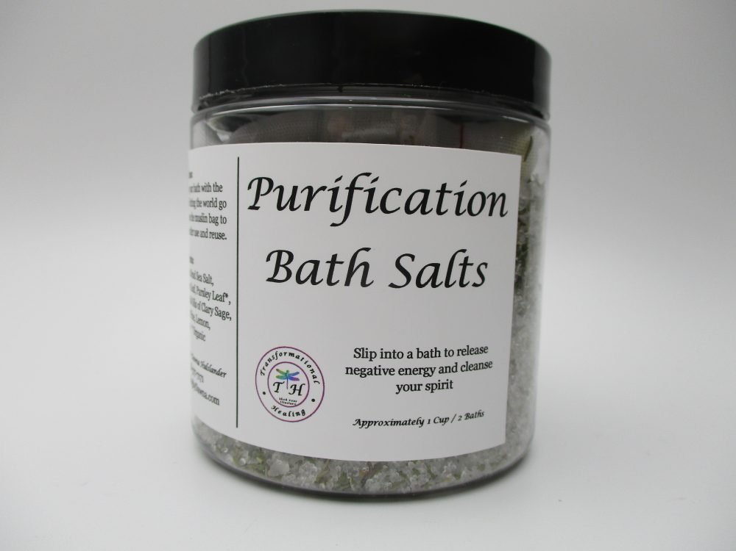
I. THE PURPOSE OF SALT
C. Its Purification Effect

Slide 6
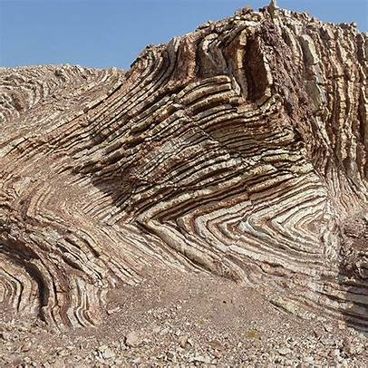
I. THE PURPOSE OF SALT
D. Its Palatability Effect
The famous Jebel Usdum
is a mountain of rock salt

Slide 7
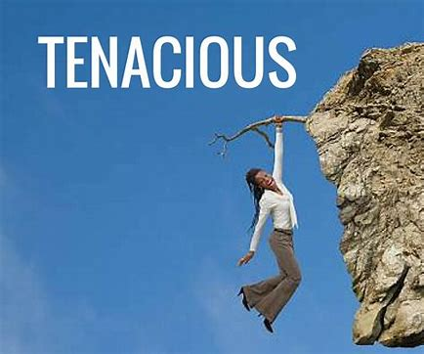
II. THE PERPLEXITY OF SALT
A. The Pertinacity of Salt
“pertinacity” means
“tenacity of purpose; unyielding adherence.”

Slide 8
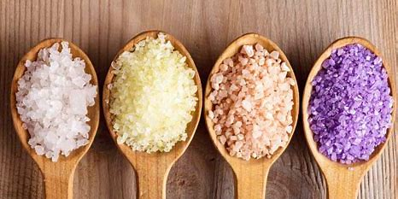
II. THE PERPLEXITY OF SALT
B. The Peculiarity of Salt

Slide 9
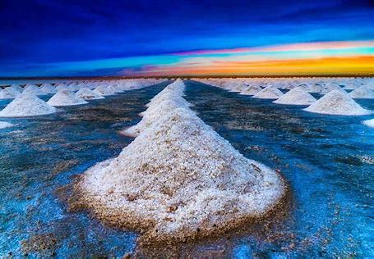
II. THE PERPLEXITY OF SALT
B. The Penetration of Salt
“Let your conversation be always full of grace, seasoned with salt, so that you may know how to answer everyone.”
Colossians 4:6

Slide 10
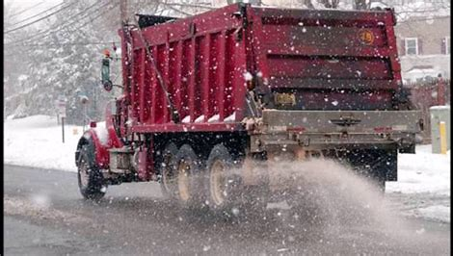
III. THE PERIL OF SALT
A. The Pollution of Salt
The word “pollution” means “to make unclean or impure; dirty; corrupt.”

Slide 11
III. THE PERIL OF SALT
A. The Pollution of Salt
Not only is the conduct of the church in question, but so is the very character of the church.
Warren Wiersbe

Slide 12
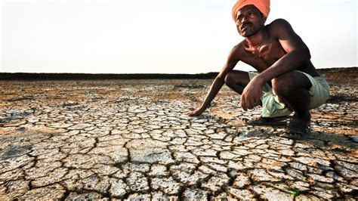
III. THE PERIL OF SALT
B. The Precariousness of Salt
“You are the salt of the earth. But if the salt loses its saltiness, how can it be made salty again?”
Matthew 5:13
1/5 of Global farm soil is degraded by salt

Slide 13
III. THE PERIL OF SALT
B. The Precariousness of Salt
“To keep oneself (unstained) from being polluted by the world.”
James 1:27
1/5 of Global farm soil is degraded by salt

Slide 14
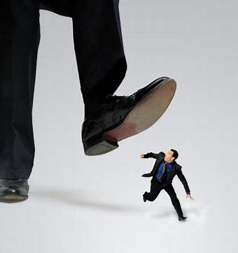
III. THE PERIL OF SALT
C. The Perishableness of Salt
“It is no longer good for anything, except to be thrown out and trampled by men.”
Matthew 5:13

