Slide 1
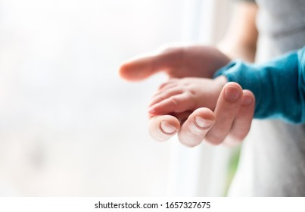
The Mission of Fountaingate: Part 1
Gently Offering Healing

Slide 2
Mission Statement:
Gently offering Healing, Health and Hope in a Hurting World

Slide 3
GENTLENESS

Slide 4
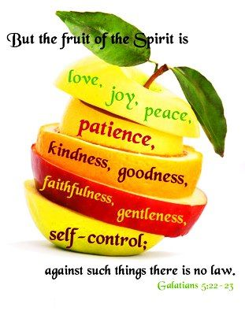
GALATIANS 5:22-23 “But the Holy Spirit produces this kind of fruit in our lives: love, joy, peace, patience, kindness, goodness, faithfulness, gentleness, and self control. There is no law against these things!”

Slide 5
“The very first thing which needs to be said about Christian ministers of all kinds is that they are “under” people as their servants rather that “over” them (as their leaders, let alone their lords). Jesus made this absolutely plain. The chief characteristic of Christian Leaders, he insisted, is humility, not authority, and gentleness, not power.” – John Stott

Slide 6
Gentleness: An inward grace of the soul; calmness toward God in particular. An Acceptance of God’s dealings with us, considering them as good. The Term basically means to stop fighting God. Gentleness is responsibility with power.” ~ Beth Moore

Slide 7
Leviticus 23:22 “When you reap the harvest of your land, moreover, you shall not reap to the very corners of your field nor gather the gleaning of your harvest; you are to leave them for the needy and the alien. I am the Lord Your God.”

Slide 8
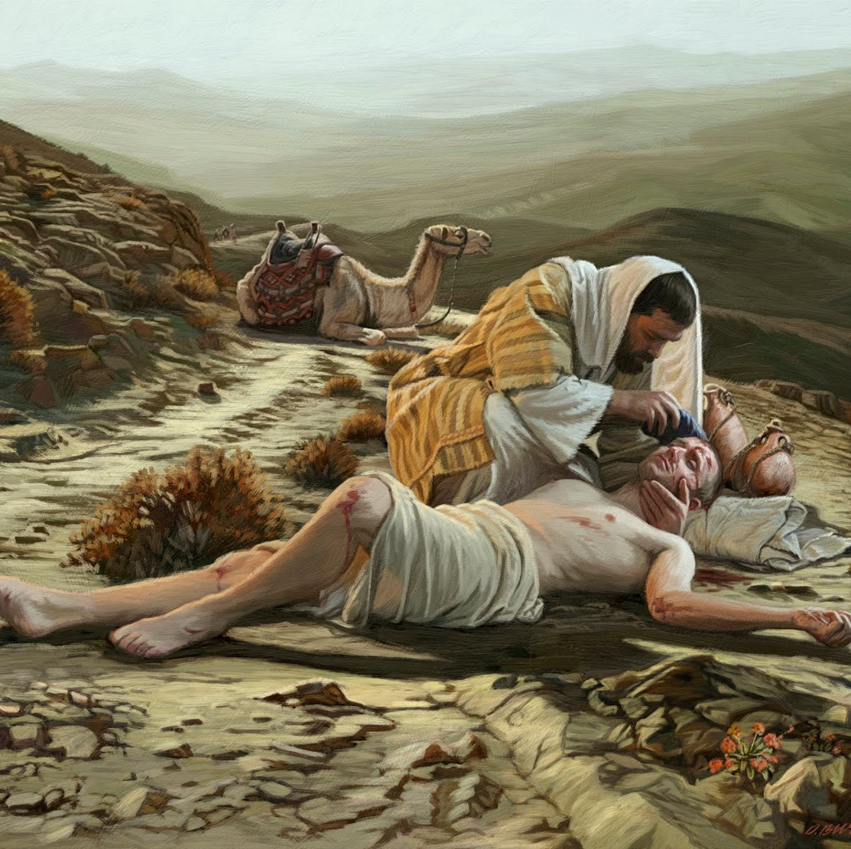
Luke 10:30-35
The Good Samaritan

Slide 10
I. God Chooses to Heal Instantly

Slide 11
John 5 – “Do you want to be made well?”

Slide 12
II. God Chooses to Heal Over Time

Slide 13
II. God Chooses to Heal Over Time
Mark 8:22-26
Luke 17:11-19

Slide 14
III. God Chooses to Heal Through Medicine

Slide 15
III. God Chooses to Heal Through Medicine

Slide 16
IV. God Chooses to Heal By Giving Grace to Accept Our Infirmity

Slide 17
2 Corinthians 12:7-10

Slide 18
Corrie Ten Boom
“The object of our greatest pain can become the source of our greatest healing when we offer it to God.”

Slide 19
The “All Things” Plan of God

Slide 20
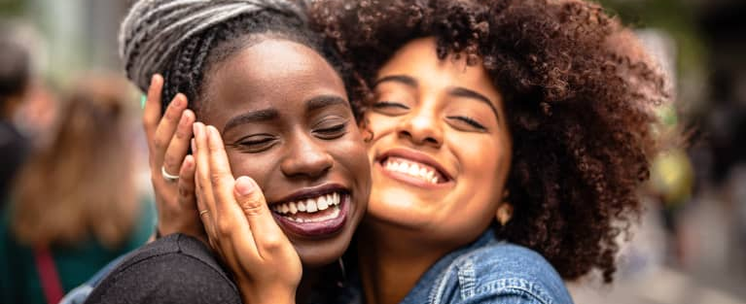
Confidant – Faithful in the Lord

Slide 21
Matthew 18:19
“…IF TWO OF YOU SHALL AGREE ON EARTH AS TOUCHING ANYTHING THAT THEY SHALL ASK,IT SHALL BE DONE FOR THEM OF MY FATHER WHO IS IN HEAVEN.”

Slide 22
John 16:33 “In the world you will have tribulation. Be of good cheer, I have overcome the world.”

Slide 23
V. God Chooses to Heal Following Death, In Eternity

Slide 24
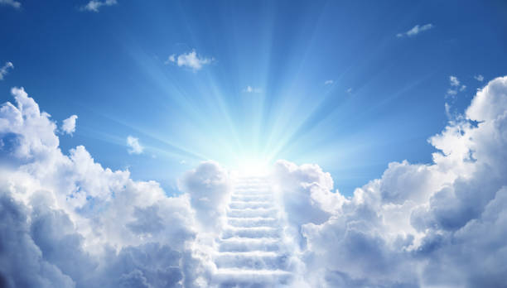
Revelation 21:3-5 "See, the home of God is among mortals. He will dwell with them as their God; they will be his peoples, and God himself will be with them; he will wipe every tear from their eyes. Death will be no more; mourning and crying and pain will be no more, for the first things have passed away." And the one who was seated on the throne said, "See, I am making all things new."

Slide 25
PRAYER

Slide 26
EPHESIANS 1:6-7
ROMANS 8:34
“ And God raised us up with Christ and seated us with him in the heavenly realms in Christ Jesus, in order that in the coming ages he might show the incomparable riches of his grace, expressed in his kindness to us in Christ Jesus.”
Christ Jesus “is at the right hand of God and is also interceding (praying) for us.”

Slide 27
OUR LITTLE DROPLETS OF PRAYER ARE VALUED BY GOD

Slide 28
Matthew 18:18-20, "...if two of you agree on earth about anything they ask, it will be done for them by my Father in heaven. For where two or three are gathered in my name, there am I."
John 16:23- 24
"...Truly, I say to you, if you ask anything of the Father, he will give it to you in my name. Hitherto you have asked nothing in my name; ask, and you will receive, that your joy may be full."
James 5:15-16
"The prayer of faith will save the sick, and the Lord will raise them up; and anyone who has committed sins will be forgiven. Therefore, confess your sins to one another, and pray for one another, so that you may be healed.."

Slide 29
Search your Heart….

Slide 30
Mission of Fountaingate

