Slide 1
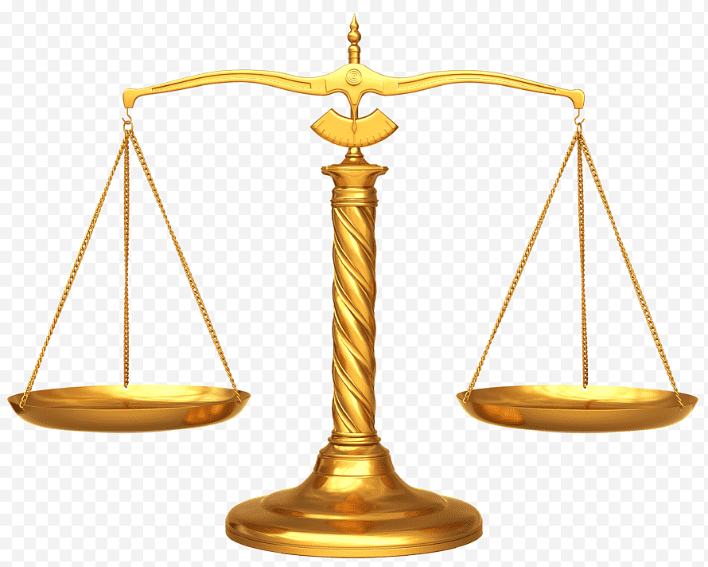
NATIONS IN THE BALANCE
Text: Joel 3:1-16

Slide 2
“Watch out that no one deceives you.
5. For many will come in my name , claiming, ‘I am the Christ,’ and will deceive many.
6. You will hear of wars and rumours of wars, but see to it that you are not alarmed. Such things must happen, but the end is still to come.
7. Nation will rise against nation, and kingdom against kingdom. There will be famines and earthquakes in various places.
8. All these are the beginning of birth pains.”
Matthew 24:4-8

Slide 3
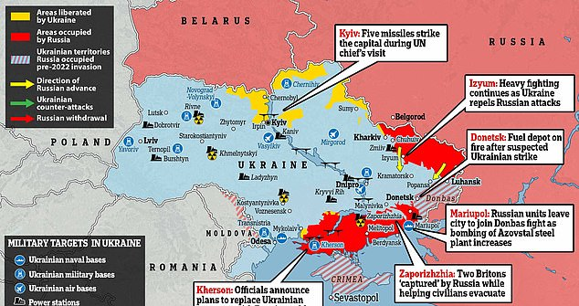

Slide 4
I. THE FORTUNES OF JUDAH AND JERUSALEM WILL BE RESTORED (Joel 3:1)
“Do not store up for yourselves treasures on earth, where moth and rust destroy, and where thieves break in and steal.
20. But store up for yourselves treasures in heaven, where moth and rust do not destroy, and where thieves do not break in and steal.
21. For where your treasure is, there your heart will be also.”
Matthew 6:19-21

Slide 5
I. THE FORTUNES OF JUDAH AND JERUSALEM WILL BE RESTORED (Joel 3:1)
“Watch out! Be on your guard against all kinds of greed; a man’s life does not consist in the abundance of his possessions.”
Luke 12:15

Slide 6
I. THE FORTUNES OF JUDAH AND JERUSALEM WILL BE RESTORED (Joel 3:1)
“You fool! This very night your life will be demanded from you. Then you will get what you have prepared for yourself?
21. This is how it will be with anyone who stores up things for himself but is not rich toward God.”
Luke 12:20,21

Slide 7
I. THE FORTUNES OF JUDAH AND JERUSALEM WILL BE RESTORED (Joel 3:1)
“Never again will foreigners invade her (Jerusalem/Zion)
18. In that day the mountains will drip with new wine, and the hills will flow with milk; all the ravines of Judah will run with water.” A fountain will flow out of the LORD’s house and will water the valley of acacias.”
Joel 3:17,18

Slide 8
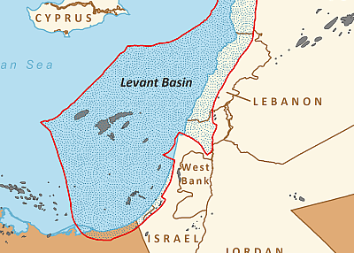
I. THE FORTUNES OF JUDAH AND JERUSALEM WILL BE RESTORED (Joel 3:1)

Slide 9
I. THE FORTUNES OF JUDAH AND JERUSALEM WILL BE RESTORED (Joel 3:1)
“For they shall partake of the abundance of the seas and of the treasures hidden in the sand”
Deuteronomy 33.19

Slide 10
I. THE FORTUNES OF JUDAH AND JERUSALEM WILL BE RESTORED (Joel 3:1)
“I will cause showers to come down in their season; there shall be showers of blessing. Then the trees of the field shall yield their fruit, and the earth shall yield her increase.”
Ezekiel 34.26,27

Slide 11
II. THE NATIONS WILL BE GATHERED TO THE VALLEY OF JEHOSHAPHAT (Joel 3:2-6)
“Do not be afraid or discouraged because of this vast army. For the battle is not yours, but God’s.”
II Chronicles 20:15

Slide 12
II. THE NATIONS WILL BE GATHERED TO THE VALLEY OF JEHOSHAPHAT (Joel 3:2-6)
“You will not have to fight this battle. Take up your positions; stand firm and see the deliverance the LORD will give you, O Judah and Jerusalem. Do not be afraid; do not be discouraged. Go out to face them tomorrow, and the LORD will be with you.”
II Chronicles 20:17

Slide 13
II. THE NATIONS WILL BE GATHERED TO THE VALLEY OF JEHOSHAPHAT (Joel 3:2-6)
“I will gather all nations to Jerusalem to fight against it; the city will be captured, the houses ransacked, and the women raped. Half the city will go into exile, but the rest of the people will not be taken from the city.
3. Then the LORD will go out and fight against the nations, as he fights in the day of battle.”
Zechariah 14:2,3

Slide 14
II. THE NATIONS WILL BE GATHERED TO THE VALLEY OF JEHOSHAPHAT (Joel 3:2-6)
“Then they gathered the kings to the place that in Hebrew is called Armageddon.”
Revelation 16:16

Slide 15
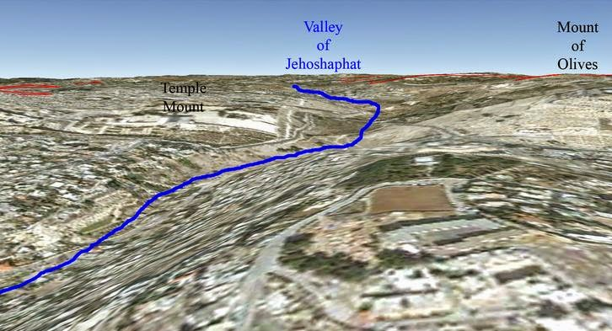
II. THE NATIONS WILL BE GATHERED TO THE VALLEY OF JEHOSHAPHAT (Joel 3:2-6)
“Come quickly, all you nations from every side, and assemble there. Bring down your warriors, O LORD!
12. Let the nations be roused; let them advance into the Valley of Jehoshaphat, for there I will sit to judge all nations on every side.”
Joel 3:11,12

Slide 16
III. THE WAR OF ALL WARS WILL TAKE PLACE (Joel 3:7-16)
“Multitudes, multitudes in the valley of decision.
15. The sun and moon will be darkened and the stars no longer shine.
16. The LORD will roar from Zion and thunder from Jerusalem; the earth and the sky will tremble. But the LORD will be a refuge for his people, a stronghold for the people of Israel.”
Joel 3:14-16

Slide 17
III. THE WAR OF ALL WARS WILL TAKE PLACE (Joel 3:7-16)
“For then there will be great distress, unequalled from the beginning of the world until now – and never to be equalled again.”
Matthew 24:21

Slide 18
III. THE WAR OF ALL WARS WILL TAKE PLACE (Joel 3:7-16)
“Immediately after the distress of those days ‘the sun will be darkened, and the moon will not give its light; the stars will fall from the sky, and the heavenly bodies will be shaken.’”
Matthew 24:29

Slide 19
III. THE WAR OF ALL WARS WILL TAKE PLACE (Joel 3:7-16)
“This is the plague with which the LORD will strike all the nations that fought against Jerusalem: Their flesh will rot while they are standing on their feet, their eyes will rot in their sockets, and their tongues will rot in their mouths.
13. On that day men will be stricken by the LORD with great panic. Each man will seize the hand of another, and they will attack each other.”
Zechariah 14:12,13

Slide 20
III. THE WAR OF ALL WARS WILL TAKE PLACE (Joel 3:7-16)
“I will turn you around and drag you along. I will bring you from the far north and send you against the mountains of Israel.
Then I will strike your bow from your left hand and make your arrows drop from your right hand.
4. On the mountains of Israel you will fall, you and all your troops and the nations with you. I will give you as food to all kinds of carrion birds and to the wild animals.”
Ezekiel 39:3,4

Slide 21
NATIONS IN THE BALANCE AND SO ARE WE
Are you ready for the return of Jesus Christ?
Have you confessed your sin to Him?
If you died today do you know without a shadow of doubt
that you would go to be with the LORD?
Make sure you know today what your future holds in store for you!

