Slide 1
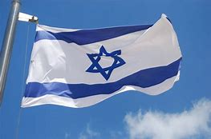
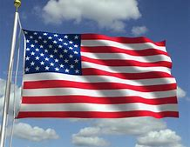
NAVIGATING TOWARD OUR DESTINY - Part VI Navigating Under a Flag of Convenience!
Text: I Samuel 8

Slide 2
As We Navigate Through Life Are We Changing to “Flags of Convenience” to Avoid “God’s Stricter Regulations?”

Slide 3
I. THE NATION OF ISRAEL
“In those days Israel had no king; everyone did as he saw fit.”
Judges 21:25

Slide 4
I. THE NATION OF ISRAEL
“But his sons did not walk in his ways. They turned aside after dishonest gain and accepting brides and perverted justice.”
I Samuel 8:3

Slide 5
I. THE NATION OF ISRAEL
“For everyone looks out for his own interests, not those of Jesus Christ.”
Philippians 2:21

Slide 6
I. THE NATION OF ISRAEL
“But I am afraid that just as Eve was deceived by the serpent’s cunning, your minds may somehow be led astray from your sincere and pure devotion to Christ.’
II Corinthians 11:3

Slide 7
I. THE NATION OF ISRAEL
“For if someone comes to you and preaches a Jesus other than the Jesus we preached, or if you receive a different spirit from the Spirit you received, or a different gospel from the one you accepted, you put up with it easily enough”.
II Corinthians 11:4

Slide 8
I. THE NATION OF ISRAEL
“For if someone comes to you and preaches a Jesus other than the Jesus we preached, or if you receive a different spirit from the Spirit you received, or a different gospel from the one you accepted, you put up with it easily enough”.
II Corinthians 11:4

Slide 9
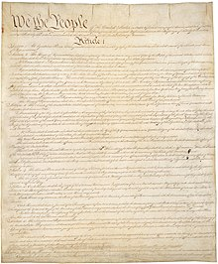
II. THE NATION OF THE UNITED STATES
The United States began with a constitution that was ratified June 21, 1788 in which 12 states were represented.

Slide 10
II. THE NATION OF THE UNITED STATES
The preamble of the constitution says that the people are in authority and that our founding fathers wrote it to form a more perfect union, establish justice, ensure domestice tranquility, or peace and to secure liberty for them and their children.”

Slide 11
II. THE NATION OF THE UNITED STATES
Their Pledge to Allegiance
"I pledge allegiance to the Flag of the United States of America, and to the Republic for which it stands, one Nation under God, indivisible, with liberty and justice for all."

Slide 12
II. THE NATION OF THE UNITED STATES
Do you also remember the slogan placed upon their currency?
“IN GOD WE TRUST”

Slide 13
III. THE NATION OF CANADA
What about the Nation of Canada or as it began to be known as the Commonwealth or Dominion of Canada?

Slide 14
Fathers of Confederation Photo Information: 1 Sept. 1864 / Charlottetown, P.E.I.

Slide 15
III. THE NATION OF CANADA
Georges Vanier (1888-1967)
The Education System - Bishop John Strachan
A Congregationalist, named Henry Alline

Slide 16
III. THE NATION OF CANADA
Sir Samuel Leonard Tilley
Egerton Ryerson (1803-1882)
The 1896 Ontario Public School Act.
Robert Stanley Weir - The National Anthem

Slide 17
Psalm 72:11-14
11. May all kings bow down to him
and all nations serve him.
12. For he will deliver the needy who cry out,
the afflicted who have no one to help.
13. He will take pity on the weak and the needy
and save the needy from death.
14. He will rescue them from oppression and violence, for precious is their blood in his sight.

Slide 18
Psalm 72:17,18
17. May his name endure forever;
may it continue as long as the sun.
Then all nations will be blessed through him,
and they will call him blessed.
18. Praise be to the Lord God, the God of Israel,
who alone does marvelous deeds.

