Slide 1
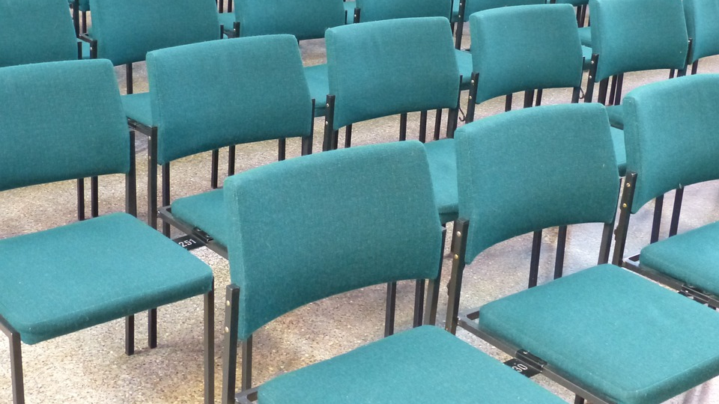
NO CHEAP SEATS

Slide 2
Super Bowl

Slide 3
I. JESUS SHARES A Pattern

Slide 4
II. Jesus shares a paradox

Slide 5
Speaking impact
III. JESUS SPEAKS OF A PENALTY

Slide 6
VICTORY

