Slide 1
THE SERMON ON THE MOUNT SERIES “OATHS - FROM A HEART OF INTEGRITY”
Text:
Matthew 5:33–37

Slide 2
The word “integrity” means: “uprightness of character, honesty.”
Text:
Matthew 5:33–37

Slide 3
I. THE COMMON PRACTICE (Matthew 5:33-36) A. Old Testament Practise
Security achieved!?

Slide 4
I. THE COMMON PRACTICE (Matthew 5:33-36) “You shall not swear falsely by My name, so as to profane the name of your God; I am the Lord.” Leviticus19:12

Slide 5
"If a man makes a vow to the Lord, or takes an oath to bind himself with a binding obligation, he shall not violate his word; he shall do according to all that proceeds out of his mouth.” Numbers 30:2

Slide 6
"You shall be careful to perform what goes out from your lips, just as you have voluntarily vowed to the Lord your God, what you have promised.” Deuteronomy 23:23

Slide 7
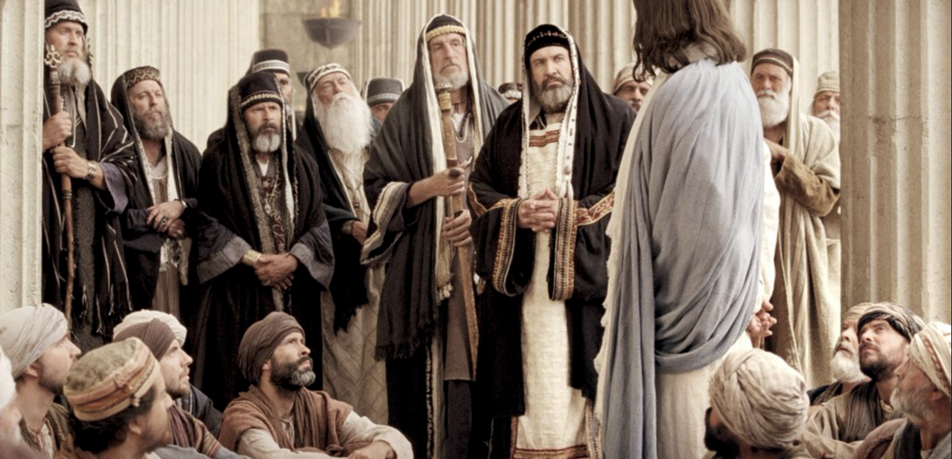
I. THE COMMON PRACTICE (Matthew 5:33-36) B. The Practice of Jesus’ day

Slide 8
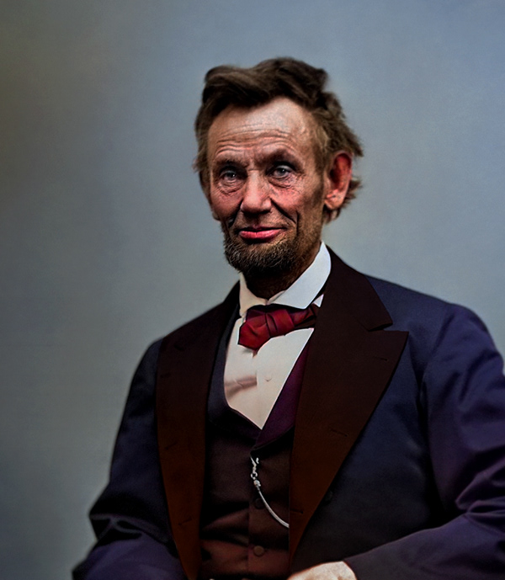
I. THE COMMON PRACTICE (Matthew 5:33-36) B. How Does this Apply Today?
Abraham Lincoln said that for a man to train up a child in the way he or she should go, he must walk that way himself.

Slide 9
II. THE NEW STANDARD OF PRACTICE (Matthew 5:33-34, 37) A. In Jesus’ Teaching
Life cannot be divided into compartments in some of which God is involved and in others of which He is not involved; there cannot be one kind of language in the Church and another kind of language in the shipyard or the factory or the office; there cannot be one kind of standard of conduct in the Church and another kind of standard in the business world.
William Barclay – Commentary of Matthew

Slide 10
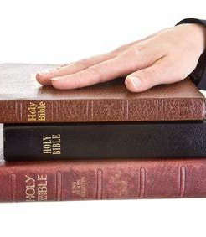
II. THE NEW STANDARD OF PRACTICE (Matthew 5:33-34, 37) B. We Are to Show Integrity by Our Words
“But above all, my brethren, do not swear, either by heaven or by earth or with any other oath; but your yes is to be yes, and your no, no, so that you may not fall under judgment.”
James 5:12

Slide 11
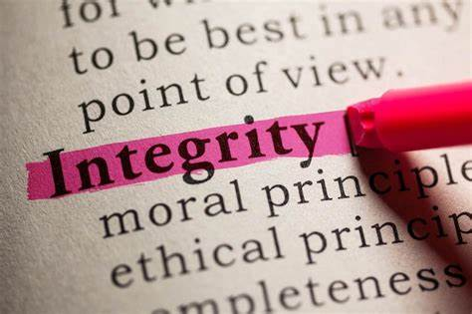
II. THE NEW STANDARD OF PRACTICE (Matthew 5:33-34, 37) B. We Are to Show Integrity by Our Words
“Let no one look down on your youthfulness, but rather in speech, conduct, love, faith and purity, show yourself an example of those who believe.”
I Timothy 4:12

Slide 12
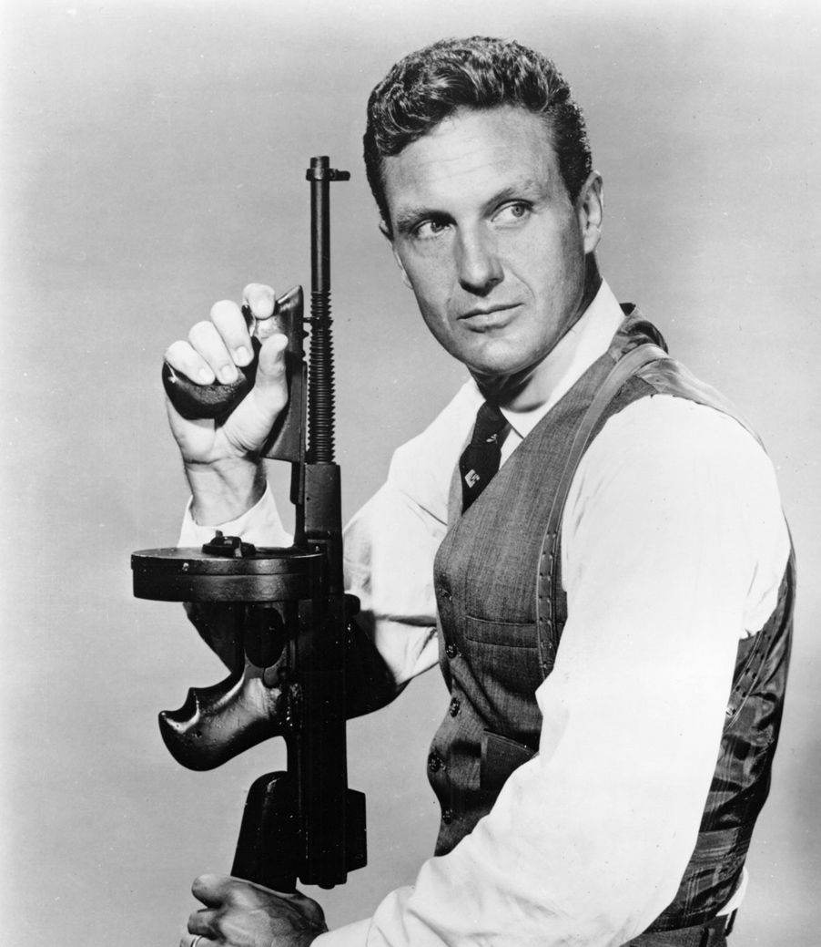
II. THE NEW STANDARD OF PRACTICE (Matthew 5:33-34, 37) C. We Are to Show Integrity in Our Actions
"Ness and his men are ’UNTOUCHABLE.’

Slide 13
II. THE NEW STANDARD OF PRACTICE (Matthew 5:33-34, 37) D. What Can We Do?
Set Our Priorities in God
Set Our Priorities in Marriage
Set Our Priorities in our Daily Routine
Set Our Priorities in Spiritual Matters

Slide 14
“Words depend on character, and oaths cannot compensate for a poor character.” Warren Wiersby “The Bible Exposition Commentary” Vol. 1, p. 24

