Slide 1
OBSTACLE TRAINING
OBEDIENT FAITH
Joshua 6

Slide 2
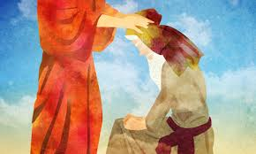

Slide 3
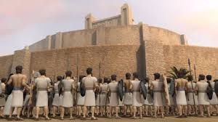

Slide 4
COMMUNICATION

Slide 5
We are to ask - James 4:2 We are to listen - Proverbs 2:1-5 We are to Receive Direction - Mark 4:24

Slide 6
COMPLIANCE
GALATIANS 2:20
COLOSSIANS 3:17
MATTHEW 28:20

Slide 7
CONFIDENCE
JEREMIAH 17:17

Slide 9
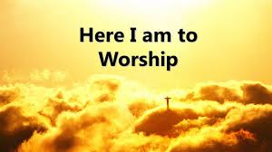

Slide 10
Victory Over the Walls IN Our Life Through 1. Communication 2. Compliance 3. Confidence & Faith

