Slide 1
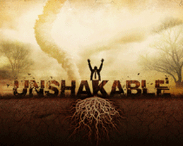
OUR UNSHAKEABLE GOD
Text: Psalm 46:1-11

Slide 2
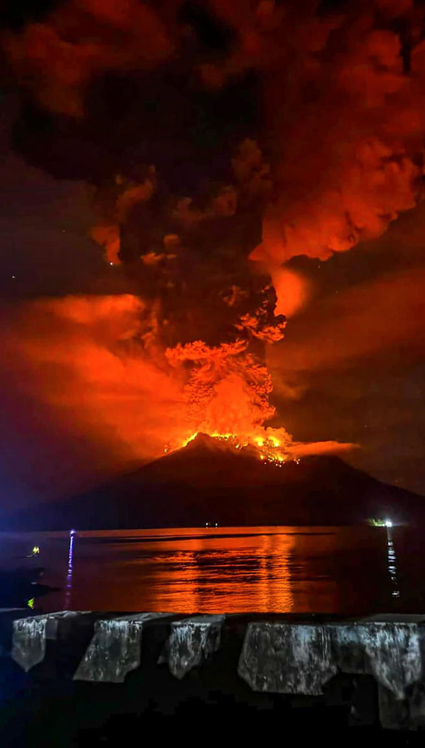
“A Mighty Fortress is our God”
Mount Ruang Indonesia erupted on Thursday. Officials fear that part of the volcano could collapse into the sea and trigger a tsunami which happened after one eruption in 1871.

Slide 3
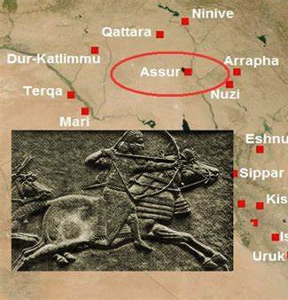
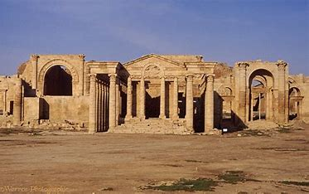
I. God in the Tumult (Psalm 46:1–3)
“You say you have strategy and military strength – but you speak only empty words. On whom are you depending that you rebel against me?”
II Kings 18:20

Slide 4
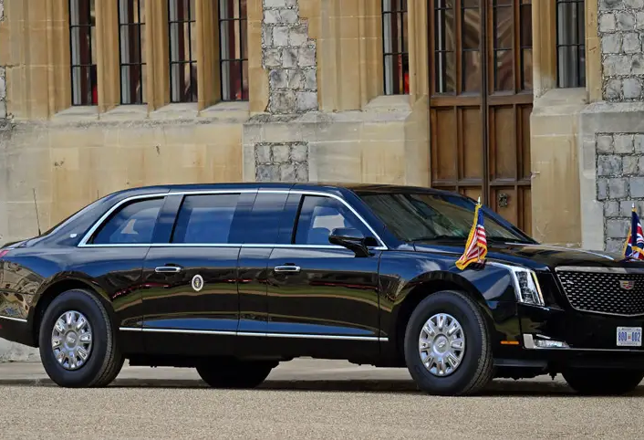
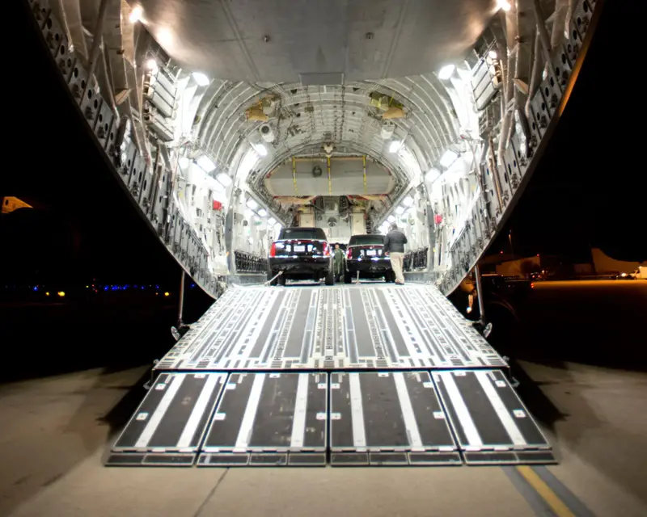
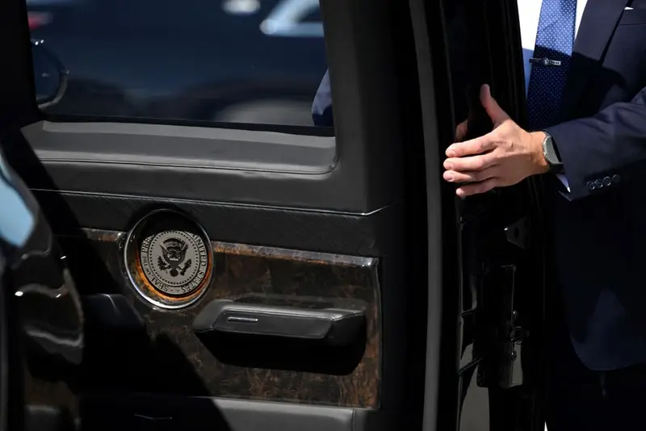
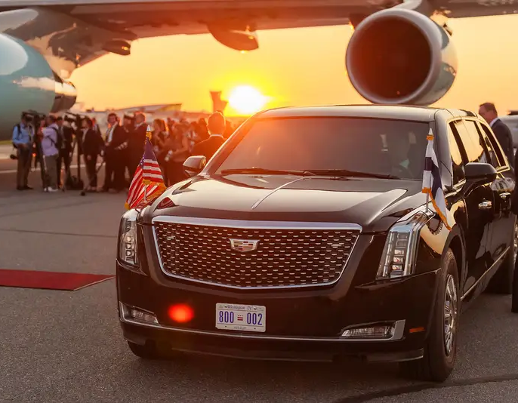
I. God in the Tumult (Psalm 46:1–3) The President’s Armored Car

Slide 5
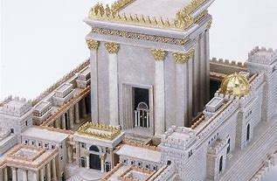
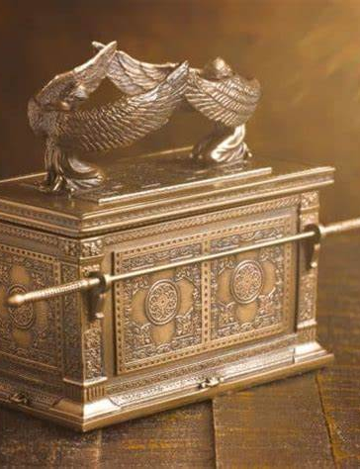
I. God in the Tumult (Psalm 46:1–3) Solomon’s Temple and The Ark of the Covenant

Slide 6
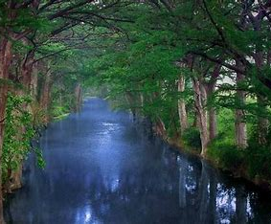
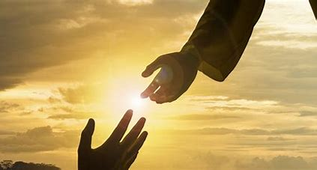
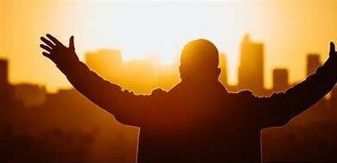
II. God in the City (Psalm 46:4–7)

Slide 7
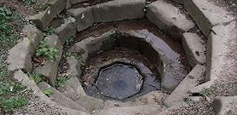
“For my people have committed two sins – they have forsaken me the spring of living water, and have dug their own cisterns, broken cisterns that cannot hold water.” Jeremiah 2:13

Slide 8
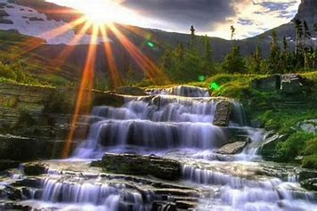
“Whoever believes in me, as the Scripture has said, streams of living water will flow from within him.” John 7:38

Slide 9
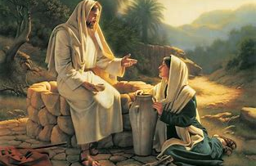
“but whoever drinks the water I give him will never thirst. Indeed, the water I give him will become, in him a spring of water welling up to eternal life.” John 4:14

Slide 10
“but whoever drinks the water I give him will never thirst. Indeed, the water I give him will become, in him a spring of water welling up to eternal life.” John 4:14

Slide 11
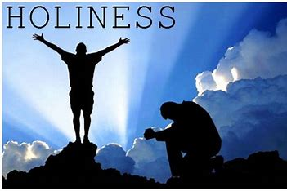
There is safety in God’s holiness

Slide 12
III. God in the Earth (Psalm 46: 8–11)

Slide 13
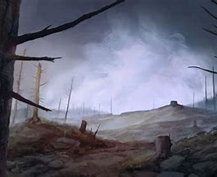
1. Desolation by wars – fields with blood and carcasses 2. Desolation by famines – cannibalism becoming the only means to survive 3. Desolation by the angel of the LORD - 185,000 died in one night 4. Desolation by floods – rinsing the earth of its uncleanliness 5. Desolation by earthquakes – swallowing whole cities and populations 6. Desolation by wild beasts – as in the Ashur (Assyrian Capital) colonies 7. Desolation by obnoxious creatures – as in Egypt 8. Desolation brought by evil men – massacres; ethnic cleansing

Slide 14
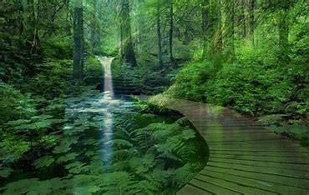
“ Be still, and know that I am God; I will be exalted among the nations, I will be exalted in the earth.” Psalm 46:10

Slide 15
So let me conclude this message by asking a simple and yet vital question. Do you know that God is with you today?

