Slide 1
OVERCOMING CONDESCENDING ATTITUDES
Text: Job 12:1-25

Slide 2
I. DEFENDING FORTH THOSE IN POVERTY (Job 12:1-4)
Then Job replied:
2. “Doubtless you are the only people who matter, and wisdom will die with you!
3. But I have a mind as well as you; I am not inferior to you. Who does not know all these things?
4. “I have become a laughingstock to my friends, though I called on God and he answered — a mere laughingstock, though righteous and blameless!
Job 12:1-4

Slide 3
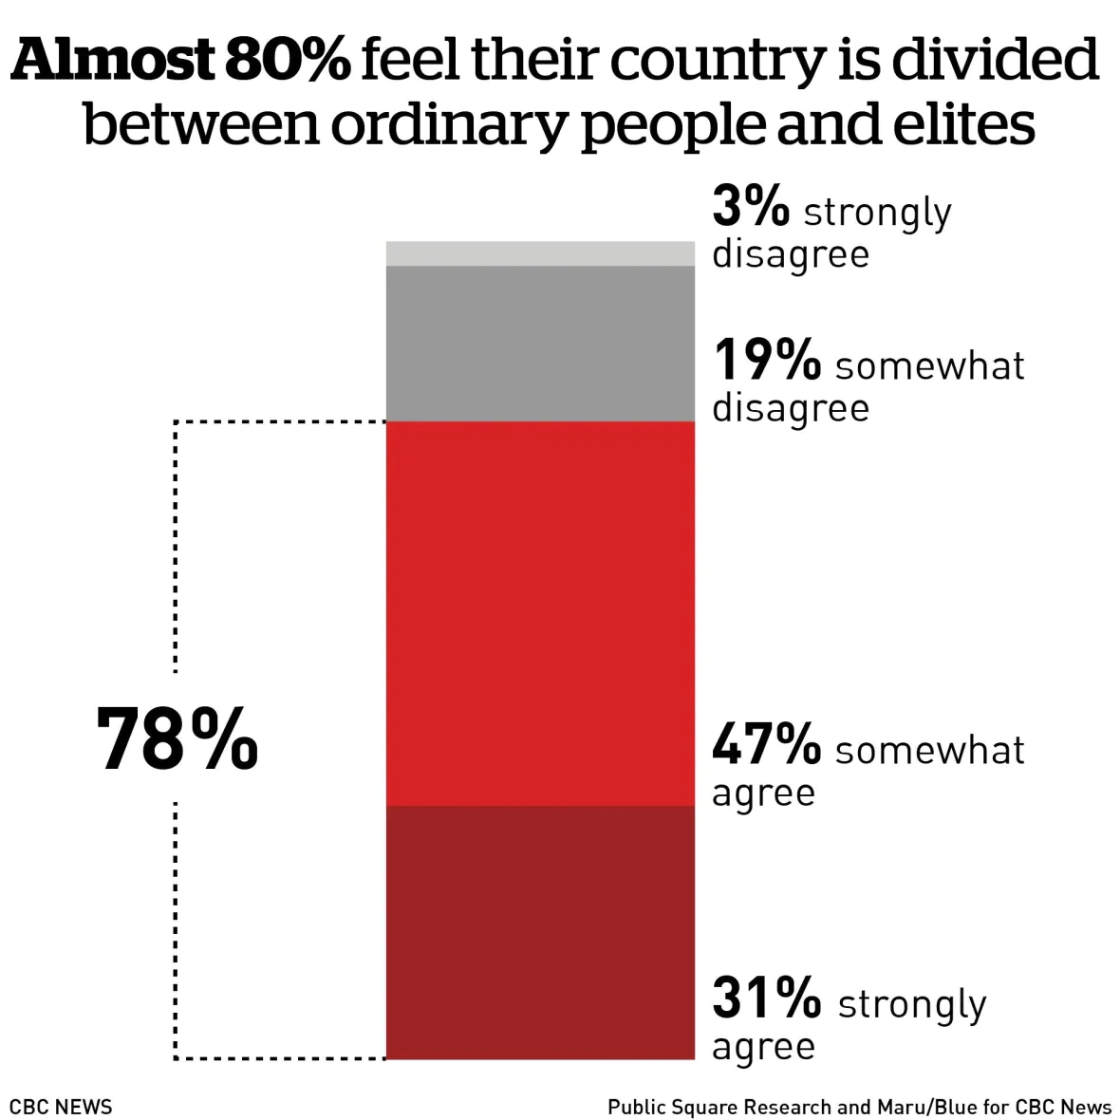
I. DEFENDING FORTH THOSE IN POVERTY (Job 12:1-4)

Slide 4
II. DISTINGUISHING FROM THOSE WHO PROSPER (Job 12:5-6)
“Those who are at ease have contempt for misfortune as the fate of those whose feet are slipping.
6. The tents of marauders are undisturbed, and those who provoke God are secure — those God has in his hand. [Or - those whose god is in their own hand].”
Job 12:5,6

Slide 5
III. DISPLAYING FAIRLY GOD’S POWER (Job 12:13-25)
“To God belong wisdom and power; counsel and understanding are his.”
Job 12:13

Slide 6
III. DISPLAYING FAIRLY GOD’S POWER (Job 12:13-25)
1. His destructive power - Job 12:14
2. His power over the captives - Job 12:14
3. His control over droughts and floods - Job 12:15
4. His has insight into the deceived as well as the deceiver - Job 12:16
5. He removes rulers and exposes unjust judges - Job 12:17
6. He sets the prisoners free and allows then run unhindered - Job 12:18

Slide 7
III. DISPLAYING FAIRLY GOD’S POWER (Job 12:13-25)
7. He removes priests in shame and brings officials to a place of humbleness - Job 12:19
8. He stops the words of the wise and causes the elders to be void of discernment - Job 12:20
9. He brings nobles to their knees and takes away the weapons of the mighty - Job 12:21
10. He overcomes darkness by His glorious light - Job 12:22

Slide 8
III. DISPLAYING FAIRLY GOD’S POWER (Job 12:13-25)
11. He controls the greatness and size of nations - Job 12:23
12. He exposes leaders as fools and causes them to wander aimlessly - Job 12:24
13. He causes them to lose their direction and stagger like one who is intoxicated. - Job 12:25

Slide 9
III. DISPLAYING FAIRLY GOD’S POWER (Job 12:13-25)
“Now to him who is able to do immeasurably more than all we ask or imagine, according to his power that is at work within us,
21. to him be glory in the church and in Christ Jesus throughout all generations, for ever and ever! Amen.”
Ephesians 3:20,21

Slide 10
III. DISPLAYING FAIRLY GOD’S POWER (Job 12:13-25)
“What, after all, is Apollos? And what is Paul? Only servants, through whom you came to believe—as the Lord has assigned to each his task.
6. I planted the seed, Apollos watered it, but God has been making it grow.
7. So neither the one who plants nor the one who waters is anything, but only God, who makes things grow.

Slide 11
III. DISPLAYING FAIRLY GOD’S POWER (Job 12:13-25)
8. The one who plants and the one who waters have one purpose, and they will each be rewarded according to their own labor.
9. For we are co-workers in God’s service; you are God’s field, God’s building.”
I Corinthians 3:5-9

