Slide 1
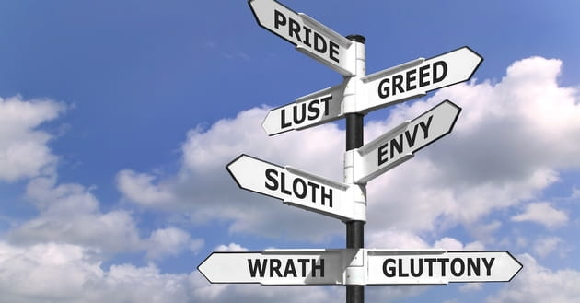
OVERCOMING OUR SINFUL DESIRES
Text:
II Samuel 23:13-17

Slide 2
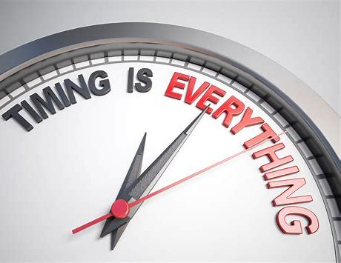
I. RECOGNIZE THE TIMING (II Samuel 23:13)
“In the spring, at the time when kings go to war, David sent Joab out with the king’s men and the whole Israelite army. They destroyed the Ammonites and besieged Rabbah. But David remained in Jerusalem.”
II Samuel 11:1

Slide 3
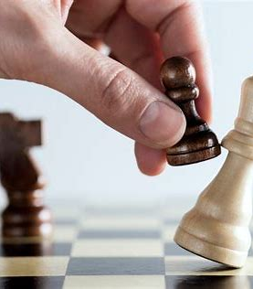
II. REVIEW YOUR POSITIONING (II Samuel 23:13,14)
. . . David had gathered with his men at the cave of Adullum (lit - “retreat or refuge”). We must be very sensitive to the fact that our enemy does not rest just because we do. We may find a place of refuge while the destroyer of our life is encamped at the “Valley of Rephaim” ( lit - “vale of giants or the mighty”)

Slide 4
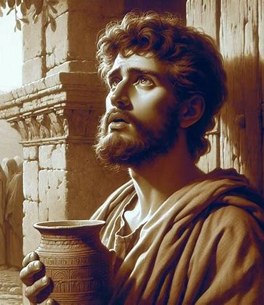
III. REFINE YOUR REQUEST (II Samuel 23:15)
“Oh that someone would give a drink from the well near the gate of Bethlehem!”
II Samuel 23:15

Slide 5
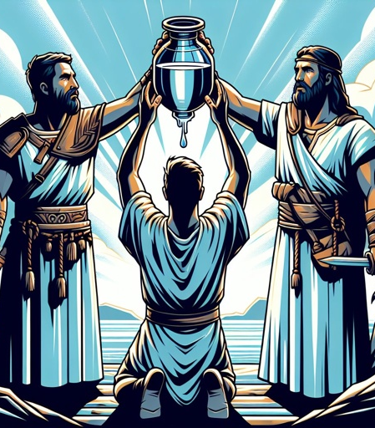
IV. REGARD THE DANGER (II Samuel 23:16)
“So the three mighty warriors broke through the Philistine lines, drew water from the well near the gate of Bethlehem and carried it back to David. But he refused to drink it; instead, he poured it out before the Lord.”
II Samuel 23:16

Slide 6
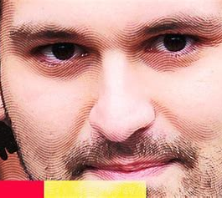
V. REGRET THE RISK (II Samuel 23:16,17)
“Is it not the blood of men who went at the risk of their lives?”
II Samuel 23:17
Sam Bankman-Fried

