Slide 1
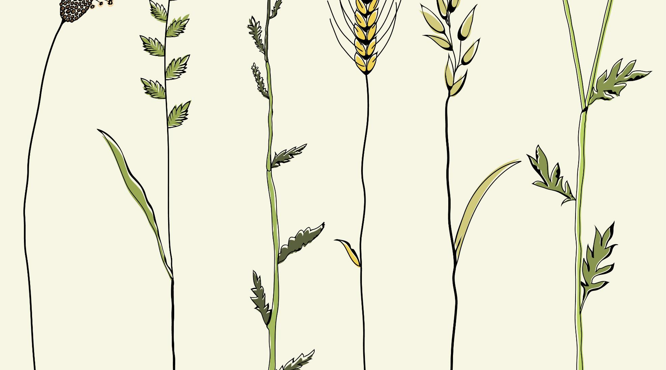
PARABLES OF THE KINGDOM - Part I The Parable of the Sower
Text: Matthew 13: 1-23

Slide 2
"It’s an earthly story with a heavenly meaning."

Slide 3
Parables take on many different figures of speech
1. Simile - " I am sending you out like sheep among the wolves. Therefore be as shrewd as snakes and as innocent as doves."
Matthew 10:16
2. Metaphor - "I am the gate for the sheep."
John 10:7

Slide 4
Parables take on many different figures of speech
3. Similitude - "The kingdom of God is like yeast that a woman took and mixed into a large amount of flour until it worked all through the dough."
Matthew 13:33
4. Story - "There was a man who had two sons . . ."
Luke 15:11

Slide 5
Let Us Consider the First of the 7 Parables Relating to the Kingdom of God.

Slide 6
I. THE SOWER
"A farmer went out . . ."
Matthew 13:3
"The one who sowed the good seed is the Son of Man.“
Matthew 13:37

Slide 7
II. THE SEED
A. On the Path
". . . to sow his seed.
4. As he was scattering the seed, some fell along the path, and the birds came and ate it up."
Matthew 13:3,4

Slide 8
II. THE SEED
On the Path
"When anyone hears the message about the kingdom and does not understand it, the evil one comes and snatches away what was sown in his heart. This is the seed sown along the path.
(This is he which receiveth seed by the wayside - KJV)“
Matthew 13:19

Slide 9
II. THE SEED
On the Path
"Do not give dogs what is sacred; do not throw pearls to pigs. If you do, they may trample them under their feet, and then turn and tear you to pieces."
Matthew 7:6

Slide 10
II. THE SEED
B. Among the Rocks
"Some fell on rocky places, where it did not have much soil. It sprang up quickly because the soil was shallow.
6. But when the sun came up, the plants were scorched, and they withered because they had no root."
Matthew 13:5,6

Slide 11
II. THE SEED
B. Among the Rocks
"The one who received the seed that fell on rocky places is the man who hears the word and at once receives it with joy.
21. But since he has no root, he lasts only a short time. When trouble or persecution comes because of the word, he quickly falls away."
Matthew 13:20,21

Slide 12
II. THE SEED
C. The Thorns
"Other seed fell among thorns, which grew up and choked the seed."
Matthew 13:7

Slide 13
II. THE SEED
C. The Thorns
"The one who received the word that fell among thorns is the man who hears the word, but the worries of life and the deceitfulness of wealth chokes it, making it unfruitful."
Matthew 13:22

Slide 14
II. THE SEED
D. The Good Soil
"Still others fell on good soil, where it produced a crop - a hundred, sixty or thirty times what was sown."
Matthew 13:9

Slide 15
II. THE SEED
D. The Good Soil
"But the one who received the seed that fell on good soil is the man who hears the word and understands it. He produces a crop, yielding a hundred, sixty or thirty times what was sown."
Matthew 13:23

Slide 16
III. THE SOIL/SEQUENCE
Non-understanding -
the soil becomes unreceptive
B. Failure to Obey - the soil becomes unproductive.

Slide 17
III. THE SOIL/SEQUENCE
C. Worries of Life/Deceitfulness of Riches -the soil becomes destructive
D. Hears & Understands- the soil becomes receptive, productive, and constructive

Slide 18
WE ARE THE ONES WHO ULTIMATELY DECIDE HOW THE SEED WILL BE RECEIVED

