Slide 1
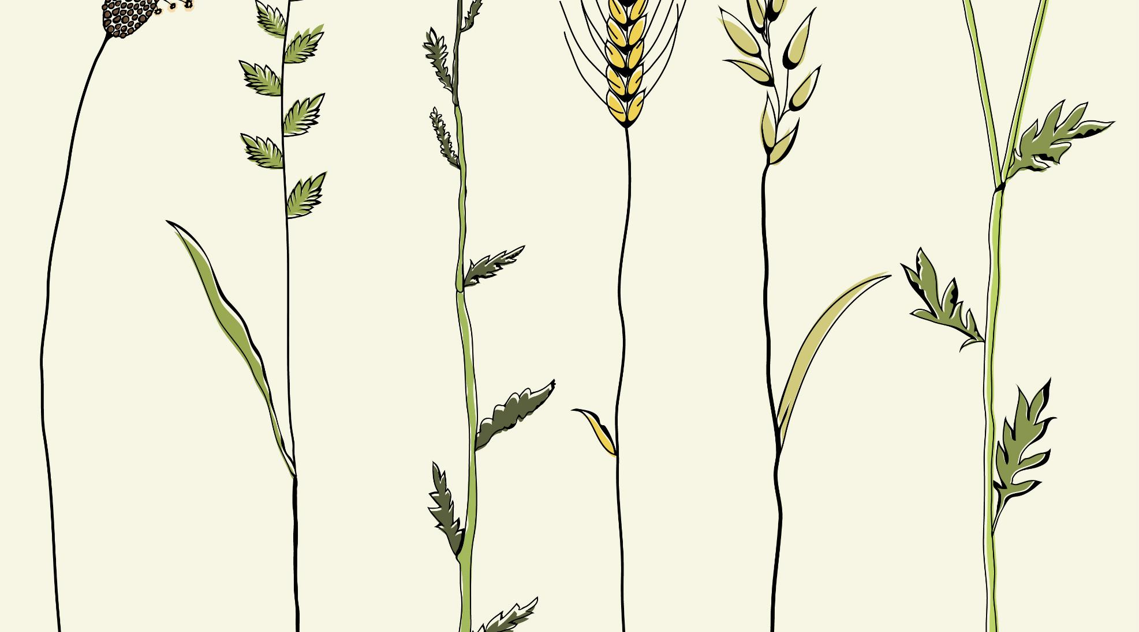
PARABLES OF THE KINGDOM - Part II The Parable of the Growing Seed
Text: Matthew 13: 1-23

Slide 2
The Central Matter Covered in this Parable Is That of Growth. What Will Produce the Harvest?

Slide 3
I. THE SEED MUST BE SOWN
Mark 4:27

Slide 4
II. THE SEED MUST GROW ALONE
Mark 4:27

Slide 5
III. THE SEED MUST BE LEFT ALONE
I Corinthians 3:6,7

Slide 6
IV. THE SEED MUST BE UNDERSTOOD
1. It is our duty to understand the Word we sow into the hearts of others.
2. It is our duty to become patient.
3. It is our duty to let God determine the growth of the seed.

Slide 7
IV. THE SEED MUST BE UNDERSTOOD
"We are very much given to digging up what we have planted, instead of resting content to scatter the seed, and leave it to the forces of God to bring in the harvest."
G. Campbell Morgan
“The Parables & Metaphors of our Lord”
F. H. Revell Co. p. 167

Slide 8
IV. THE SEED MUST BE UNDERSTOOD
4. The harvest will come in its time.

