Slide 1
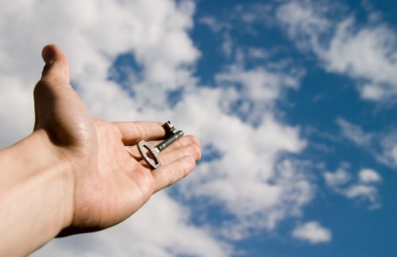
THE PEOPLE OF EMPOWERMENT
EMPOWERED FOR CHANGE
Text: Acts 1:9-26

Slide 2
What distinguishes the people of God who wish to be Empowered for Change?
Notes:
Made necessary by varying arrival rates and service requirements.
Properly thought out and designed queuing systems decrease waiting times and subsequently the need for further managing waiting times; however, occasionally, waiting time management tactics must be utilized to decrease perceived waiting times.

Slide 3
I. THEY ARE A PEOPLE OF VISION (Acts 1:9-11)
Psalm 68:18
Notes:
Answers to these questions will allow the firm to adequately design a queuing system that will provide acceptable service to customers while minimizing service system cost and the cost of lost and disgruntled customers.

Slide 4
II. THEY ARE A PEOPLE OF PROVISION (Acts 1:12-14)

Slide 5
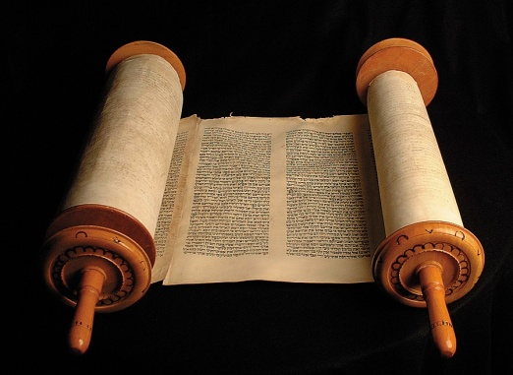
III. THEY ARE A PEOPLE OF DIVISION (Acts 1:15-26)
Galatians 2:11-21
Theological differences
I Timothy 1:19,20
Blasphemous rejecters
I Timothy 6:20,21
Godless chatter; Opposing ideas
Notes:
Waiting results from variations in arrival rates and service rates.
David H. Maister’s Laws of Service book
When customers expect a certain level of service, and then perceive the ser-vice they actually receive to be higher, then they will be satisfied. Conversely, when customers service expectations are higher than their perceptions once the service has been received, they are unsatisfied.
A common practice coming out of Law # 1 is to underpromise and over-deliver.
If customers start out happy when the service is first encountered, it is easy to keep them happy. If they start out disgruntled, it is almost impossible to turn things around.
Service Law # 2 is good for firms to remember when they are trying to im-prove service.

Slide 6
People who
Are empowered by the
Holy Spirit should be . . .
Able to know where to place a dividing line
Sensitive to their part
Sensitive to God’s part
Notes:
Magazines, tv, toys for children
Give waiting customers menus, forms to complete, drinks
Ease anxieties
Observe customers and learn what is likely to cause anxiety for them.
Misery loves company, togetherness
First come, first serve / discipline

