Slide 1
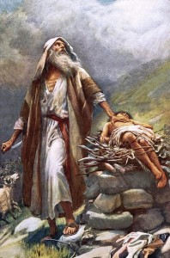
SIGNS OF A MATURE CHURCH Pitfalls of Progress
Text: Ephesians 4:27

Slide 2
I. TEST OF OUR WILL (Jeremiah 11:20)
"But, O Lord Almighty, you who judge righteously and test (triest - KJV) the heart and mind . . . "
Jeremiah 11:20

Slide 3
I. TEST OF OUR WILL (Jeremiah 11:20)
"Before I formed you in the womb, I knew you, before you were born I set you apart; I appointed you as prophet to the nations."
Jeremiah 1:5

Slide 4
I. TEST OF OUR WILL (Jeremiah 11:20)
His calling was to . . .
"uproot and tear down, to destroy and overthrow to build and to plant."
Jeremiah 1:10

Slide 5
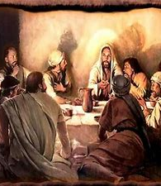
I. TEST OF OUR WILL (Jeremiah 11:20)
"You are those who have stood by me in my trials."
Luke 22:28

Slide 6
I. TEST OF OUR WILL (Jeremiah 11:20)
They had faced . . .
a) strong opposition from religious leaders
b) severe demands of those in need
c) lack of food and housing
d) punishment of the sun by day and the cold by night
e) rejection by those who once loved them
f) the Word of God eagerly heard, but seldom lived

Slide 7
I. TEST OF OUR WILL (Jeremiah 11:20)
"you will all fall away," Jesus told them, "for it is written: I will strike the shepherd and the sheep will be scattered."
Mark 14:27

Slide 8
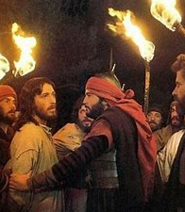
I. TEST OF OUR WILL (Jeremiah 11:20)
"Then everyone deserted him and fled."
Mark 14:50

Slide 9
I. TEST OF OUR WILL (Jeremiah 11:20)
"But after I uproot them, I will again have compassion and will bring each of them back to his own inheritance and his own country."
Jeremiah 12:15

Slide 10
I. TEST OF OUR WILL (Jeremiah 11:20)
"In this you greatly rejoice, though now for a little while you may have had to suffer grief in all kinds of trials (manifold temptation - KJV).”
I Peter 1:6

Slide 11
I. TEST OF OUR WILL (Jeremiah 11:20)
“These have come so that your faith - of greater worth than gold, which perishes even though refined by fire - may be proved genuine and may result in praise, glory and honor when Jesus Christ is revealed (apocalypse; revelation; appearing; manifestation)."
I Peter 1:7

Slide 12
I. TEST OF OUR WILL (Jeremiah 11:20)
"and lead us not into temptation, but deliver us from the evil one"
Matthew 6:13

Slide 13
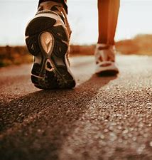
II. TEST OF OUR WALK (James 1:12)
"Blessed is the man who perseveres under trials (endureth temptation - KJV), because when he has stood the test (he is tried - KJV), he will receive the crown of life that God has promised to those who love him."
James 1:12

Slide 14
II. TEST OF OUR WALK (James 1:12)
"those who are led by the Spirit of God are the sons of God.
15. For you did not receive a spirit that makes you a slave again to fear, but you have received the Spirit of sonship. And by Him we cry,"Abba Father."
Romans 8:14-15

Slide 15
II. TEST OF OUR WALK (James 1:12)
16. The Spirit himself testifies with our spirit that we are God's children.
17. Now if we are children, then we are heirs - heirs of God and co-heirs with Christ, IF indeed we share in his sufferings in order that we may also share in his glory."
Romans 8:16-17

Slide 16
II. TEST OF OUR WALK (James 1:12)
1. Natural life of the body - Luke 12:22
2. Immaterial or invisible part of man - Matthew 10:28
3. Disembodied man - II Corinthians 5:1-4
4. Seat of our personality - Luke 9:24

Slide 17
II. TEST OF OUR WALK (James 1:12)
5. Seat of our sentiment (feelings, desires) - Matthew 11:29
6. Seat of our will and purpose - Matthew 22:37
7. Seat of our appetite - Psalm 107:9

Slide 18
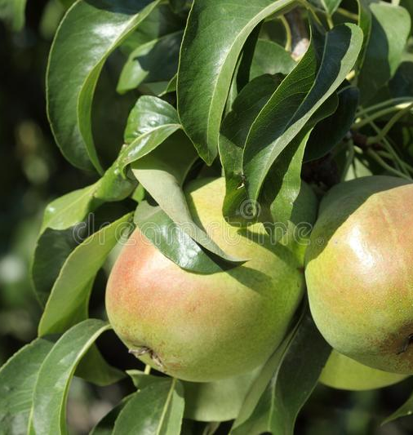
II. TEST OF OUR WALK (James 1:12)
"Each tree is recognized by its own fruit. People do not pick figs from thorn bushes, or grapes from briers."
Luke 6:44

