Slide 1
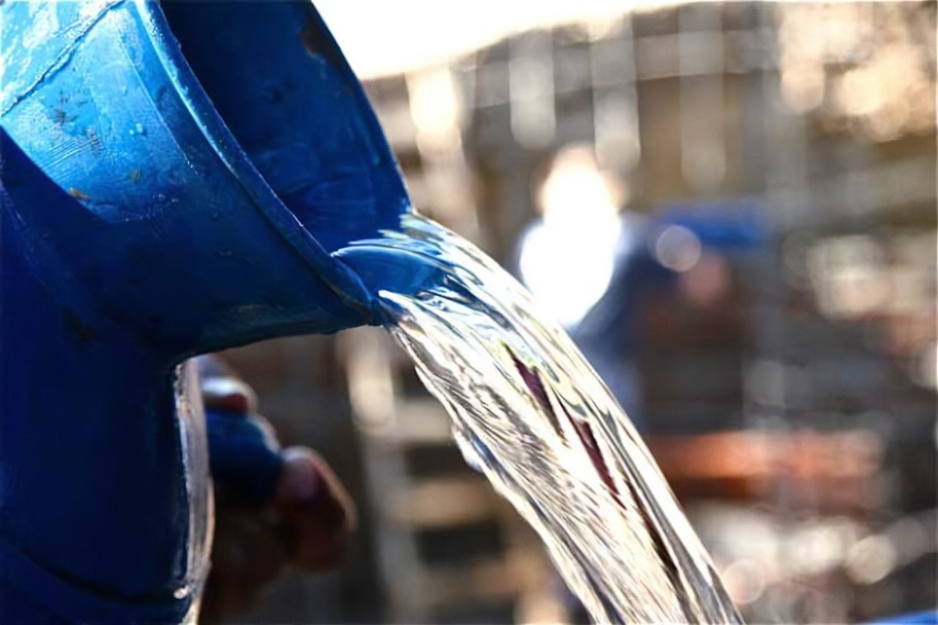
POURED IN/POURED OUT
Text: Psalm 22:14

Slide 2
I. POURED OUT FROM GOD (Titus 3:4-7)
“But when the kindness and love of God our Savior appeared,
5. He saved us, not because of righteous things we had done, but because of his mercy. He saved us through the washing of rebirth and renewal by the Holy Spirit,
Titus 3:4-5

Slide 3
I. POURED OUT FROM GOD (Titus 3:4-7)
“Whom he poured out on us generously through Jesus Christ our Savior.
7. So that, having been justified by his grace, we might become heirs having the hope of eternal life.”
Titus 3:4-7

Slide 4
I. POURED OUT FROM GOD (Titus 3:4-7)
“This is my blood of the (new) covenant, which is poured out for many for the forgiveness of sins.”
Matthew 26:28
cf. Luke 22:20

Slide 5
I. POURED OUT FROM GOD (Titus 3:4-7)
“Not only so, but we also rejoice in our sufferings, because we know that suffering produces perseverence;
4. perseverence, character; and character, hope.”
Romans 5:3-4

Slide 6
I. POURED OUT FROM GOD (Titus 3:4-7)
“And hope does not disappoint us, because God has poured out his love into our hearts by the Holy Spirit, whom he has given us.”
Romans 5:5

Slide 7
II. POURED INTO US (Isaiah 44:3)
“I will no longer hide my face from them, for I will pour out my Spirit on the house of Israel, declares the Sovereign LORD.”
Ezekiel 39:29

Slide 8
II. POURED INTO US (Isaiah 44:3)
“For I will pour water on the thirsty land, and streams upon dry ground; I will pour out my Spirit on your offspring, and my blessing on your descendant.”
Isaiah 44:3

Slide 9
II. POURED INTO US (Isaiah 44:3)
“And afterward, I will pour out my Spirit on all people. Your sons and daughters will prophesy, your old men will dream dreams, your young men will see visions.
29. Even on my servants, both men and women, I will pour out my Spirit in those days.”
Joel 2:28

Slide 10
II. POURED INTO US (Isaiah 44:3)
What God chooses, He cleanses.
What God cleanses, He molds.
What God molds, He fills.
What God fills, He uses.
J. S. Baxter/Michael Green
“Illustrations for Biblical Preaching”
#662, p. 190

Slide 11
III. POURED OUT FOR OTHERS (II Timothy 4:6)
“I am poured out like water, all my bones are out of joint.
My heart has turned to wax; it has melted away within me.”
Psalm 22:14

Slide 12
III. POURED OUT FOR OTHERS (II Timothy 4:6)
“But even if I am being poured out like a drink offering on the sacrifice and service coming from your faith, I am glad and rejoice with all of you.”
Philippians 2:17

Slide 13
III. POURED OUT FOR OTHERS (II Timothy 4:6)
“Even if I am executed here and now, I’ll rejoice in being an element in the offering of your faith that you make on Christ’s altar, a part of rejoicing.”
Philippians 2:17
The Message

Slide 14
III. POURED OUT FOR OTHERS (II Timothy 4:6)
“For I am already poured out like a drink offering, and the time has come for my departure.”
II Timothy 4:6

Slide 15
III. POURED OUT FOR OTHERS (II Timothy 4:6)
“The world measures a man’s greatness by the number who serve him. Heaven’s yardstick measures a man by the number who are served by him.”
Rev. Herschel H. Hobbs, D.D.

