Slide 1
PREPARING FOR THE MESSIAH Part I
Text: Matthew 24:1-51

Slide 4
1. When will this happen? 2. What will be the sign of Your coming? 3. What will be the sign of the end of the age?
"Do you see all these things?" he asked. "I tell you the truth, not one stone here will be left on another; every one will be thrown down."
Matthew 24:2

Slide 5
What Were These Disciples Told about the Signs Proceeding the Return of Christ?

Slide 6
I. THE BEGINNING OF BIRTH PAINS (Matthew 24:4-8)
A. Deception by False Messiahs (Matthew 24:4,5,24)

Slide 7
I. THE BEGINNING OF BIRTH PAINS (Matthew 24:4-8)
“The names of 24 false Messiahs are recorded as having appeared between the time of the Emperor Adrian (AD. 76-138) and the year 1682.”
Albert Barnes’ Notes on the Bible

Slide 8
I. THE BEGINNING OF BIRTH PAINS (Matthew 24:4-8)
B. Deception of False Prophets (24:11; 24)

Slide 9
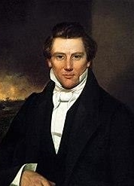
B. Deception of False Prophets (Matthew 24:11; 24)
"Watch out for false prophets. They come to you in sheep's clothing, but inwardly they are ferocious wolves.
16. By their fruit you will recognize them. Do people pick grapes from thorn bushes, or figs from thistles?
17. Likewise every good tree bears good fruit, but a bad tree bears bad fruit.

Slide 10
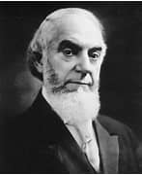
B. Deception of False Prophets (Matthew 24:11; 24)
18. A good tree cannot bear bad fruit, and a bad tree cannot bear good fruit.
19. Every tree that does not bear good fruit is cut down and thrown into the fire.
20. Thus, by their fruit you will recognize them. “
Matthew 7:15-20

Slide 11
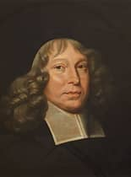
B. Deception of False Prophets (Matthew 24:11; 24)
"But there were also false prophets among the people, just as there will be false teachers among you. They will secretly introduce destructive heresies, even denying the sovereign Lord who bought them –- bringing swift destruction on themselves.
2. Many will follow their shameful ways and will bring the way of truth into disrepute.
II Peter 2:1-3

Slide 12
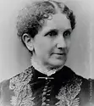
B. Deception of False Prophets (Matthew 24:11; 24)
3. In their greed these teachers will exploit you with stories they have made up. Their condemnation has long been hanging over them, and their destruction has not been sleeping."
II Peter 2:1-3

Slide 13
B. Deception of False Prophets (Matthew 24:11; 24)
"Dear friends, do not believe every spirit, but test the spirits to see whether they are from God, because many false prophets have gone out into the world.
2. This is how you can recognize the Spirit of God: Every spirit that acknowledges that Jesus Christ has come in the flesh is from God,”

Slide 14
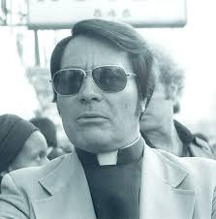
B. Deception of False Prophets (Matthew 24:11; 24)
"3. but every spirit that does not acknowledge Jesus, that spirit is not from God. This is the spirit of the antichrist, which you have heard is coming and even now is already in the world"
I John 4:1-3

Slide 15
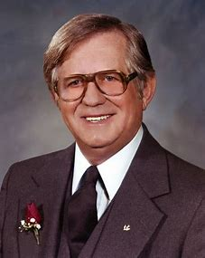
B. Deception of False Prophets (Matthew 24:11; 24)
"3. but every spirit that does not acknowledge Jesus, that spirit is not from God. This is the spirit of the antichrist, which you have heard is coming and even now is already in the world"
I John 4:1-3

Slide 16
1. Two Kinds of False Prophets
“But a prophet who presumes to speak in my name anything I have not commanded, or a prophet who speaks in the name of other gods, is to be put to death.”
²¹ You may say to yourselves, “How can we know when a message has not been spoken by the Lord?”
²² If what a prophet proclaims in the name of the Lord does not take place or come true, that is a message the Lord has not spoken. That prophet has spoken presumptuously, so do not be alarmed.”
Deuteronomy 18:20-22

Slide 17
1. Two Kinds of False Prophets
“If a prophet, or one who foretells by dreams, appears among you and announces to you a sign or wonder, ² and if the sign or wonder spoken of takes place, and the prophet says, “Let us follow other gods” (gods you have not known) “and let us worship them,” ³ you must not listen to the words of that prophet or dreamer. The Lord your God is testing you to find out whether you love him with all your heart and with all your soul.” Deuteronomy 13:1-3

Slide 18
2. Four Kinds of False Prophecy
False Visions
Divinations
Idolatries
Delusions

