Slide 1
PRESSING FORWARD FOR GOD

Slide 2
What Must We Do to Reach Our Goals in Life?

Slide 3
I. TAKE HOLD OF WHAT’S CHRISTLIKE (Philippians 3:12) “Not that I have already obtained all this, or have already been made perfect, but I press on to take hold of that for which Christ Jesus took hold of me.” Philippians 3:12

Slide 4
A. An Attitude of Humility “I am the least of the apostles.” 1 Corinthians 15:9 “I am the very least of all the saints.” Ephesians 3:8 “I am the foremost of sinners.” 1 Timothy 1:15

Slide 5
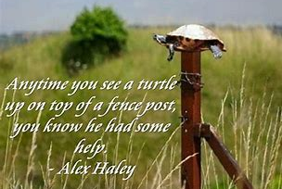
A. An Attitude of Humility

Slide 6
B. An Attitude of Holding on
“When our convictions are yielded
to Him completely, He is able to give Himself to us in all His fullness.
Until that is so, He cannot trust us.”
Dr. G Campbell Morgan

Slide 7
II. STRAIN TOWARD WHAT IS AHEAD (Philippians 3:13)
He used the word
“strain” or “press”
which means
“to pursue; to follow after;
to be given to.”

Slide 8
II. STRAIN TOWARD WHAT IS AHEAD (Philippians 3:13) A. Don’t Strain for the Past
The Past is
a Place of Reference
NOT
a Place of Residence

Slide 9
II. STRAIN TOWARD WHAT IS AHEAD (Philippians 3:13) B. Don’t Strain for the Present
And it
came
to pass
Luke 2:1

Slide 10
II. STRAIN TOWARD WHAT IS AHEAD (Philippians 3:13) C. Strain for the Future
Forgetting what is behind
and straining
toward what is ahead
Philippians 3:13

Slide 11
II. STRAIN TOWARD WHAT IS AHEAD (Philippians 3:13) C. Strain for the Future
“Never be afraid to trust
an unknown future
to a known God”
Corrie Ten Boom

Slide 12
III. PRESS ONTO WIN THE PRIZE (Philippians 3:14) “I press on toward the goal to win the prize for which God has called me heavenward in Christ Jesus.” Philippians 3:14

Slide 13
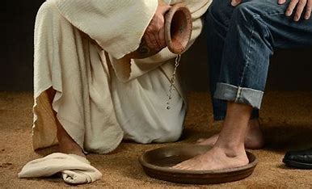
III. PRESS ONTO WIN THE PRIZE (Philippians 3:14) A. The Prize Coming from Serving Christ 1. Faithful Servant - Matthew 23:21,23,34-36: Mark 10:42-45

Slide 14
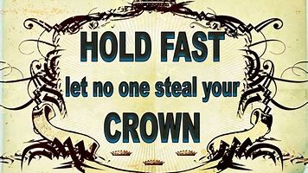
III. PRESS ONTO WIN THE PRIZE (Philippians 3:14) A. The Prize Coming from Serving Christ 2. The Crowns i). The Incorruptible Crown – I Corinthians 9:25 (getting to the finish) ii). The Crown of Righteousness – II Timothy 4:8 (longing to see Jesus) iii). The Crown of Life/Victor’s Crown - James 1:12; Revelation 2:10 (perseveres under trials)

Slide 15
III. PRESS ONTO WIN THE PRIZE (Philippians 3:14) B. The Prize Coming from Knowing Christ “I want to know Christ and the power of his resurrection and the fellowship of sharing in his sufferings, becoming like him in his death, 11. and so, somehow, to attain to the resurrection from the dead.” Philippians 3:10,11

Slide 16
III. PRESS ONTO WIN THE PRIZE (Philippians 3:14) C. The Prize of Christ Himself “What is more, I consider everything a loss compared to the surpassing greatness of knowing Christ Jesus my Lord, for whose sake I have lost all things. I consider them rubbish, that I may gain Christ.” Philippians 3:8

Slide 17
What Must We Do to Reach Our Goals in Life?

