Slide 1
PROVERBS OF ASHES - DEFENCES OF CLAY
Text: Job 13:1-19

Slide 2
This Evil World Is Escalating Its False Accusations Against Those Who Choose to Follow the Scriptures AND Set Their Actions As a Proper Example Against Satan’s Deception.

Slide 3
“My eyes have seen all this, my ears have heard and understood it. 2. What you know, I also know; I am not inferior to you. 3. But I desire to speak to the Almighty and to argue my case with God.” Job 13:1-3
I. JOB’S DECLARATION OF HIS DESIRE (Job 13:1-5)

Slide 4
“4. You, however, smear me with lies; you are worthless physicians, all of you! 5. If only you would be altogether silent! For you, that would be wisdom.” Job 13:4-5
I. JOB’S DECLARATION OF HIS DESIRE (Job 13:1-5)

Slide 5
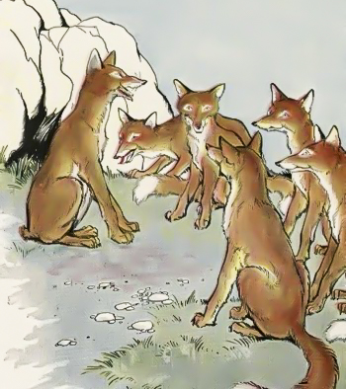
I. JOB’S DECLARATION OF HIS DESIRE (Job 13:1-5)

Slide 6
“Far be it from you to do such a thing—to kill the righteous with the wicked, treating the righteous and the wicked alike. Far be it from you! Will not the Judge of all the earth do (what is) right?” Genesis 18:25
I. JOB’S DECLARATION OF HIS DESIRE (Job 13:1-5)

Slide 7
“If only you would be altogether silent! For you, that would be wisdom.” Job 13:5
I. JOB’S DECLARATION OF HIS DESIRE (Job 13:1-5)

Slide 8
“Hear now my argument; listen to the pleas of my lips. 7. Will you speak wickedly on God’s behalf? Will you speak deceitfully for him? 8. Will you show him partiality? Will you argue the case for God? 9. Would it turn out well if he examined you? Could you deceive him as you might deceive a mortal? Job 13:6-9
II. JOB’S DECLARATION OF THEIR DECEPTION (Job 13:6-12)

Slide 9
10. He would surely call you to account if you secretly showed partiality. 11. Would not his splendor terrify you? Would not the dread of him fall on you? 12. Your maxims (a short statement expressing a general truth or rule of conduct) are proverbs of ashes; your defenses are defenses of clay. Job 13:10-12
II. JOB’S DECLARATION OF THEIR DECEPTION (Job 13:6-12)

Slide 10
“Do not be deceived: God cannot be mocked. A man reaps what he sows.” Galatians 6:7
II. JOB’S DECLARATION OF THEIR DECEPTION (Job 13:6-12)

Slide 11
“The Lord is not slow in keeping his promise, as some understand slowness. Instead, he is patient with you, not wanting anyone to perish, but everyone to come to repentance.” II Peter 3:9
II. JOB’S DECLARATION OF THEIR DECEPTION (Job 13:6-12)

Slide 12
“Outside are the dogs, those who practice magic arts, the sexually immoral, the murderers, the idolaters and everyone who loves and practices falsehood.” Revelation 22:15
II. JOB’S DECLARATION OF THEIR DECEPTION (Job 13:6-12)

Slide 13
“I tell you that everyone will have to give account on the day of judgment for every empty word they have spoken” Matthew 12:36
II. JOB’S DECLARATION OF THEIR DECEPTION (Job 13:6-12)

Slide 14
“The mouth speaks what the heart is full of.” Matthew 12:34
II. JOB’S DECLARATION OF THEIR DECEPTION (Job 13:6-12)

Slide 15
“If God is for us, who can be against us?” Romans 8:31
III. JOB’S DECLARATION OF GOD’S DEFENCE (Job 13:13-19)(Contd.)

Slide 16
“Though he slay me, yet will I hope in him; I will surely defend my ways to his face. 16. Indeed, this will turn out for my deliverance, for no godless person would dare come before him! 17. Listen carefully to what I say; let my words ring in your ears. Job 13:15-17
III. JOB’S DECLARATION OF GOD’S DEFENCE (Job 13:13-19)(Contd.)

Slide 17
18. Now that I have prepared my case, I know I will be vindicated. 19. Can anyone bring charges against me? If so, I will be silent and die.” Job 13:18-19
III. JOB’S DECLARATION OF GOD’S DEFENCE (Job 13:13-19)(Contd.)

Slide 18
“for I know that through your prayers and God’s provision of the Spirit of Jesus Christ what has happened to me will turn out for my deliverance.” Philippians 1:19
III. JOB’S DECLARATION OF GOD’S DEFENCE (Job 13:13-19)(Contd.)

Slide 19
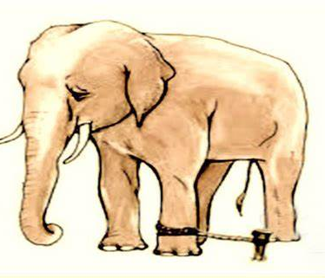
III. JOB’S DECLARATION OF GOD’S DEFENCE (Job 13:13-19)
(Contd.)
Past pain can become
a rope of bondage

