Slide 1
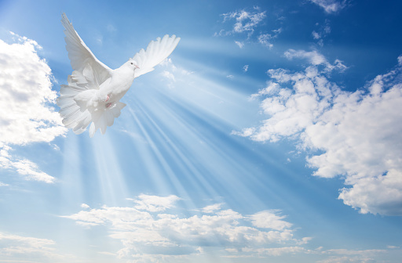
Possessing the Promises
of God
Joshua 14:6-15

Slide 2
Possessing the Promises of God
1. Caleb didn't allow the past to determine his future
2. How we start does not matter – How we end is what matters
3. He trusted in the promises of God
4. He refused to be influenced by the majority
5. He didn’t allow the obstacles to stop him

