Slide 1
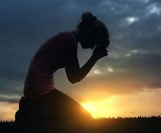
Prayer Series: Part I
PRAYER IS ABOUT REQUESTING
MATTHEW 6:11

Slide 2
I. THE DEVOTION OF THIS PRAYER
A) I BELIEVE IN GOD’S POWER

Slide 3
I. THE DEVOTION OF THIS PRAYER
B) I BELIEVE IN GOD’S PROMISES

Slide 4
I. THE DEVOTION OF THIS PRAYER
C) I BELIEVE IN GOD’S PERSONALITY

Slide 5
II. THE DEPENDENCE OF THIS PRAYER
A) IT IS A PRAYER OF CONFESSION

Slide 6
II. THE DEPENDENCE OF THIS PRAYER
B) IT IS A PRAYER OF CONFIDENCE

Slide 7
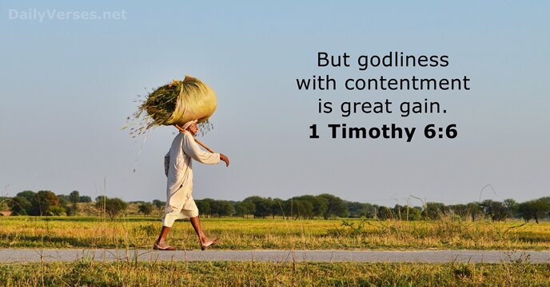
II. THE DEPENDENCE OF THIS PRAYER
C) IT IS A PRAYER OF CONTENTMENT

Slide 8
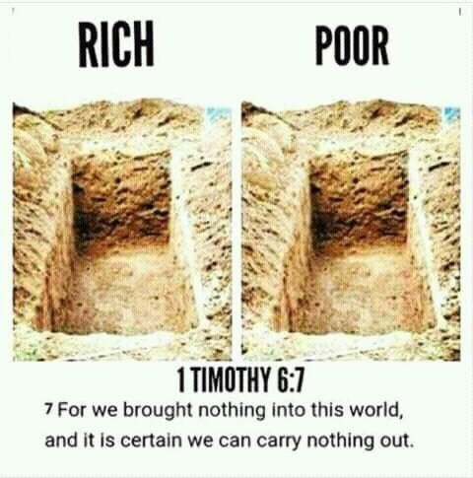
II. THE DEPENDENCE OF THIS PRAYER
C) IT IS A PRAYER OF CONTENTMENT

Slide 9
III. THE DEPTH OF THIS PRAYER
A) IT IS A COMMUNAL PRAYER

Slide 10
III. THE DEPTH OF THIS PRAYER
B) IT IS A COMPREHENSIVE PRAYER

Slide 11
III. THE DEPTH OF THIS PRAYER

Slide 12
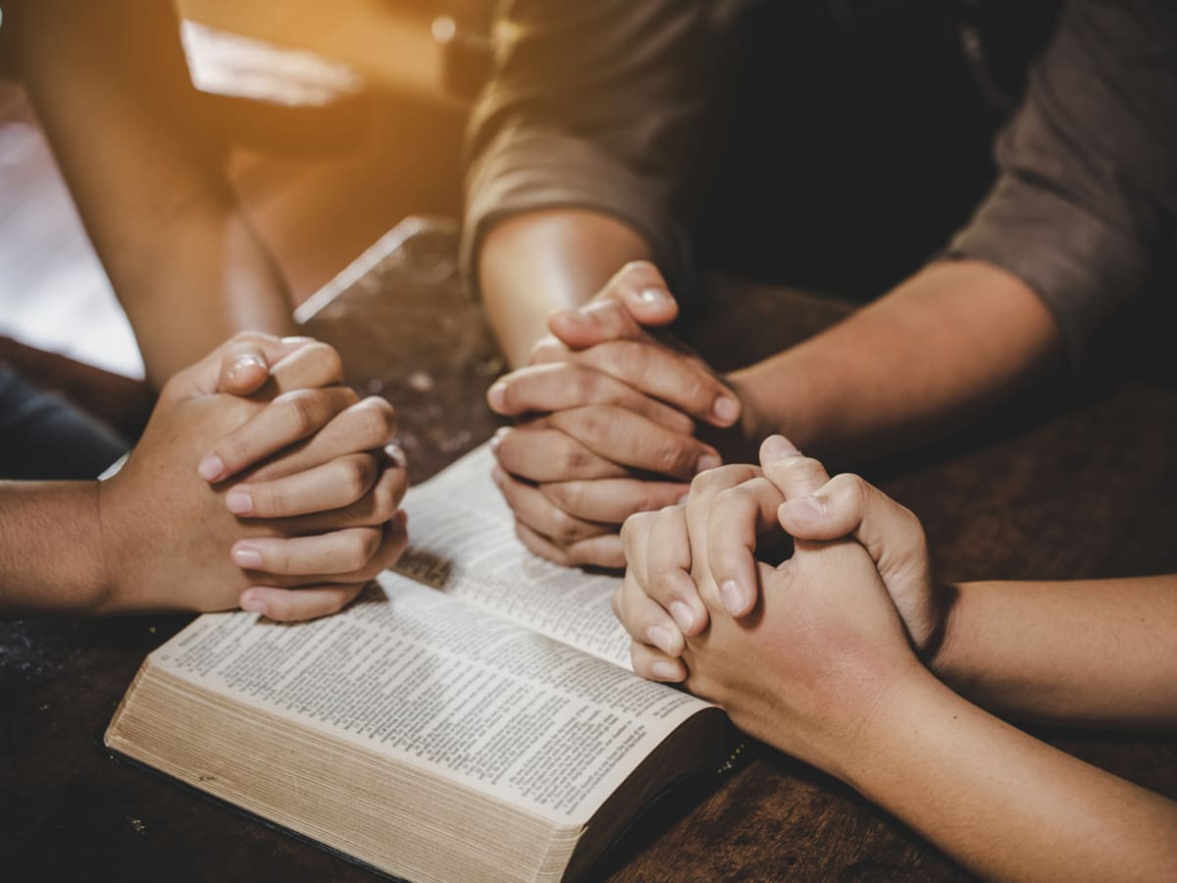
WHAT DO YOU NEED TO PRAY FOR TODAY?

