Slide 1
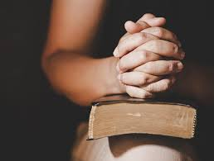
Prayer Series Part Three: Prayer is About Relying
Matthew 6:1-11

Slide 2
I. THE PROBLEM OF TEMPTATION

Slide 3
I. THE PROBLEM OF TEMPTATION

Slide 4
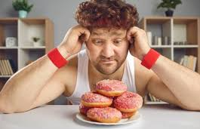
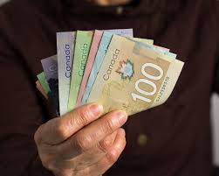
II. THE POWER OF TEMPTATION
“ENTICE”
“TO BAIT”

Slide 5
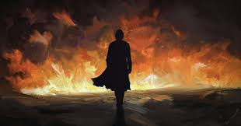
II. THE POWER OF TEMPTATION
“WHEN YOU PASS THROUGH THE WATERS, I WILL BE WITH YOU;
AND WHEN YOU PASS THROUGH THE RIVERS, THEY WILL NOT SWEEP OVER YOU.
WHEN YOU WALK THROUGH THE FIRE, YOU WILL NOT BE BURNED;
THE FLAMES WILL NOT SET YOU ABLAZE.”
ISAIAH 43:2

Slide 6
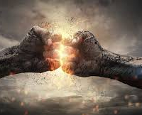
III. THE PLEA IN TEMPTATION

Slide 7
VICTORY IS OURS!!!

