Slide 1
Prepare For the Spirit of Victory
Galatians 5:16-25

Slide 2
“So I say, walk by the Spirit, and you will not gratify the desires of the flesh. ¹⁷ For the flesh desires what is contrary to the Spirit, and the Spirit what is contrary to the flesh. They are in conflict with each other, so that you are not to do whatever you want. ¹⁸ But if you are led by the Spirit, you are not under the law. ¹⁹ The acts of the flesh are obvious: sexual immorality, impurity and debauchery; ²⁰ idolatry and witchcraft; hatred, discord, jealousy, fits of rage, selfish ambition, dissensions, factions ²¹ and envy; drunkenness, orgies, and the like. I warn you, as I did before, that those who live like this will not inherit the kingdom of God. ²² But the fruit of the Spirit is love, joy, peace, forbearance, kindness, goodness, faithfulness, ²³ gentleness and self-control. Against such things there is no law. ²⁴ Those who belong to Christ Jesus have crucified the flesh with its passions and desires. ²⁵ Since we live by the Spirit, let us keep in step with the Spirit.” Galatians 5:16-25

Slide 3
2 POSSIBLE PATHWAYS

Slide 4
I. THE PATHWAY OF SPIRITUAL LOSS & SLAVERY
FLESH IS OPPOSED TO THE SPIRIT
FLESH IS OPEN TO ANY SIN

Slide 5
I. THE PATHWAY OF SPIRITUAL LOSS & SLAVERY
THE FLESH IS ORDAINED TO JUDGEMENT

Slide 6
II. THE PATHWAY OF SPIRITUAL VICTORY & FREEDOM
THE SPIRIT GIVES US VICTORY OVER OUR LUSTS

Slide 7
II. THE PATHWAY OF SPIRITUAL VICTORY & FREEDOM
THE SPIRIT GIVES US VICTORY OVER THE LAW

Slide 8
II. THE PATHWAY OF SPIRITUAL VICTORY & FREEDOM
THE SPIRIT GIVES US VICTORY OVER THIS LIFE

Slide 9
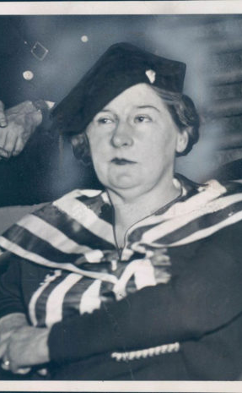
LOUIS & KATHRYN LAWES **** SING SING PRISON

Slide 10
Are you bearing fruit for His Glory?

