Slide 1
Preparing for the Wedding
Text: Revelation 19:7-9

Slide 2
"The Lord God said, 'It is not good for man to be alone. I will make a helper suitable for him."
Genesis 2:18
“So the Lord God caused man to fall into a deep sleep; and while he was sleeping, he took one of the man's ribs and closed up the place with flesh."
Genesis 2:21
I. SIGNIFICANCE IN THE BEGINNING

Slide 3
"Then the Lord God made a woman from the rib he had taken out of man (broke off man ), and he brought her to the man.”
Genesis 2:22
“This is now bone of my bones and flesh of my flesh; she shall be called woman, (Isha) for she was taken out of man (broken off).”
Genesis 2:23
I. SIGNIFICANCE IN THE BEGINNING

Slide 4
I. SIGNIFICANCE IN THE BEGINNING
"For this reason will a man leave his father and mother and be united to his wife, and they will become one flesh."
Genesis 2:24

Slide 5
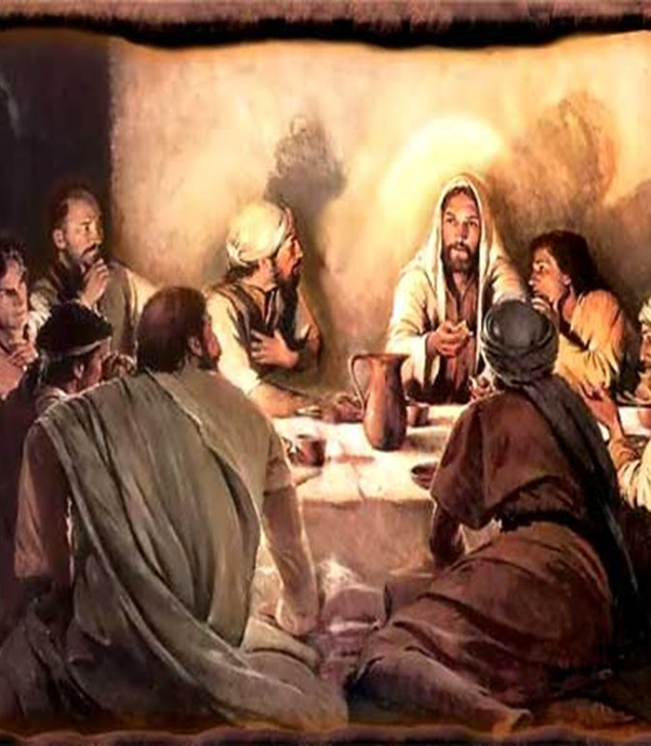
II. SIGNIFICANCE OF THE NEW COVENANT
“The Lord Jesus, on the night He was betrayed, took bread,
24. And when He had given thanks He broke it and said, "This is by body, which is [broken] for you; do this in remembrance of me."
I Corinthians 11:23,24

Slide 6
II. SIGNIFICANCE OF THE NEW COVENANT
"In my Father's house are many rooms; if it were not so, I would have told you. I am going to prepare a place for you.
3. And if I go to prepare a place for you, I will come back and take you to be with me that you also may be where I am."
John 14:2,3

Slide 7
II. SIGNIFICANCE OF THE NEW COVENANT
"I am jealous for you with a Godly jealousy. I promised you to one husband, to Christ, so
that I might present you as a pure virgin to Him."
II Corinthians 11:2

Slide 8
II. SIGNIFICANCE OF THE NEW COVENANT
"This is what the Lord Almighty says: I am very jealous for Zion;
I am burning with jealousy for her."
Zechariah 8:2

Slide 9
II. SIGNIFICANCE OF THE NEW COVENANT
"Do you not know that your bodies are members of Christ Himself? Shall I then take the members of Christ and unite with a prostitute? Never!
16. Do you not know that He who unites himself with a prostitute is one with her in body? For it is said, 'The two will become one flesh.'
17. but whoever is united with the Lord is one with Him in spirit."
I Corinthians 6:15-17

Slide 10
II. SIGNIFICANCE OF THE NEW COVENANT
"In the same way after supper He took the cup, saying, "This cup is the new covenant [blood letting] in my blood; do this, whenever you drink it, in remembrance of me."
I Corinthians 11:25

Slide 11
The Church of Christ needs to enter the Bridal chamber.

