Slide 1
PURSUIT
JOHN 4:20-24

Slide 2
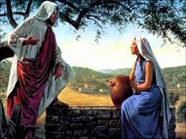

Slide 3
Spirit and truth
And we all, who with unveiled faces contemplate the Lord’s glory, are being transformed into his image with ever-increasing glory, which comes from the Lord, who is the Spirit. 2 Corinthians 3:18
Hebrews 6:18
so that by two unchangeable things in which it is impossible for God to lie, we who have taken refuge would have strong encouragement to take hold of the hope set before us

Slide 4
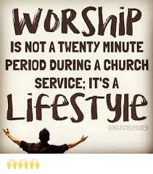
What worship is not
Worship is not just a feeling that comes over you
Worship is not just a musical experience
Worship is not just a corporate activity

Slide 5
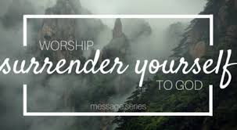
What worship is
Worship is love responding to love romans 5:8
But God demonstrates his own love for us in this: while we were still sinners Christ died for us
Worship is giving back to the one who gave Psalms 116:12-19
Worship is a lifestyle
Romans 12:1-2
See the divine in the daily

Slide 6
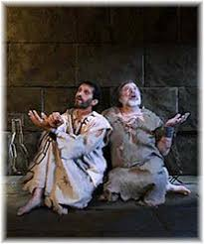
Paul and Silas
24 Having received such a charge, he put them into the inner prison and fastened their feet in the stocks.
The Philippian Jailer Saved
25 But at midnight Paul and Silas were praying and singing hymns to God, and the prisoners were listening to them. 26 Suddenly there was a great earthquake, so that the foundations of the prison were shaken; and immediately all the doors were opened and everyone’s chains were loosed
Acts 16:24-26

Slide 7
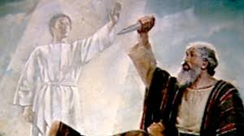
Abraham’s willing
^{Genesis 22:12 -14}
But the Angel of the Lord called to him from heaven and said, “Abraham, Abraham!”
So he said, “Here I am.”
And He said, “Do not lay your hand on the lad, or do anything to him; for now I know that you fear God, since you have not withheld your son, your only son, from Me.”

Slide 8
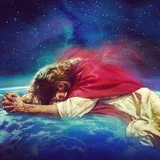
Jesus surrenders
Luke 22:41-43 And he was withdrawn from them about a stone's cast, and kneeled down, and prayed,
42 Saying, Father, if thou be willing, remove this cup from me: nevertheless not my will, but thine, be done.
43 And there appeared an angel unto him from heaven, strengthening him.

Slide 9
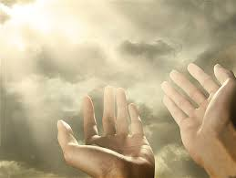
Are you ready to pursue God ?
Lets us worship him in spirit and truth
Do you believe what God can do ?
Come all the broken and be restored

Slide 10
