Slide 1
Questioning God
Text: Job 10

Slide 2
“What we tolerate today - we embrace tomorrow.”

Slide 3
“Are not my few days almost over? Turn away from me so I can have a moment’s joy 21. before I go to the place of no return, to the land of gloom and utter darkness, 22. to the land of deepest night, of utter darkness and disorder, where even the light is like darkness. Job 10:20-22

Slide 4
I. TO SPEAK OUT IN THE BITTERNESS OF HIS SOUL (Job 10:1)
“I loathe my very life; therefore I will give free rein to my complaint and speak out in the bitterness of my soul.”
Job 10:1

Slide 5
I. TO SPEAK OUT IN THE BITTERNESS OF HIS SOUL (Job 10:1)
“but no human being can tame the tongue. It is a restless evil, full of deadly poison.”
James 3:8

Slide 6
I. TO SPEAK OUT IN THE BITTERNESS OF HIS SOUL (Job 10:1)
“Woe is me! For I am lost; for I am a man of unclean lips, and I dwell in the midst of a people of unclean lips; for my eyes have seen the King, the Lord of hosts!”
Isaiah 6:5

Slide 7
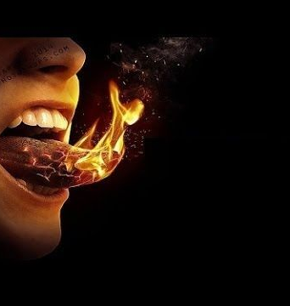
I. TO SPEAK OUT IN THE BITTERNESS OF HIS SOUL (Job 10:1)
"Death and life are in the power of the tongue, And those who love it will eat its fruit."
Proverbs 18:21 NKJV

Slide 8
I. TO SPEAK OUT IN THE BITTERNESS OF HIS SOUL (Job 10:1)
"But I tell you that everyone will have to give account on the day of judgment for every empty word they have spoken.
37. For by your words you will be acquitted (exonerated or cleared), and by your words, you will be condemned."
Matthew 12:36,37

Slide 9
II. TO LAMENT THAT GOD WAS NOT JUST (Job 10:13-15)
“But this is what you concealed in your heart, and I know that this was in your mind:
14. If I sinned, you would be watching me and would not let my offense go unpunished.”
Job 10:13-14

Slide 10
II. TO LAMENT THAT GOD WAS NOT JUST (Job 10:13-15)
“Don’t call me Naomi (Hebrew - “pleasant”), she told them. Call me Mara, because the Almighty has made my life very bitter. (Mara in Hebrew means “bitter”)
21. I went away full, but the LORD has brought me back empty. Why call me Naomi? The LORD has afflicted me, the Almighty has brought misfortune upon me.
Ruth 1:20-21

Slide 12
III. TO BELIEVE THAT GOD WAS FIGHTING AGAINST HIM (Job 9:16-17)
“If I hold my head high, you stalk me like a lion and again display your awesome power against me.
17. You bring new witnesses against me and increase your anger toward me; your (fresh - NEB) forces come against me wave upon wave.”
Job 10:16,17

Slide 13
III. TO BELIEVE THAT GOD WAS FIGHTING AGAINST HIM (Job 9:16-17)
“Anyone whose name was not found in the book of life was thrown into the lake of fire.”
Revelation 20:15

