Slide 1
REMEMBERING THE COVENANT
Text: Luke 1:67-75

Slide 2
What are Some of the Promises
Entailed in this Covenant That Zechariah Spoke About?

Slide 3
I. A RESCUE FROM OUR ENEMIES (Luke 1:74a)
THE COVENANTS OF SCRIPTURE
1. Eternal Covenant - Hebrews 13:20
2. Edenic Covenant - Genesis 1:26-28
3. Adamic Covenant - Genesis 3:14-19
4. Noahic Covenant - Genesis 8:20-9:6
5. Abrahamic Covenant - Genesis 12:1-3
6. Mosaic Covenant - Exodus 20:1-31:18
7. Palestinian Covenant - Deuteronomy 30:1-10
8. Davidic Covenant - 2 Samuel 7:4-17,
1 Chronicles 17:4-15
9. New Covenant - Jeremiah 31:31-33; Matthew 26:28; Mark 14:24; Luke 22:20; Hebrews 8:8-12
Merrill F. Unger
“The New Unger’s Bible Handbook”
Moody Press, Chicago, 1984, p. 595

Slide 4
A RESCUE FROM OUR ENEMIES
(Luke 1:74a)
Out-live Them
Out-give Them
“Do not judge, and you will not be judged. Do not condemn, and you will not be condemned. Forgive, and you will be forgiven.
38. Give, and it will be given to you. A good measure, pressed down, shaken together and running over, will be poured into your lap. For with the measure you use, it will be measured to you.”
Luke 6:37,38

Slide 5
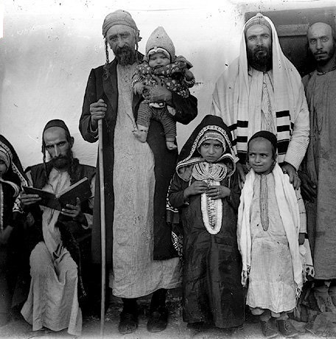
A RESCUE FROM OUR ENEMIES
(Luke 1:74a)
C. Out-love Them
“But I tell you who hear me: Love your enemies, do good to those who hate you,
28. bless those who curse you, pray for those who mistreat you.
29. If someone strikes you on one cheek, turn to him the other also. If someone takes your cloak, do not stop him from taking your tunic.
30. Give to everyone who asks you, and if anyone takes what belongs to you, do not demand it back.
31. Do to others as you would have them do to you.” Luke 6:27-31
20th-century Yemenite Jewish men
dressed in tunics 1944

Slide 6
A RESCUE FROM OUR ENEMIES
(Luke 1:74a)
C. Out-love Them
32. “If you love those who love you, what credit is that to you? Even ‘sinners’ love those who love them.
33. And if you do good to those who are good to you, what credit is that to you? Even ‘sinners’ do that.
34 And if you lend to those from whom you expect repayment, what credit is that to you? Even ‘sinners’ lend to ‘sinners,’ expecting to be repaid in full.
35. But love your enemies, do good to them, and lend to them without expecting to get anything back. Then your reward will be great, and you will be sons of the Most High, because he is kind to the ungrateful and wicked.
36. Be merciful, just as your Father is merciful.
Luke 6:32-36
On December 20, 1974, 10-year-old
Chris Carrier was kidnapped

Slide 7
II. AN ENABLEMENT TO SERVE HIM
(Luke 1:74b)
“Whatever you do, work at it with all your heart, as working for the Lord, not for men,
24. since you know that you will receive an inheritance from the Lord as a reward. It is the Lord Christ you are serving.”
Colossians 3:23,24

Slide 8
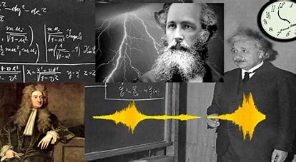
II. AN ENABLEMENT TO SERVE HIM
(Luke 1:74b)
Albert Einstein removed the portraits of two scientists -- Newton and Maxwell -- from his wall

Slide 9
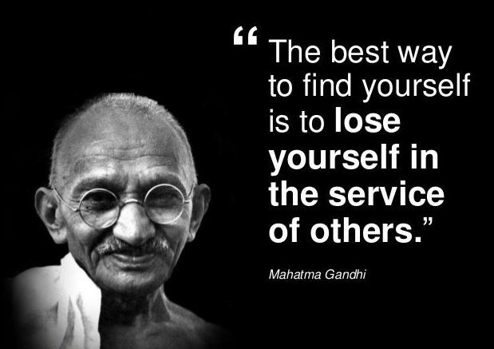
II. AN ENABLEMENT TO SERVE HIM
(Luke 1:74b)
He replaced those with portraits of Gandhi and Schweitzer. Einstein explained that it was time to replace the image of success with the image of service.

Slide 10
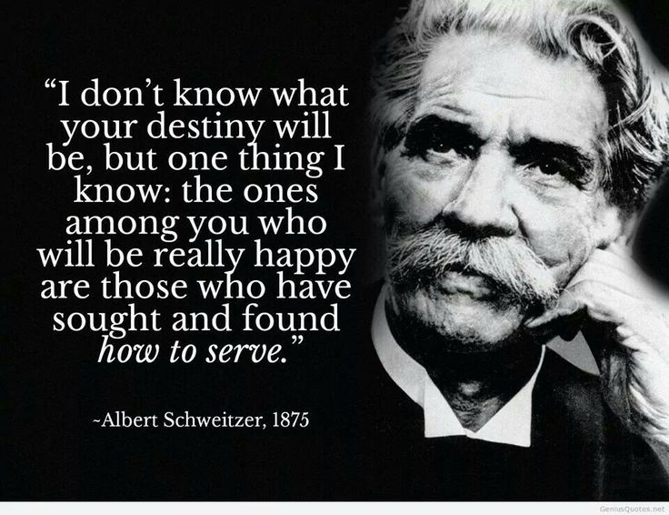
II. AN ENABLEMENT TO SERVE HIM
(Luke 1:74b)
He replaced those with portraits of Gandhi and Schweitzer. Einstein explained that it was time to replace the image of success with the image of service.

Slide 11
II. AN ENABLEMENT TO SERVE HIM
(Luke 1:74b)
“Now it is an extraordinary thing for one to willingly give his life even for an upright man, though perhaps for a good man [one who is noble and selfless and worthy] someone might even dare to die.
8. But God clearly shows and proves His own love for us, by the fact that while we were still sinners, Christ died for us.”
Romans 5:7-8

Slide 12
II. AN ENABLEMENT TO SERVE HIM
(Luke 1:74b)
“Therefore, since we have now been justified [declared free of the guilt of sin] by His blood, [how much more certain is it that] we will be saved from the wrath of God through Him.
10. For if while we were enemies we were reconciled to God through the death of His Son, it is much more certain, having been reconciled, that we will be saved [from the consequences of sin] by His life [that is, we will be saved because Christ lives today].”
Romans 5:9-10

Slide 13
II. AN ENABLEMENT TO SERVE HIM
(Luke 1:74b)
“Not only that, but we also rejoice in God [rejoicing in His love and perfection] through our Lord Jesus Christ, through whom we have now received and enjoy our reconciliation [with God].”
Romans 5:11

Slide 14
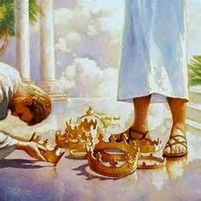
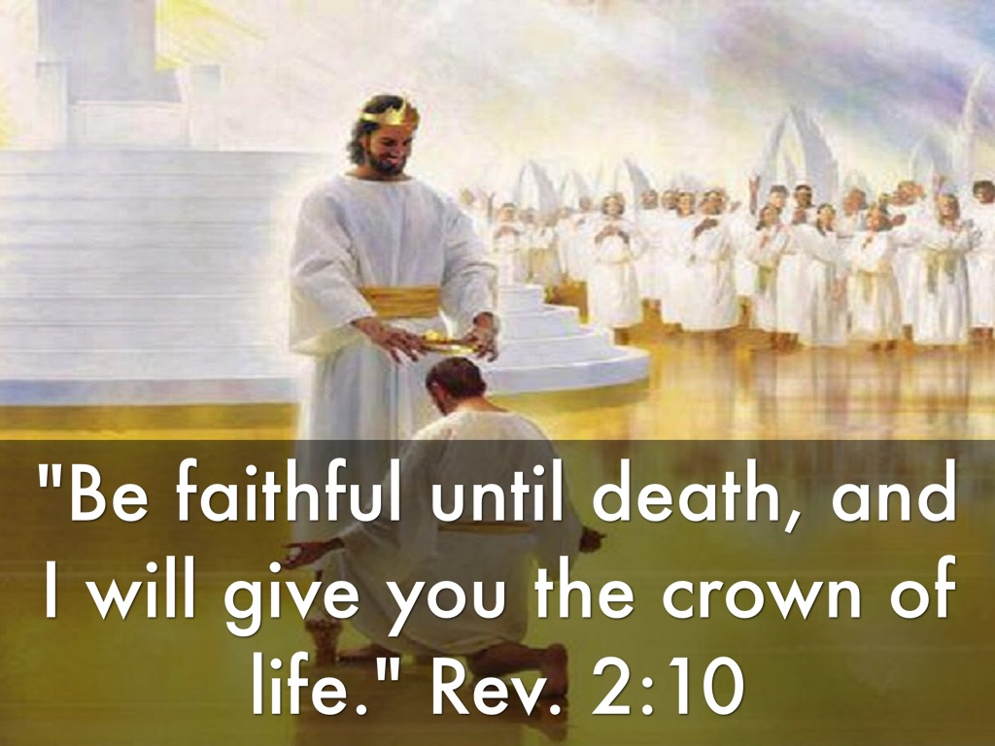
II. AN ENABLEMENT TO SERVE HIM
(Luke 1:74b)
“But it is my happiness that I have served Him who never fails to reward His servants to the full extent of His promise.“
John Calvin

Slide 15
III. A LIBERATION FROM FEAR (Luke 1:74c)
“There is no fear in love. But perfect love drives out fear, because fear has to do with punishment. The one who fears is not made perfect in love.”
I John 4:18

Slide 16
III. A LIBERATION FROM FEAR (Luke 1:74c)
“But now, this is what the LORD says— he who created you, O Jacob, he who formed you, O Israel: Fear not, for I have redeemed you; I have summoned you by name; you are mine.”
Isaiah 43:1

