Slide 1
THE SERMON ON THE MOUNT SERIES “RETALIATION - FROM A BITTER HEART”
Text: Matthew 5:38-42

Slide 2
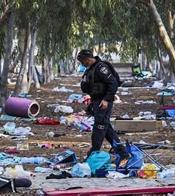
THE SERMON ON THE MOUNT SERIES “RETALIATION - FROM A BITTER HEART”
Carnage after Oct 11, 2023
attack on Israel

Slide 3
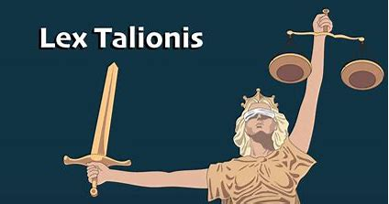
I. THE OLD LAW OF RETALIATION

Slide 4
I. THE OLD LAW OF RETALIATION
B. THE MOSAIC LAW
“But if there is serious injury, you are to take life for life,
24. eye for eye, tooth for tooth, hand for hand, foot for foot,
25. burn for burn, wound for wound, bruise for bruise.”
Exodus 21:23-25

Slide 5
I. THE OLD LAW OF RETALIATION
B. THE MOSAIC LAW
“If anyone injures his neighbor, whatever he has done must be done to him:
20. fracture for fracture, eye for eye, tooth for tooth. As he has injured the other, so he is to be injured.”
Leviticus 24:19,20

Slide 6
I. THE OLD LAW OF RETALIATION
B. THE MOSAIC LAW
“Show no pity: life for life, eye for eye, tooth for tooth, hand for hand, foot for foot.”
Deuteronomy 19:21

Slide 7
I. THE OLD LAW OF RETALIATION
B. THE MOSAIC LAW
The Limitation of Vengeance
2. The Limitation of Court Action
3. The Limitation of Symbolic Use Only (Matthew 5:38)

Slide 8
I. THE OLD LAW OF RETALIATION
C. The Baba Kamma
(The First Gate)
1. For injury
2. For pain
3. For healing
4. For loss of time
5. For dignity

Slide 9
I. THE OLD LAW OF RETALIATION
D. This is not the whole of the Old Testament teaching
“Do not seek revenge or bear a grudge against one of your people, but love your neighbor as yourself. I am the LORD.”
Leviticus 19:18
“If your enemy is hungry, give him food to eat; if he is thirsty, give him water to drink.”
Proverbs 25:21

Slide 10
A. Striking the Right Cheek (Matthew 5:39)

Slide 11
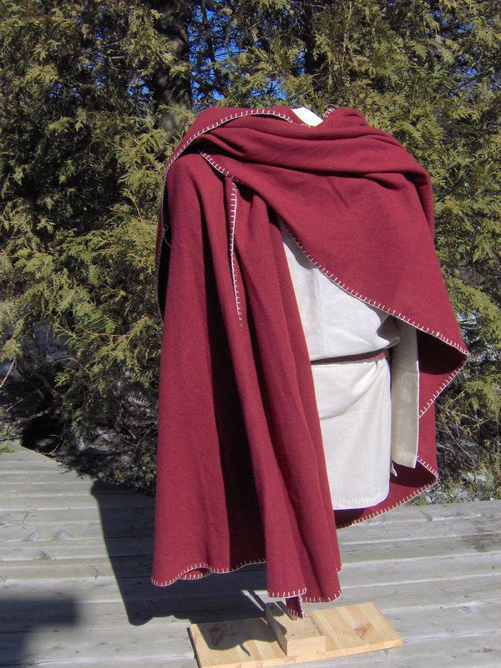
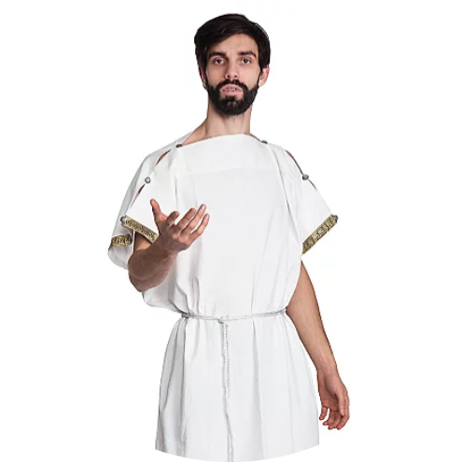
B. Suing and Taking a Tunic or Cloak (Matthew 5:40)
“If you take your neighbour’s cloak as a pledge, return it to him by sunset
27. because his cloak is the only covering he has for his body. What else will he sleep in? When he cries out to me, I will hear, for I am compassionate.”
Exodus 22:26,27

Slide 12
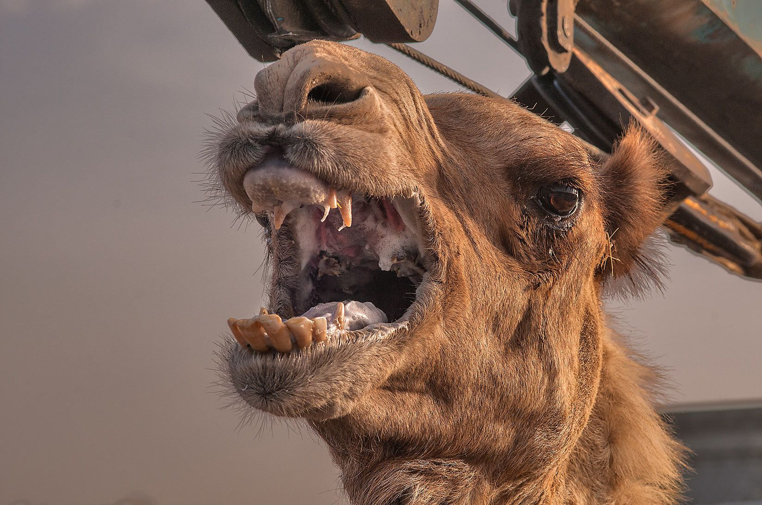
B. Suing and Taking a Tunic or Cloak (Matthew 5:40)
An Angry Camel

Slide 13
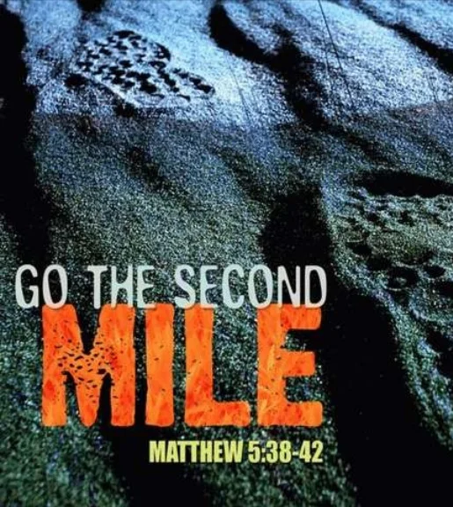
II. THE NEW LAW OF NON-RETALIATION
C. Striving to go the Second Mile (Matthew 5:41)
“The inefficient workman, the resentful servant, the ungracious helper have not even begun to have the right idea of the Christian life.”
William Barclay
“The Gospel of Matthew”
Vol. 1, p. 169

Slide 14
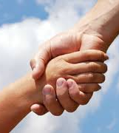
II. THE NEW LAW OF NON-RETALIATION
D. Security in our Giving (Matthew 5:42)
This was never intended to encourage an individual to return to a pattern of laziness and irresponsibility. It was a HAND UP not a HAND OUT.
True Christians have a heart of gold tempered with discernment AND a head of knowledge tempered in wisdom.

