Slide 1
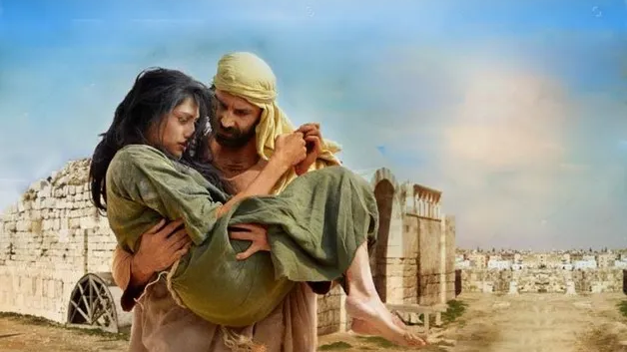
Redeeming Love
Hosea 3:1-3

Slide 2
I. A LOVING PURSUIT
(A) GOMER’S LIFESTYLE
“Their mother has been unfaithful and has conceived them in disgrace. She said, “I will go after my lovers, who give me my food and my water, my wool and my linen, my olive oil and my drink.”

Slide 3
I. A LOVING PURSUIT
(B) GOMER’S LUSTS

Slide 4
I. A LOVING PURSUIT
(C) GOMER’S LOVER
“Go yet, Love a woman.”

Slide 5
II. A LAVISHING PURCHASE
(A) HOSEA’S PRICE
“For fifteen pieces of silver, and for a homer of barley, and a half homer of barley.”

Slide 6
II. A LAVISHING PURCHASE
(B) HOSEA’S POSSESSION
“So, I bought her to me.”

Slide 7
“That’s my boat!”

Slide 8
III. A LASTING PURPOSE
THERE IS A NEW CHARACTER
“Thou shalt abide for me many days; thou shalt not play the harlot.”

Slide 9
III. A LASTING PURPOSE
(B) THERE IS A NEW COMMITMENT
“Thou shalt not be for another man; so will I also be for thee.”

Slide 10
III. A LASTING PURPOSE
(C) THERE IS A NEW COMPANION
“Never leave thee, nor forsake thee!”

Slide 11
“Son, Where did you get those Birds?”

Slide 12
Redeemed, Redeemed, Redeemed!

