Slide 1
Restoring The Broken
Joel 2:28-29

Slide 2
Joel 2:28 “And afterward, I will pour out my Spirit on all people. Your sons and daughters will prophesy, your old men will dream dreams, your young men will see visions.”

Slide 3
How are they spending their time?

Slide 4
What is attacking our youth?

Slide 5
God wants to RESTORE the Broken!

Slide 6
Numbers 11:25-29 “Then the Lord came down in the cloud and spoke with him, and he took some of the power of the Spirit that was on him and put it on the seventy elders. When the Spirit rested on them, they prophesied – but did not do so again.

Slide 7
“However, two men, whose names were Eldad and Medad, had remained in the camp. They were listed among the elders, but did not go out to the tent. Yet the Spirit also rested on them, and they prophesied in the camp. A young man ran and told Moses, “Eldad and Medad are prophesying in the camp.”

Slide 8
Joshua, son of Nun, who had been Moses’ aide since youth, spoke up and said, “Moses, my lord, Stop them!” But Moses replied, “Are you jealous for my sake? I wish that all the Lord’s people were prophets and that the Lord would put His Spirit on them!”

Slide 9
Joel 2:28-29 “And afterward, I will pour out my Spirit on all people. Your sons and daughters will prophesy, your old men will dream dreams, your young men will see visions. Even on my servants, both men and women, I will pour out my Spirit in those days.”

Slide 10
Acts 2:13-16 “Some, however, made fun of them and said, “They have had too much wine.” Then Peter stood up with the Eleven, raised his voice and addressed the crowd. “Fellow Jews and all of you who live in Jerusalem, let me explain this to you; listen carefully to what I say.”

Slide 11
Acts 2:13-16 “These people are not drunk, as you suppose. It’s only 9 in the morning! No, this is what was spoken by the prophet Joel…”

Slide 12
Joel 2:28 “And afterward, I will pour out my Spirit on all people. Your sons and daughters will prophesy, your old men will dream dreams, your young men will see visions.”

Slide 13
Church of Tomorrow…

Slide 14
I. Careful in Discipline
Proverbs 13:24
“Whoever spares the rod, hates their children, but the one who loves their children is CAREFUL to discipline them”

Slide 15
What do you do in the meantime?
Love them….
Smile….

Slide 16
II. Do Not Judge
Matthew 7:1-2
“Do not judge, or you too will be judged. For in the same way you judge others, you will be judged, and with the measure you use, it will be measured to you.”

Slide 17
What does God want from us?
TO JUDGE….
TO BE KIND….

Slide 18
“COMPLETELY AUTHENTIC”
“GENUINE, SO OTHERS CAN BE THEMSELVES”

Slide 19
III. Speak In Love
Ephesians 4:15-16
“Instead, speaking the truth in love, we will grow to become in every respect the mature body of Him who is the head, that is, Christ.”

Slide 20
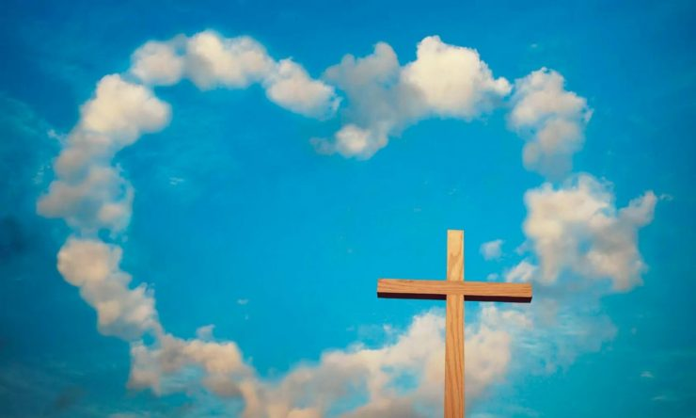
Rich Wilkerson Jr. “Unless you figure out how much God loves you, you will never let Him lead you.”

Slide 21
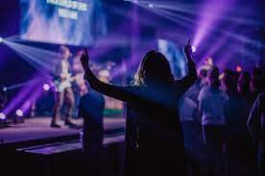
ENCOUNTER GOD….

Slide 22
Kent Crockett “I Once Was Blind, But Now I Squint”

Slide 23
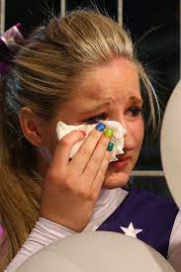
“I did make varsity…but Melissa didn’t make it!”

Slide 24
Hannah knew the best thing she could do was to be near her friend..

Slide 25
“When you swap places with others to feel how they hurt…you love your neighbour as yourself!”

Slide 26
What can we learn from the Book of Joel? 1. Disaster should turn us to God. 2. God Decides to Judge, there is no Escape! 3. Day of the Lord can be a blessing or Curse. 4. God is seeking True Repentance – Restoration will come! 5. God Can Restore all that is Broken and what has been Destroyed!

