Slide 1
Revival God’s Way
Mark 2:18-22

Slide 2
Revival God’s Way
How Can We Tell What Is Not from God? Jesus Used 3 Distinctive Illustrations to Explain.

Slide 3
I. THE ILLUSTRATION OF FASTING (Mark 2:18-20)
Leviticus 16:1-34; 23:26-32

Slide 4
I. THE ILLUSTRATION OF FASTING (Mark 2:18-20)
4th Month - commemorated the breaking of the tablets of the law – Exodus 32:19
2. 5th Month - commemorated the destruction of the temple by King Nebuchadnezzar (and later by Emperor Titus)
3. 7th Month - commemorated the murder of Gedaliah - II Kings 25:25f
4. 10th Month - commemorated the siege and taking of Jerusalem by the Babylonians - Jeremiah 52:14

Slide 5
I. THE ILLUSTRATION OF FASTING (Mark 2:18-20)
"David wearing a linen ephod, danced before the LORD with all his might,
15. while he and the entire house of Israel brought up the ark of the LORD with shouts and the sound of trumpets."
II Samuel 6:14,15

Slide 6
II. THE ILLUSTRATION OF PATCHING (Mark 2:21)
They would never use a new garment as a patch even though it may look nicer.

Slide 7
II. THE ILLUSTRATION OF PATCHING (Mark 2:21)
If the ungodly were attracted to something that drew them away from God, then the early church stayed away from it.

Slide 8
II. THE ILLUSTRATION OF PATCHING (Mark 2:21)
When Jesus starts something new, the world will find no peace, pleasure or attraction to it. It will take a surrendered and repentive heart to respond to what God is doing.

Slide 9
III. THE ILLUSTRATION OF WINESKINS (Mark 2:22)
Leviticus 10:9;
Ezekiel 44:21,
Numbers 6:5,20

Slide 10
III. THE ILLUSTRATION OF WINESKINS (Mark 2:22)
Every
NEW VESSEL
requires a
NEW FILLING

Slide 11
III. THE ILLUSTRATION OF WINESKINS (Mark 2:22)
New life like new wine is full of energy ready to burst forth

Slide 12
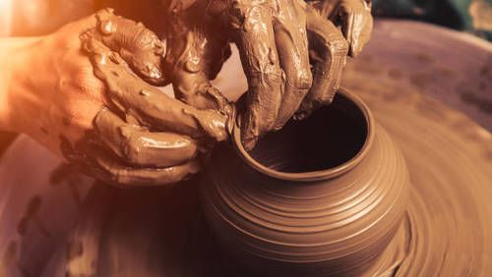
III. THE ILLUSTRATION OF WINESKINS (Mark 2:22)
Are we willing to become new and pliable in the Hands of God?

