Slide 1
SEVEN HABITS OF UNHEALTHY CHURCHES Part I
Text: Revelation 2

Slide 2
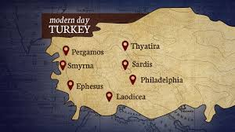
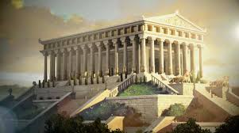
I. THEY FAIL TO CONTINUE LOVING GOD AND EACH OTHER (Revelation 2:1:6)
MODERN TURKEY
TEMPLE OF ARTEMIS IN EPHESUS

Slide 3
I. THEY FAIL TO CONTINUE LOVING GOD AND EACH OTHER (Revelation 2:1:6)
“Yet I hold this against you: You have forsaken your first love.”
Revelation 2:4

Slide 4
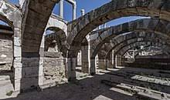
II. THEY ARE FEARFUL OF ADVERSITY (2:9,10)
“Do not be afraid of what you are about to suffer. I tell you, the devil will put some of you in prison to test you, and you will suffer persecution for ten days. Be faithful, even to the point of death, and I will give you the crown of life.” Revelation 2:10
CHURCH AT SMYRNA

Slide 5
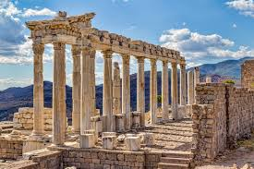
III. THEY TOLERATE POOR THEOLOGY AND IMMORAL BEHAVIOUR (2:14-16)
CHURCH AT PERGAMUM
“Nevertheless, I have a few things against you: You have people there who hold to the teaching of Balaam, who taught Balak to entice the Israelites to sin by eating food sacrificed to idols and by committing sexual immorality.
15. Likewise you also have those who hold to the teaching of the Nicolaitans.” Revelation 2:14,15

Slide 6
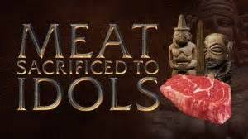
III. THEY TOLERATE POOR THEOLOGY AND IMMORAL BEHAVIOUR (2:14-16)
“Nevertheless, I have a few things against you: You have people there who hold to the teaching of Balaam, who taught Balak to entice the Israelites to sin by eating food sacrificed to idols and by committing sexual immorality.
15. Likewise you also have those who hold to the teaching of the Nicolaitans.” Revelation 2:14,15

Slide 7
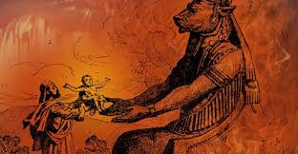
IV. THEY WHITEWASH OVER SINFUL ACTIONS (Revelation 2:20-23)
“Nevertheless, I have this against you: You tolerate that woman Jezebel, who calls herself a prophetess. By her teaching she misleads my servants into sexual immorality and the eating of food sacrificed to idols.
21. I have given her time to repent of her immorality, but she is unwilling.
Revelation 2:20-21
Worship of Baal

Slide 8
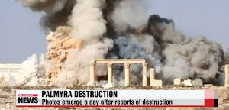
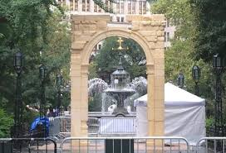
IV. THEY WHITEWASH OVER SINFUL ACTIONS (Revelation 2:20-23)
22. So I will cast her on a bed of suffering, and I will make those who commit adultery with her suffer intensely, unless they repent of her ways.
23. I will strike her children dead. Then all the churches will know that I am he who searches hearts and minds, and I will repay each of you according to your deeds.”
Revelation 2:20-23
Worship of Baal

Slide 9
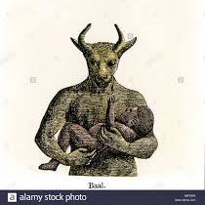
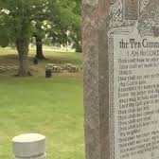
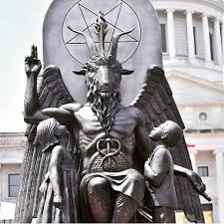
IV. THEY WHITEWASH OVER SINFUL ACTIONS (Revelation 2:20-23)
22. So I will cast her on a bed of suffering, and I will make those who commit adultery with her suffer intensely, unless they repent of her ways.
Revelation 2:22
Satanic Temple brings Worship of Baphomet

Slide 10
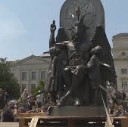
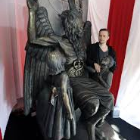
IV. THEY WHITEWASH OVER SINFUL ACTIONS (Revelation 2:20-23)
Arkansas's state capital
Missouri's’ abortion law challenge
23. I will strike her children dead. Then all the churches will know that I am he who searches hearts and minds, and I will repay each of you according to your deeds.”
Revelation 2:23
Satanic Temple brings Worship of Baphomet

