Slide 1
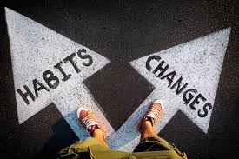
SEVEN HABITS OF UNHEALTHY CHURCHES Part II
Text: Revelation 3

Slide 2
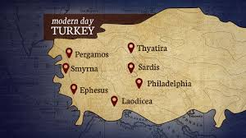
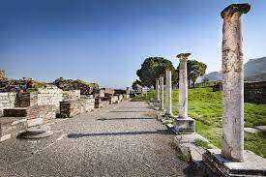
V. THEY RELAX IN THEIR REPUTATION (Revelation 3:1-3)
MODERN TURKEY
THE CHURCH AT SARDIS

Slide 3
V. THEY RELAX IN THEIR REPUTATION (Revelation 3:1-3)
“These are the words of him who holds the seven spirits of God and the seven stars. I know your deeds; you have a reputation of being alive, but you are dead.
2. Wake up! Strengthen what remains and is about to die, for I have not found your deeds complete in the sight of my God.
3. Remember, therefore, what you have received and heard; obey it, and repent. But if you do not wake up, I will come like a thief, and you will not know at what time I will come to you.”

Slide 4
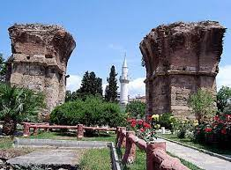
VI. THEY FOCUS ON THEIR WEAKNESSES (Revelation 3:8)
CHURCH AT PHILADELPHIA
“I know your deeds. See, I have placed before you an open door that no one can shut. I know that you have little strength, yet you have kept my word and have not denied my name.”
Revelation 3:8

Slide 5
VI. THEY FOCUS ON THEIR WEAKNESSES (Revelation 3:8)
CHURCH AT PHILADELPHIA
“Therefore, I will boast all the more gladly about my weakness, so that Christ’s power may rest on me.
10. That is why, for Christ’s sake, I delight in my weaknesses, in insults, in hardships, in persecutions, in difficulties. For when I am weak, then I am strong.” II Corinthians 12:10

Slide 6
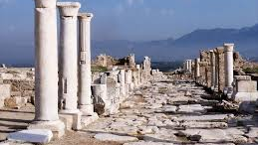
VII. THEY FAIL TO DEPEND UPON GOD (Revelation 3:17,18)
CHURCH AT LAODICEA
“You say, ‘I am rich; I have acquired wealth and do not need a thing.’ But you do not realize that you are wretched, pitiful, poor, blind and naked.
Revelation 3:17

Slide 7
VII. THEY FAIL TO DEPEND UPON GOD (Revelation 3:17,18)
CHURCH AT LAODICEA
18. I counsel you to buy from me gold refined in the fire, so you can become rich; and white clothes to wear, so you can cover your shameful nakedness; and salve to put on your eyes, so you can see.”
Revelation 3:18

