Slide 1
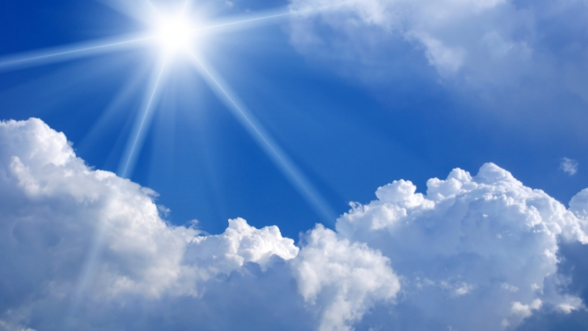
SHEDDING THE LIGHT – PART 1
Text: Matthew 5:14-16

Slide 2
What Should We Know About Being the Light of the World?
Text: Matthew 5:14-16

Slide 3
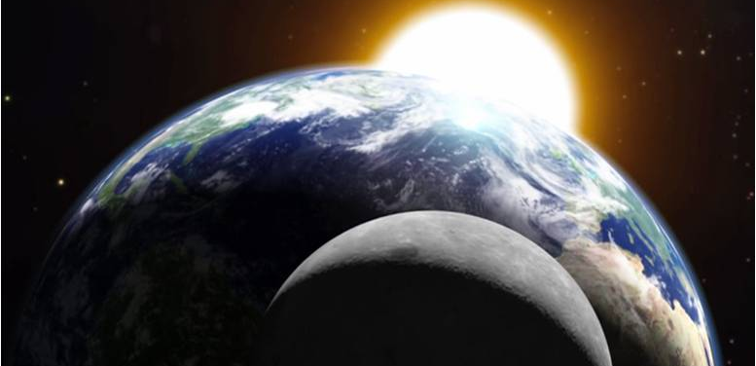
I. THE SOURCE OF LIGHT - (Matthew 5:14a) A. The Sun/Moon Source - Reflection

Slide 4
I. THE SOURCE OF LIGHT - (Matthew 5:14a) A. The Sun/Moon Source – Reflection Day 1 Genesis 1:3-5 Day 4 Genesis 1:14-19

Slide 5
“Now we see but a poor reflection as in a mirror; then we shall see face to face. Now I know in part; then I shall know fully, even as I am fully known.” I Corinthians 13:12
Reflection

Slide 6
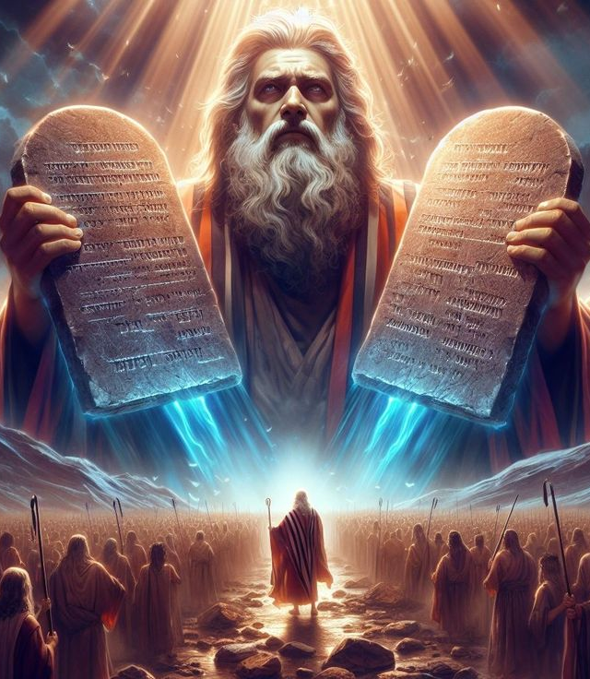
“When Moses went up on the mountain, the cloud covered it. 16. And the glory of the LORD settled on Mount Sinai. For six days the cloud covered the mountain, and on the seventh day the LORD called to Moses from within the cloud. 17. To the Israelites the glory of the LORD looked like a consuming fire on top of the mountain.” Exodus 24:15-17
Reflection

Slide 7
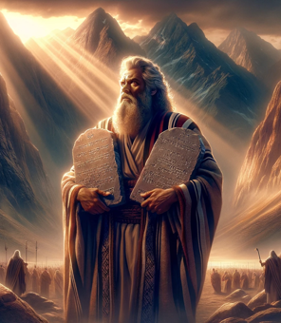
“When Moses came down from Mount Sinai with the two tablets of the Testimony in his hands, he was not aware that his face was radiant because he had spoken with the LORD. 30. Then Aaron and all the Israelites saw Moses, his face was radiant, and they were afraid to come near him . . . 33. When Moses finished speaking to them, he put a veil over his face. 34. But whenever he entered the LORD’s presence to speak with him, he removed the veil until he came out. And when he came out and told the Israelites what he had been commanded, 35. they saw that his face was radiant. Then Moses would put the veil back over his face until he went in to speak with the LORD.” Exodus 24:15-17
Reflection

Slide 8
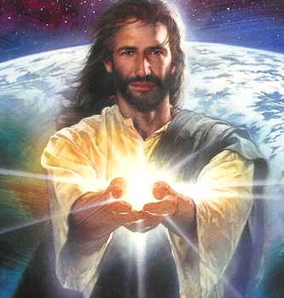
B. The Single Eye Source – Resistance “When Jesus spoke again to the people, he said, “I am the light of the world. Whoever follows me will never walk in darkness, but will have the light of life.” John 8:12 “As long as I am in the world, I am the light of the world.” John 9:5

Slide 9
B. The Single Eye Source – Resistance “Death and Destruction are never satisfied, and neither are the eyes of man.” Proverbs 27:20 “All things are wearisome, more than one can say. The eye never has enough of seeing, nor the ear its fill of hearing.” Ecclesiastes 1:8

Slide 10
C. The Stimulated Source - Resilience - Hebrews 12:1-11

Slide 11
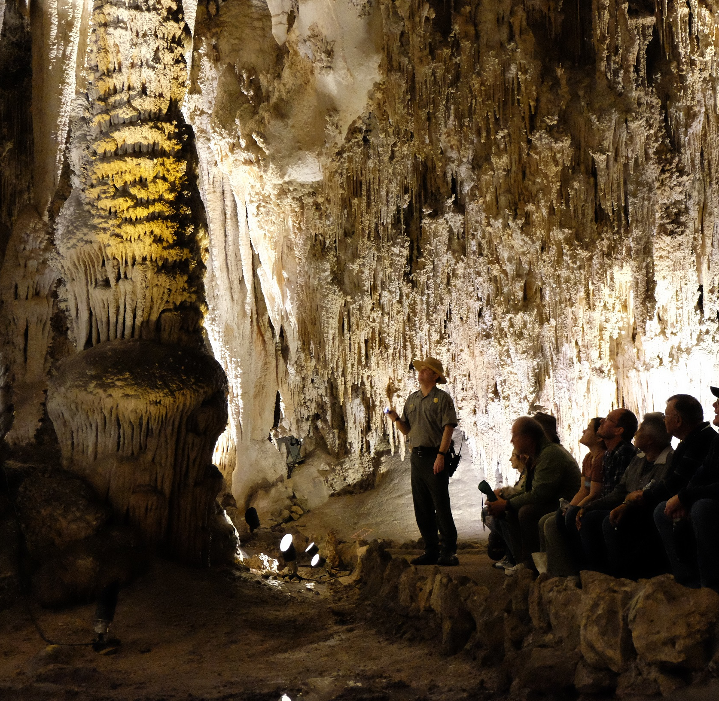
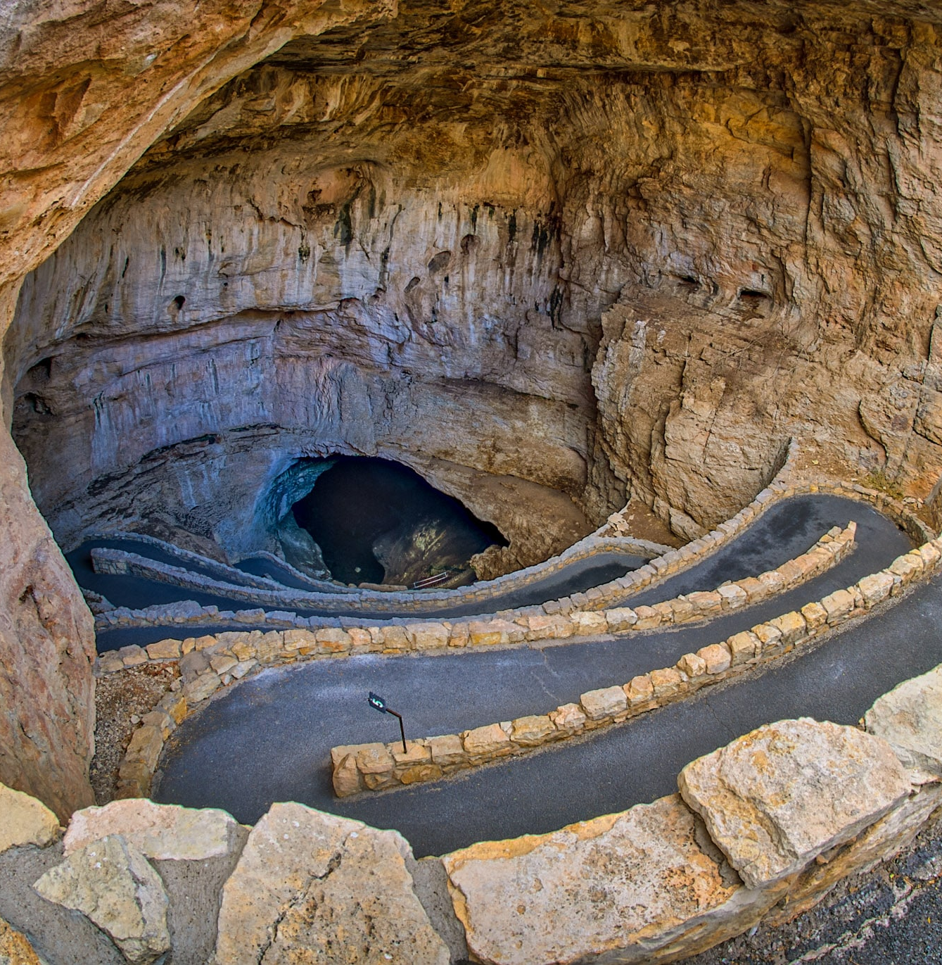
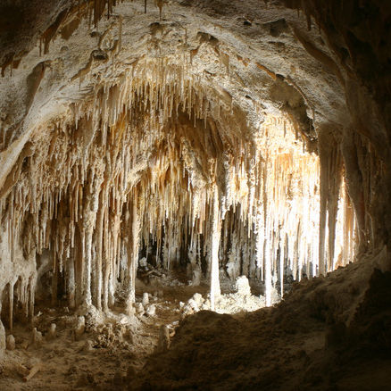
C. The Stimulated Source - Resilience
Caverns in Carlsbad Springs in New Mexico
In a real sense, that is the message of the gospel: light is available,
even when darkness seems overwhelming.

