Slide 1
STANDING ON GUARD FOR A CHRISTIAN CANADA

Slide 2
From far and wide, O Canada, We stand on guard for thee. God keep our land glorious and free! O Canada, we stand on guard for thee. O Canada, we stand on guard for thee.”

Slide 3
1. THE PEACE TOWER (above the east window) “He shall have dominion also from sea to sea, and from the River to the ends of the earth” -Psalm 72:8 A Mari usque Ad Mare (Latin on coat of arms)

Slide 4
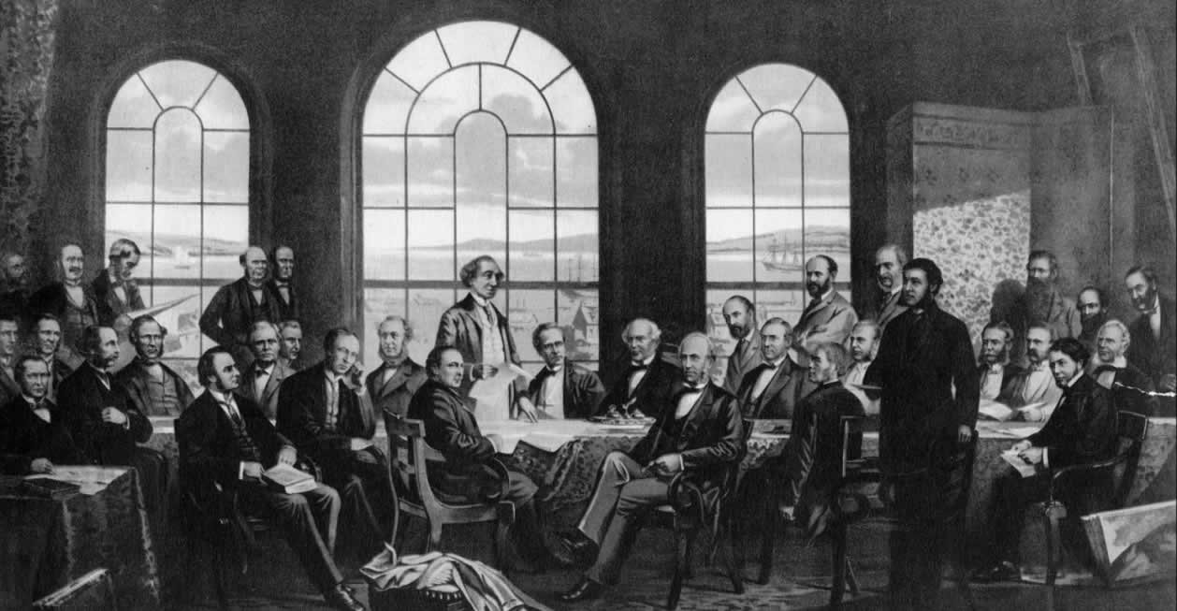
Sir Samuel Leonard Tilley, one of Canada’s founding fathers

Slide 5
“Give the King thy judgement, O God, and thy righteousness unto the King’s son” -Psalm 72:1 (above the South window)

Slide 6
“Where there is no vision, the people perish but he that keeps the law, happy is he” - Proverbs 29:18 (above west window)

Slide 7
THE PEACE TOWER REMINDS US OF OUR FORMER CHRISTIAN IDENTITY AND THE DESTINY THAT AWAITS THE WISE DECISIONS OF GODLY NATIONS!!!

Slide 8
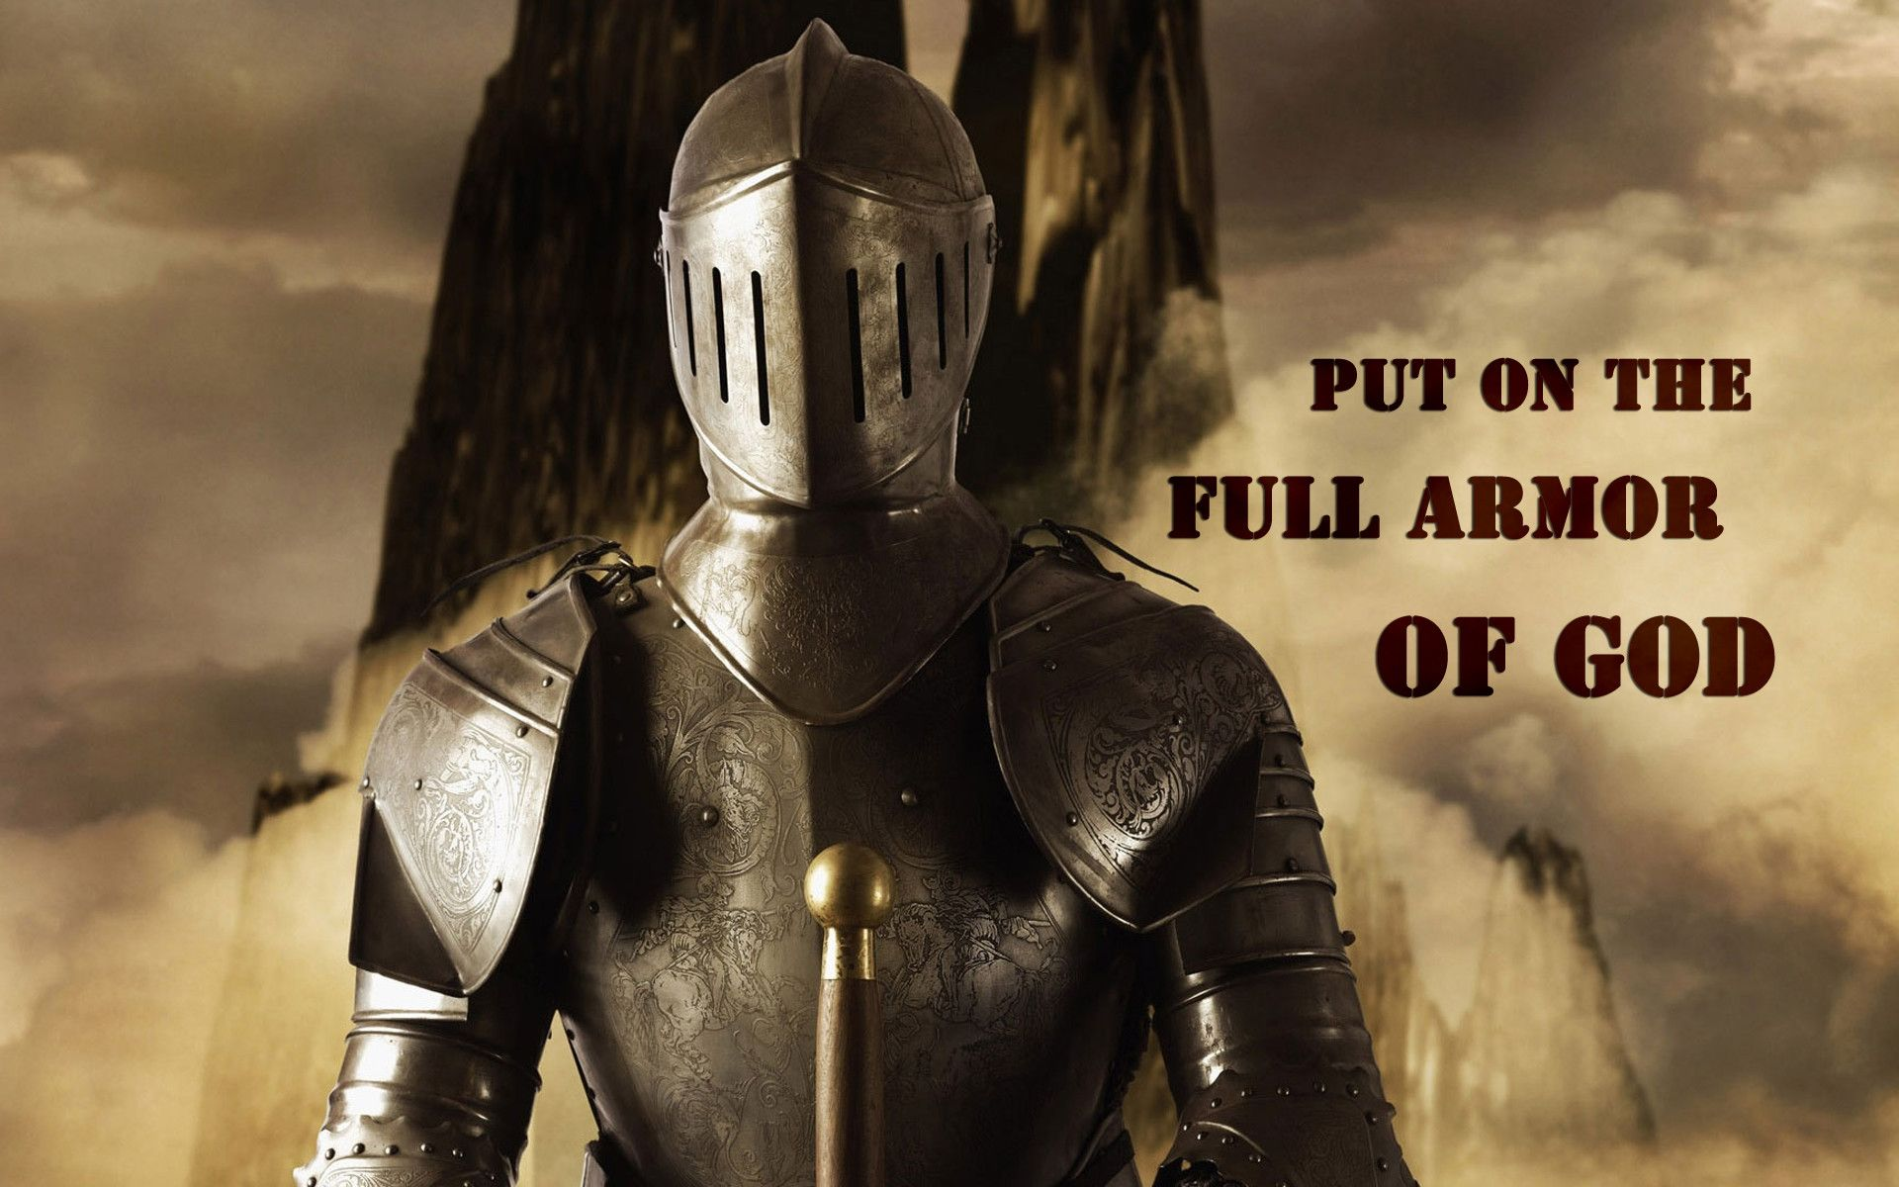
2. PARLIAMENT BUILDINGS. …”Take up the whole armor of God, that you may be able to withstand in the evil day, and having done all, to stand firm” Ephesians 6:13

Slide 9
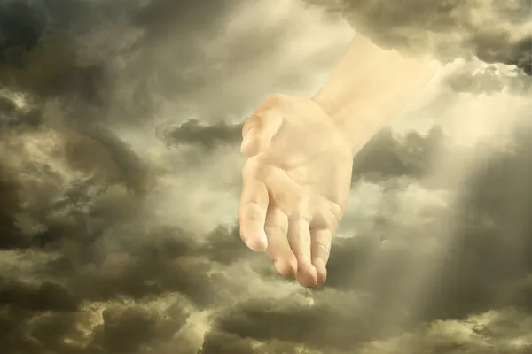
“7. Where can I go from your Spirit? Where can I flee from your presence? 8.If I go up to the heavens, you are there if I make my bed in the depths, you are there. 9. If I rise on the wings of the dawn, If I settle on the far side of the sea, 10. even there your hand will guide me, your right hand will hold me fast.” - Psalm 139:7 - 10

Slide 10
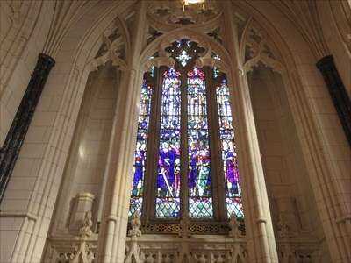
3. MEMORIAL CHAMBER
“…execute judgement and justice in the earth” - Jeremiah 23:5 (ESV)
“The Lord is good, a stronghold in the day
of trouble; he knows those who take refuge in him”
- Nahum 1:7

Slide 11
“17. At the time they will call Jerusalem The Throne of the Lord, and all nations will gather in Jerusalem to honor the name of the Lord. No longer will they follow the stubbornness of their evil hearts. 18. In those days the people of Judah will join the people of Israel, and together they will come from a northern land to the land I gave your ancestors as an inheritance.” - Jeremiah 3:17,18

Slide 12
THE LEGAL SYSTEM WAS NOT MEANT TO REPLACE THE JUDGEMENT OF GOD… BUT TO UPHOLD THE LAW OF GOD AND WHATEVER JUDGEMENT IS GIVEN BY THE COURTS, CHRIST WILL STILL ADMINISTER THE FINAL JUDGEMENT OF GOD!!

Slide 13
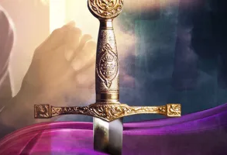
WHOM OR WHAT ARE YOU STANDING ON GUARD FOR?????

