Slide 1
SUPERWOMAN Ephesians 6:10

Slide 2
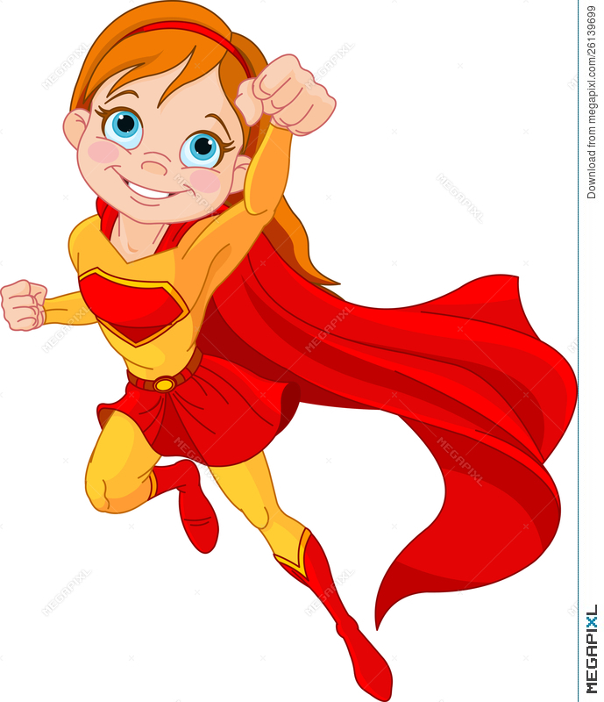

Slide 4
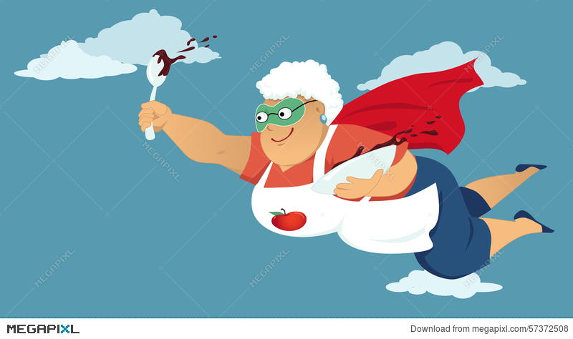

Slide 7
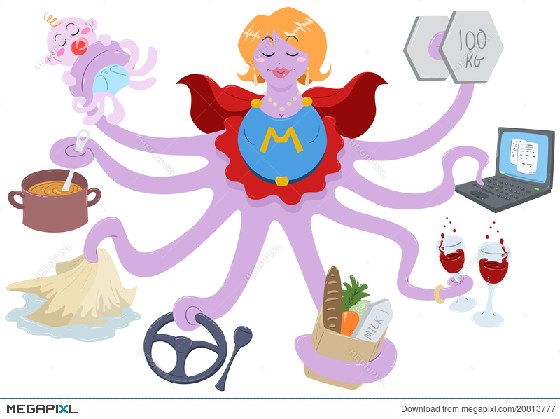

Slide 8
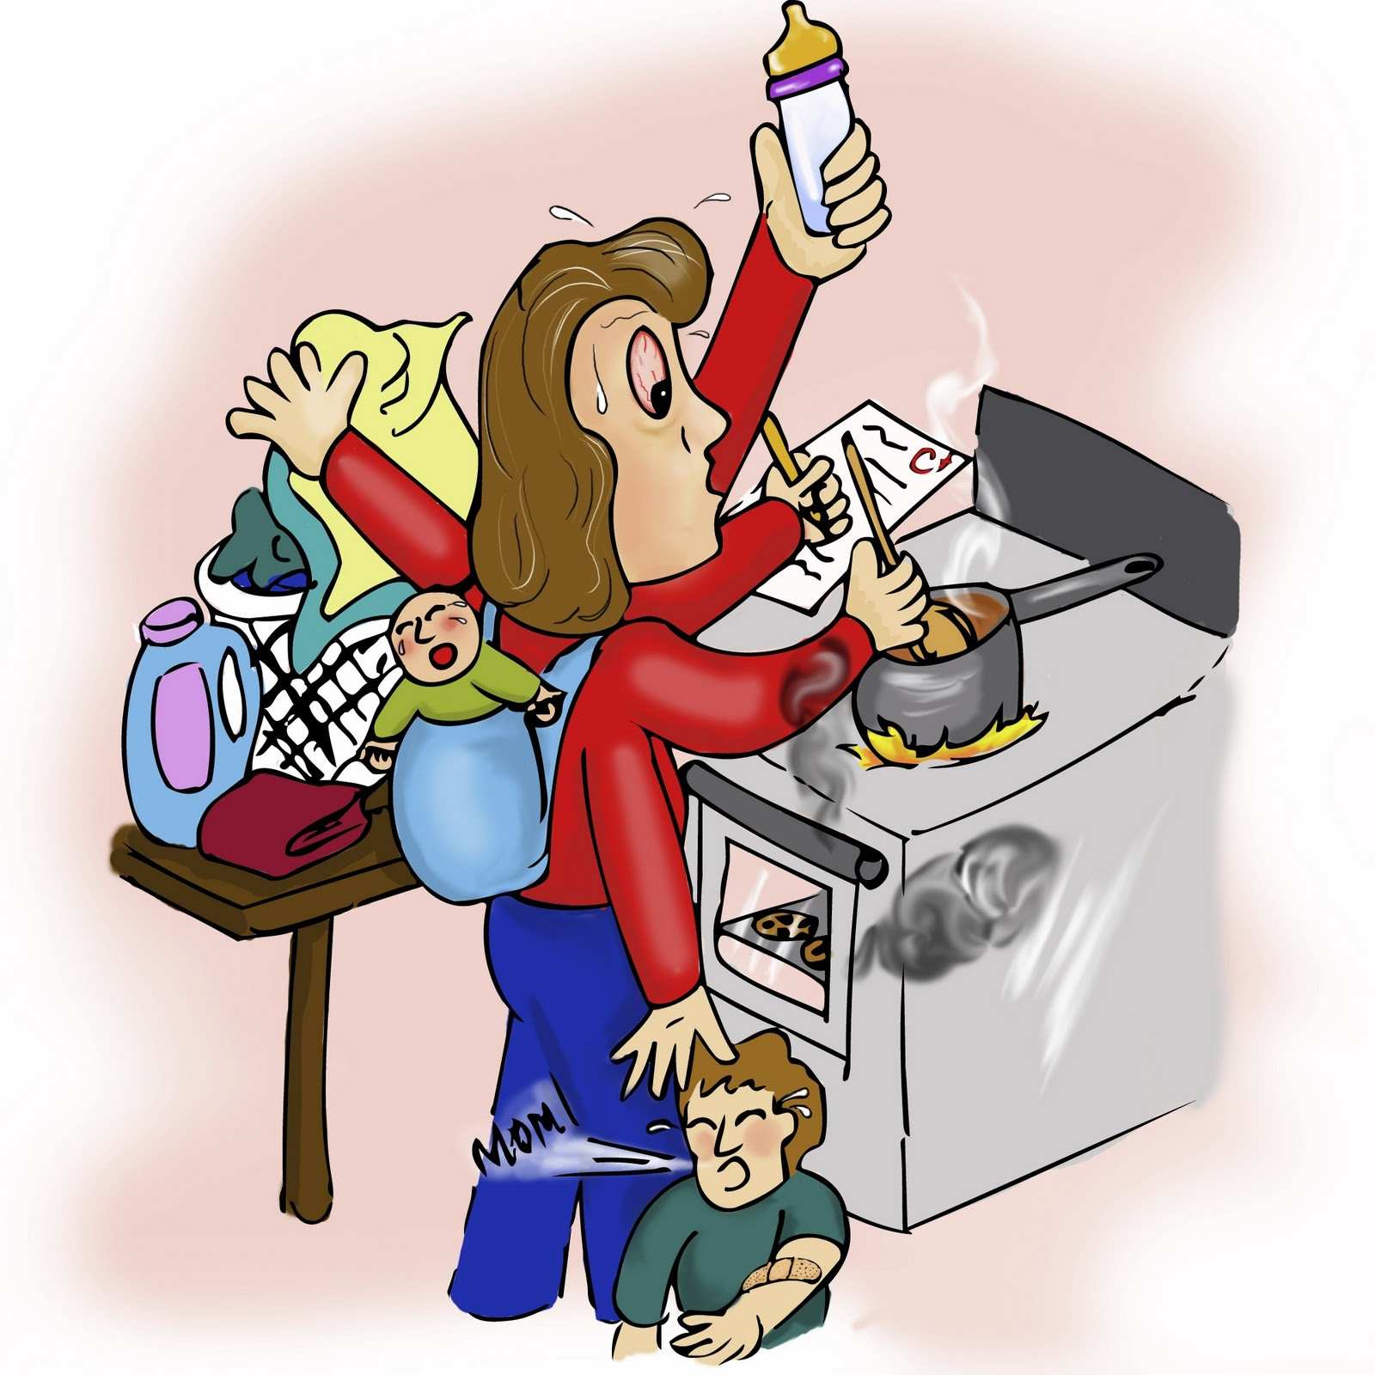

Slide 9
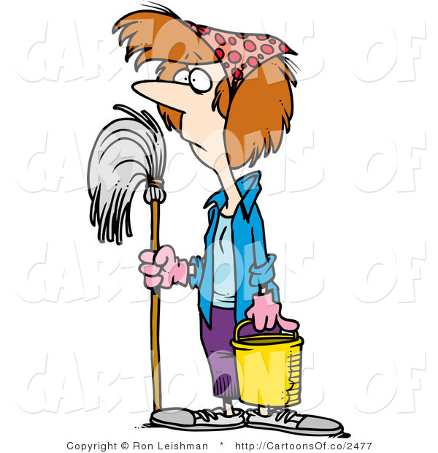
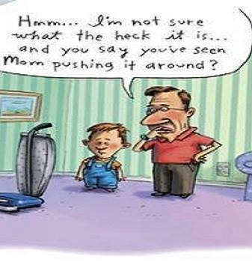

Slide 10
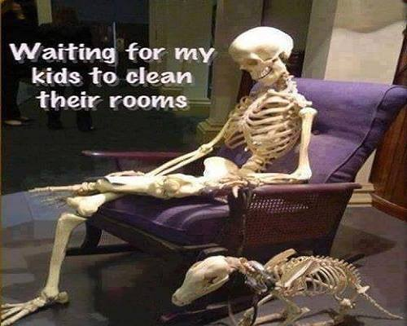

Slide 11
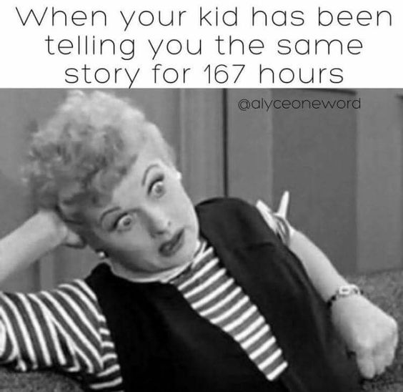

Slide 12
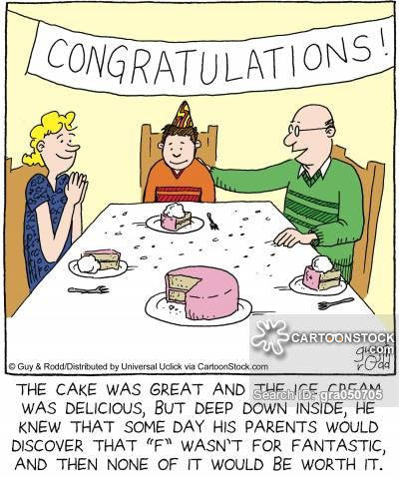

Slide 13
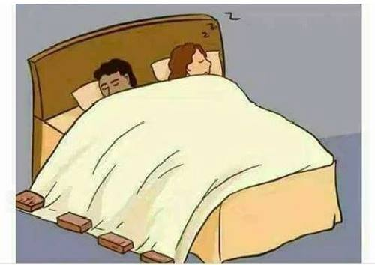

Slide 14
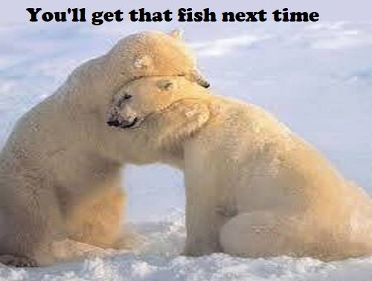

Slide 16
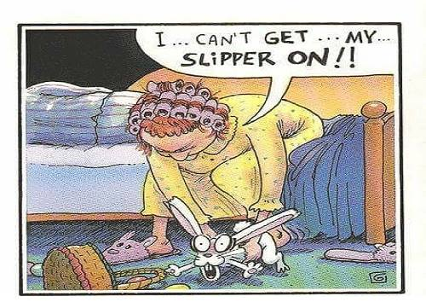

Slide 21
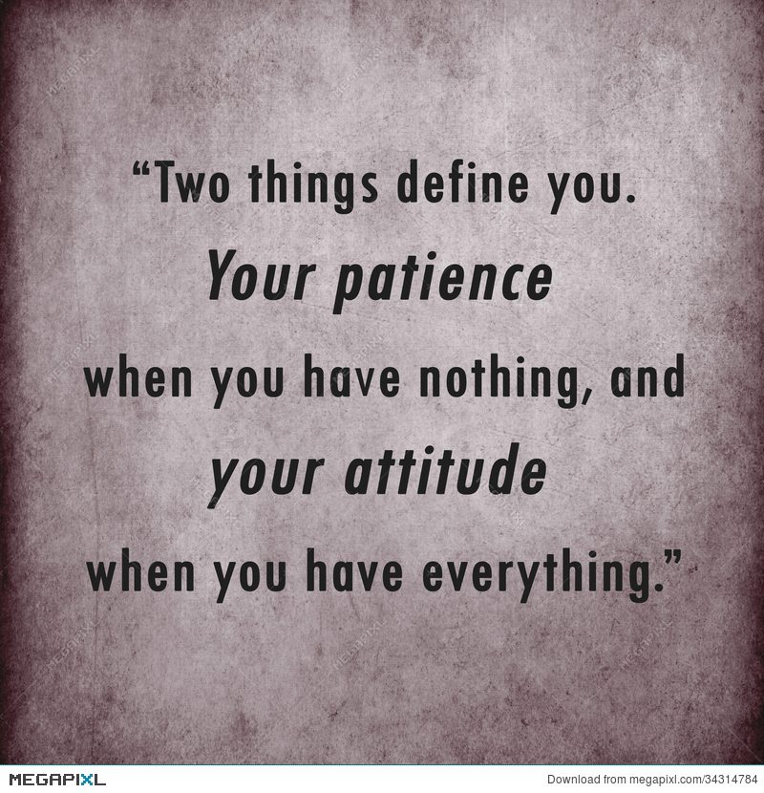
I have got to remember that I posses the ability, the power to be kind and it is always, always, available. I need to use the power of kindness (not wimpiness). I need to use Super Breath!!
“Do not let any unwholesome talk come out of your mouths,
but only what is helpful for building others up;
according to their needs, that it may benefit those who listen”
-Ephesians 4:29

Slide 22
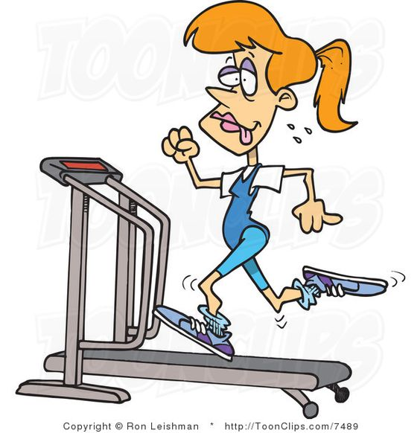
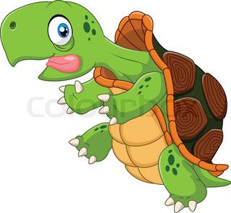

Slide 25
Isaiah 40:28-31
“Do you not know? Have you not heard?
The Lord is the everlasting God, the Creator of the ends of the earth.
He will not grow tired or weary
and his understanding none can fathom.
He gives strength to the weary;
and increases the power of the weak,
Even youth grows tired and weary and young men stumble and fall.
But those who hope in the Lord will renew their strength,
They will
soar on wings like eagles;
they will run and not grow weary, they
will walk and not be faint”

Slide 26
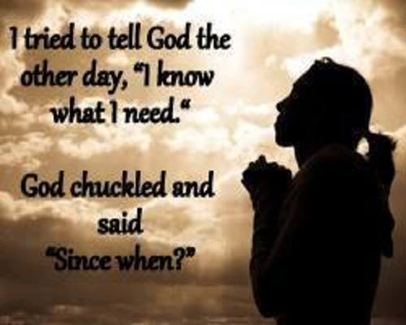

Slide 28
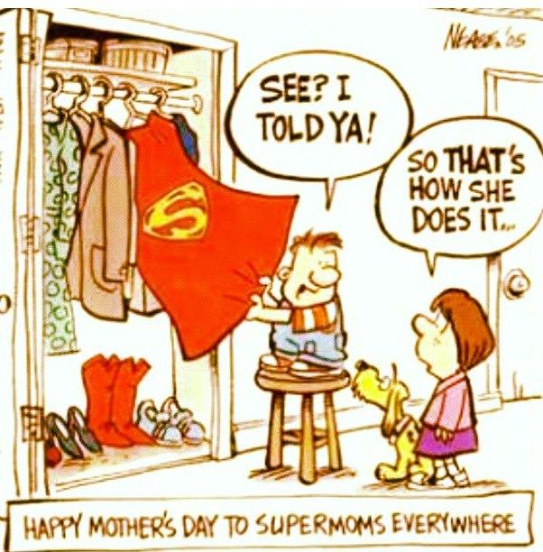

Slide 29
“This Book will keep you from sin
or sin will keep you from this book”

Slide 30
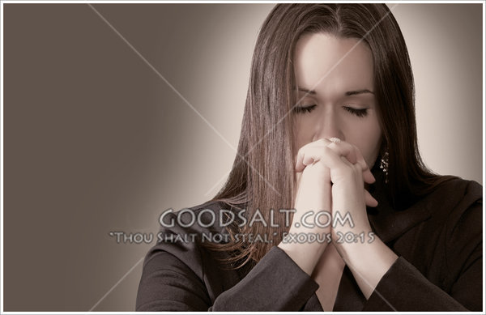
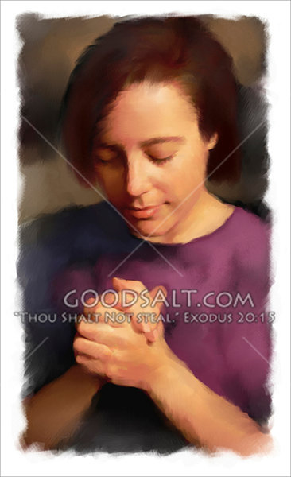

Slide 31
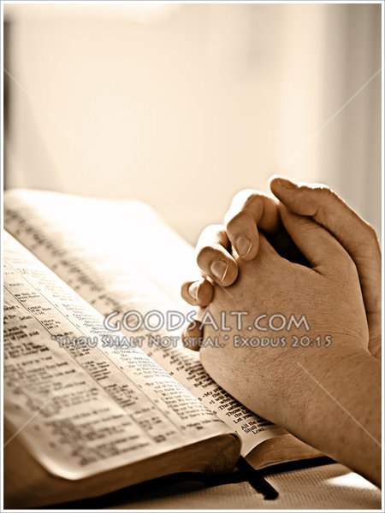
Ephesians 6:10
“Finally, be strong in the Lord and in his mighty power”

