Slide 1
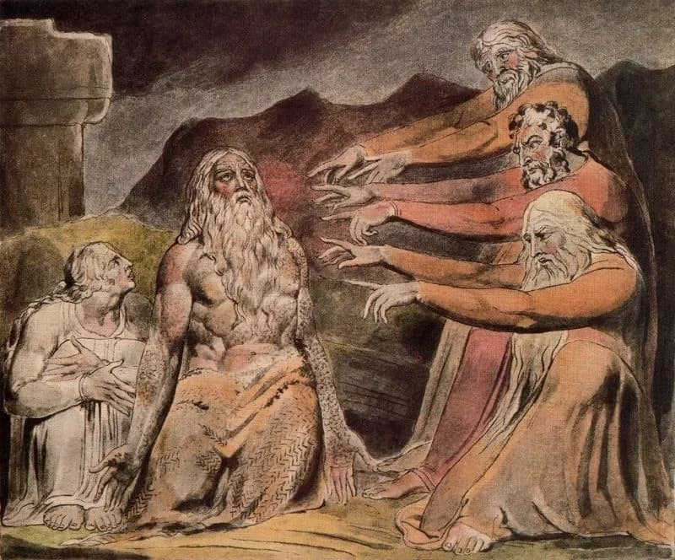
THE BOOK OF JOB “SYMpathetic Comforters”
Text: Job 2:11-13

Slide 2
I. THEY SYMPATHIZED AND COMFORTED (Job 2:11)
“Anyone who withholds kindness from a friend forsakes the fear of the Almighty.
15. But my brothers are as undependable as intermittent streams, as the streams that overflow”
Job 6:14,15

Slide 3
I. THEY SYMPATHIZED AND COMFORTED (Job 2:11)
“Bear one another burdens and so fulfill the law of Christ.”
Galatians 6:2

Slide 4
I. THEY SYMPATHIZED AND COMFORTED (Job 2:11)
“Concerning Edom: This is what the Lord Almighty says: “Is there no longer wisdom in Teman?
Has counsel perished from the prudent? Has their wisdom decayed?”
Jeremiah 29:7

Slide 5
I. THEY SYMPATHIZED AND COMFORTED (Job 2:11)
“Concerning Edom: This is what the Lord Almighty says: “Is there no longer wisdom in Teman?
Has counsel perished from the prudent? Has their wisdom decayed?”
Jeremiah 29:7

Slide 6
II. THEY SPRINKLED DUST IN THE AIR (Job 2:12)
“When they saw him from a distance, they could hardly recognize him; they began to weep aloud, and they tore their robes and sprinkled dust on their heads.”
Job 2:12

Slide 7
II. THEY SPRINKLED DUST IN THE AIR (Job 2:12)
I will be glad and rejoice in your love, for you saw my affliction and knew the anguish of my soul.”
Psalm 31:7

Slide 8
III. THEY SAT ON THE GROUND (Job 2:13)
The Hebrew word describing these
“painful sores” or
“sore boils” (Job 2:7) were in reference to a malignant ulcer which was the worst kind of leprosy.

Slide 9
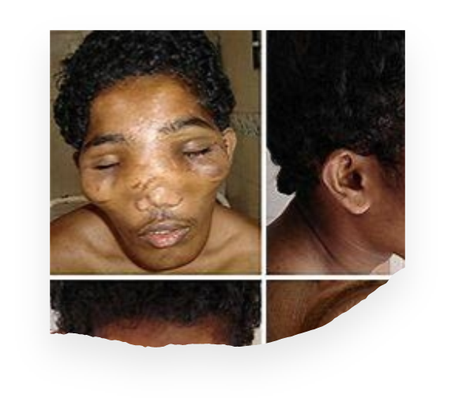
III. THEY SAT ON THE GROUND (Job 2:13)
“Then they sat on the ground with him for seven days and seven nights. No one said a word to him, because they saw how great his suffering was.”
Job 2:13
“Elephantiasis.”
“Leonitasis.”

Slide 10
III. THEY SAT ON THE GROUND (Job 2:13)
The Hebrew word describing these
“painful sores” or
“sore boils” (Job 2:7) were in reference to a malignant ulcer which was the worst kind of leprosy.

