Slide 1
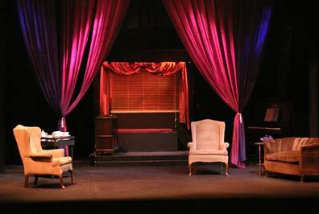
Setting the Stage – Part 2
Matthew 5:17-20

Slide 2
I. THE COMPONENTS OF THE SCRIPT (Matthew 5:17,18)
Galatians 3:17,19,21
The wonderful truths found in the Scriptures declare that God didn’t have to rewrite the script as the drama of life took place for all to see. It was simply another component or chapter of the script that came forth. We could say that the Bible set the script before us in different parts of the whole drama.
It was like Act 1, Act 2, Act 3 etc.

Slide 3
I. THE COMPONENTS OF THE SCRIPT (Matthew 5:17,18)
“Do not think that I have come to abolish the Law or the Prophets; I have not come to abolish them but to fulfill them.
18. I tell you the truth, until heaven and earth disappear, not the smallest letter, not the least stroke of a pen, will by any means disappear from the Law until everything is accomplished.”
Matthew 5:17,18

Slide 4
II. THE CAST OF THE ACTORS (Matthew 5:19)
A. A Law Breaker -
“Anyone who breaks (relaxes - RSV) one of the least of these commandments and teaches others to do the same will be called least in the kingdom of heaven,” Matthew 5:19a

Slide 5
II. THE CAST OF THE ACTORS (Matthew 5:19)
A. A Law Breaker -
“According to a 3rd century rabbi, Moses gave 365 prohibitions and 248 positive commands. David reduced them to 11 in Psalm 15. Isaiah made them 6 (Isaiah 33:14, 15). Micah 6:8 binds them into 3 commands. Habbakuk reduces them all to one great statement: ‘The just shall live by faith.”

Slide 6
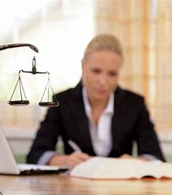
II. THE CAST OF THE ACTORS
(Matthew 5:19)
B. A Law Keeper
“but whoever practices and teaches these commands will be called great (highly esteemed) in the kingdom of heaven.”
Matthew 5:19b

Slide 7
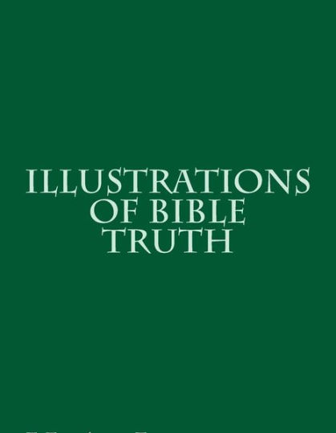
II. THE CAST OF THE ACTORS
(Matthew 5:19)
B. A Law Keeper
“I have been listening very carefully, because I am here to learn all I can in order to take it back to my people”.
A Young Navajo Man

Slide 8
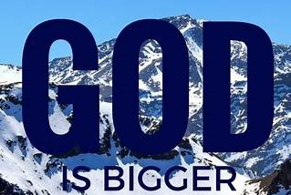
III. THE COST OF THE PRODUCTION (Matthew 5:20)

Slide 9
“Except our righteousness shall exceed” – not be different from but “exceed;” that is, we have to be all they (the Pharisees) are and infinitely more!”
“101 Days in the Gospels with Oswald Chambers”
III. THE COST OF THE PRODUCTION (Matthew 5:20)

Slide 10
The Scribes were considered as the wisest while
the Pharisees
were considered to be the holiest of all men.
III. THE COST OF THE PRODUCTION (Matthew 5:20)

Slide 11
Fasting –
Monday and Thursday until 3:00 Pm
III. THE COST OF THE PRODUCTION (Matthew 5:20)

Slide 12
B. Tithing
They gave a tenth of their whole earnings every year plus a tenth of any increase. The stricter ones also gave an additional tenth to the poor through alms giving.
III. THE COST OF THE PRODUCTION (Matthew 5:20)

Slide 13
C. Study of Scriptures
They devoted their lives to studying the Word of God and teaching it to others.
III. THE COST OF THE PRODUCTION (Matthew 5:20)

