Slide 1
Super Conquerors
Romans 8:37

Slide 2
“Let’s go! Let’s Go!”

Slide 3
“More than Conquerors!!”

Slide 4
I. THE REALITY OF OUR CONQUEST

Slide 5
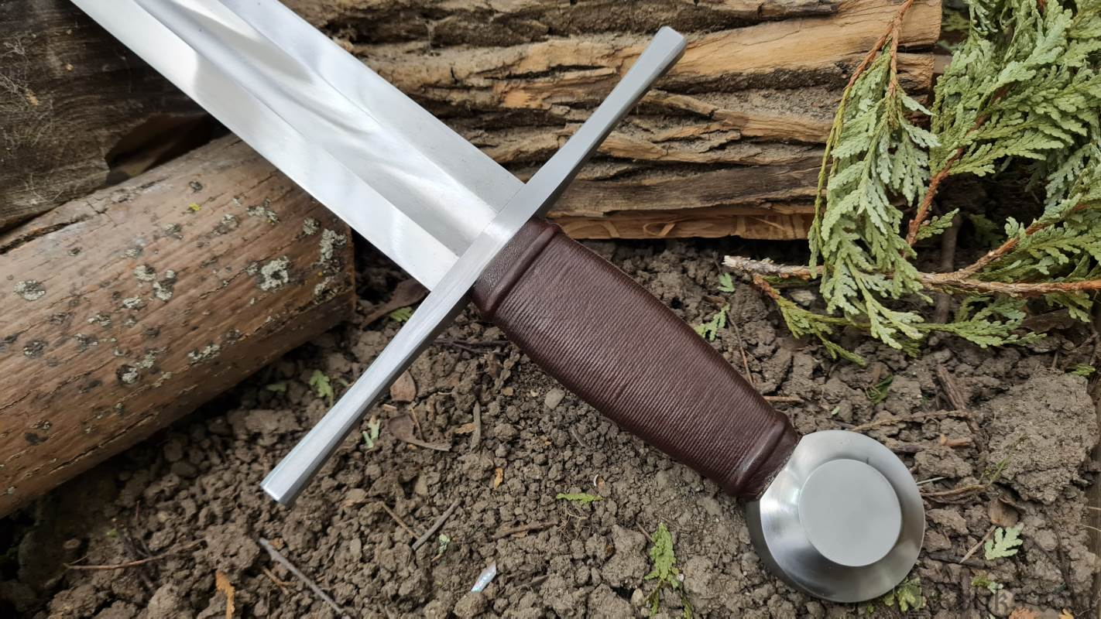
II. THE REALM OF OUR CONQUEST

Slide 6
II. THE REALM OF OUR CONQUEST
A) HE IS REFINING OUR LIVES
B) HE IS REMAKING OUR LIVES

Slide 7
II. THE REALM OF OUR CONQUEST
C) HE IS REALIGNING OUR LIVES

Slide 8
III. THE REASON FOR OUR CONQUEST

Slide 9
ARE YOU CONVINCED??

