Slide 1
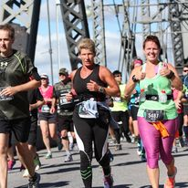
The Amazing race OF Faith

Slide 2
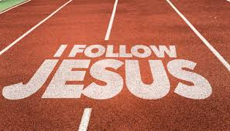
I. The race- the Christ life
Progress: Philippians 3:13-14
Concentration “One thing I Do”
Endurance: Hebrews 12:10

Slide 3
II. The spectators – a great cloud of witnesses Hebrews 12:1
God’s eye is upon us (Proverbs 5:21)
The world is watching (1 Peter 2:12)
Fellow believers are watching (2 Corinthians 6:3)

Slide 4
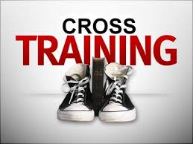
III. The training
Entails strict discipline
Willingness to endure hardness
Requires laying aside everything that hinders !!!

Slide 5
Overcomer
1 Timothy 4:8 NIV
"For physical training is of some value, but Godliness has value for all things, holding promise for both the present life, and the life to come."...

Slide 6
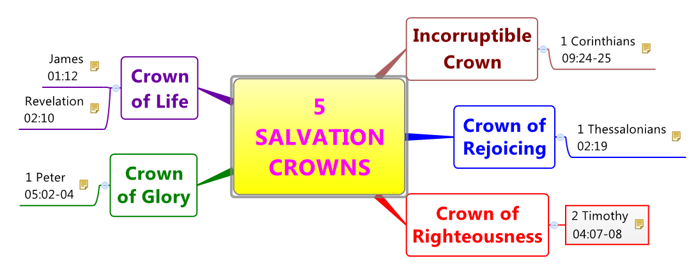
IV. The prize
The greatest honor of the year (2 Timothy 4:8)
Given by the King himself (1 Peter 5:4)
Ours an imperishable crown (James 1:12)

Slide 7
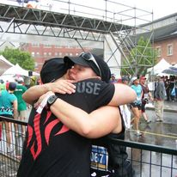

Slide 8
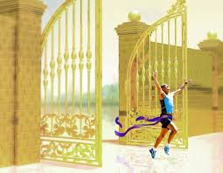
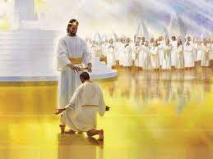
Add a Slide Title - 3
Overcomer

