Slide 1
THE BLESSINGS OF REPENTANCE
Text: Joel 2:18-27

Slide 2
What Are the Blessings of Repentance?

Slide 3
I. PROTECTION FROM OUR ENEMIES (Joel 2:20,25)
“Those who hate me without reason outnumber the hairs of my head; many are my enemies without cause, those who seek to destroy me. I am forced to restore what I did not steal.”
Psalm 69:4

Slide 4
I. PROTECTION FROM OUR ENEMIES (Joel 2:20,25)
“I have done no wrong, yet they are ready to attack me. Arise to help me; look on my plight!
Psalm 59:4

Slide 5
II. PROVISION FROM ABUNDANT SHOWERS (Joel 2:23-24)
“But blessed is the man who trusts in the LORD, whose confidence is in him.
8. He will be like a tree planted by the water that sends out its roots by the stream. It does not fear when heat comes; its leaves are always green. It has no worries in the year of drought and never fails to bear fruit.”
Jeremiah 17: 7,8

Slide 6
II. PROVISION FROM ABUNDANT SHOWERS (Joel 2:23-24)
“Be glad, O people of Zion, rejoice in the LORD your God, for he has given you the autumn rains in righteousness. He sends you abundant showers, both autumn and spring rains as before.
24. The threshing floors will be filled with grain; the vats will overflow with wine and oil.”
Joel 2:23,24

Slide 7
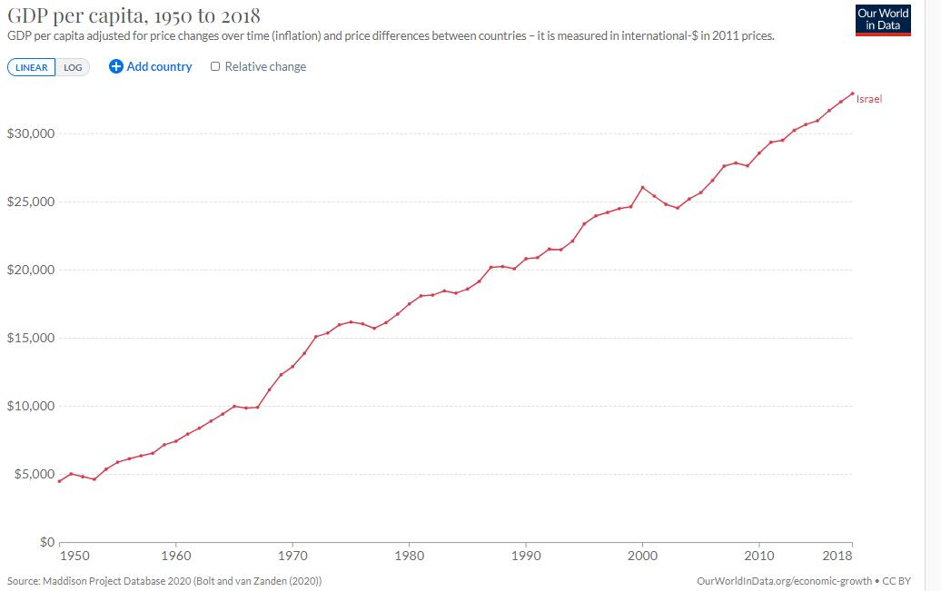
III. PRODUCTION FROM THE PARCHED LAND (Joel 2:21-22, 26)

