Slide 1
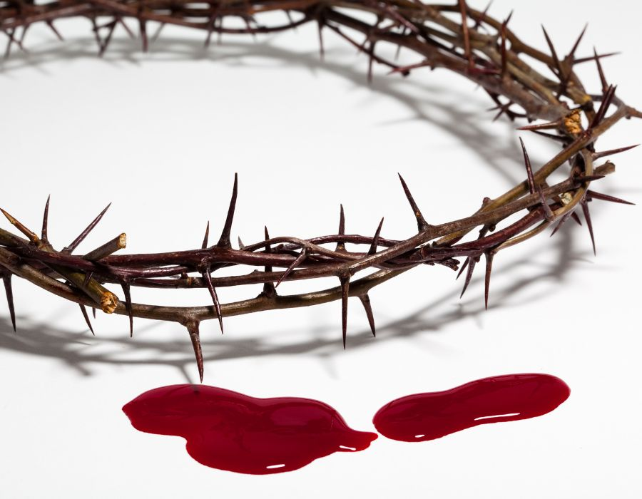
THE BLOOD OF JESUS
Ephesians 1:3-14

Slide 2
I. The Blood of Jesus has CALLED us Back from Sin's Curse
"In him we have redemption through his blood . . ."
Ephesians 1:7a

Slide 3
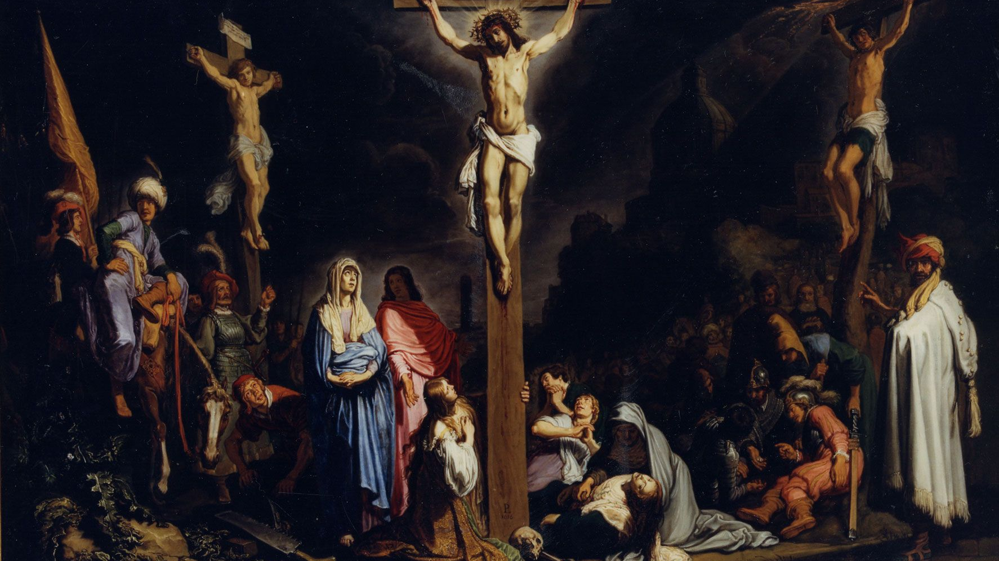
I. The Blood of Jesus has CALLED us Back from Sin's Curse
Rembrandt’s Painting of Our Crucified Christ

Slide 4
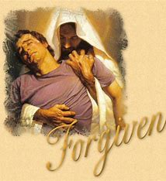
II. The Blood of Jesus has CLEANSED our Guilt Before God
"In him we have redemption through his blood, the forgiveness of sin . . ."
Ephesians 1:7b

Slide 5
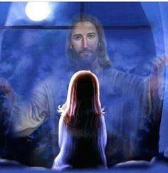
III. The Blood of Jesus has CROWNED us with the Riches of His Grace
“Praise be to the God and father of our Lord Jesus Christ, who has blessed us in the heavenly realms with every spiritual blessing in Christ .
7 . . . in accordance with the riches of God's grace."
Ephesians 1:3,7c

Slide 6
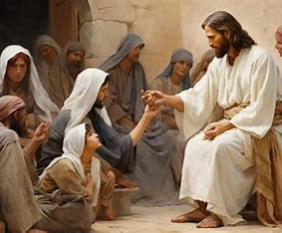
IV. The Blood of Jesus has CHOSEN us to Live out His Plan
"For he chose us in him before the creation of the world to be holy and blameless in his sight . . .
Ephesians 1:4

Slide 7
IV. The Blood of Jesus has CHOSEN us to Live out His Plan
" In him we were also chosen, having been predestined according to the plan of him who works out everything in conformity with the purpose of his will.”
Ephesians 1:11

