Slide 1
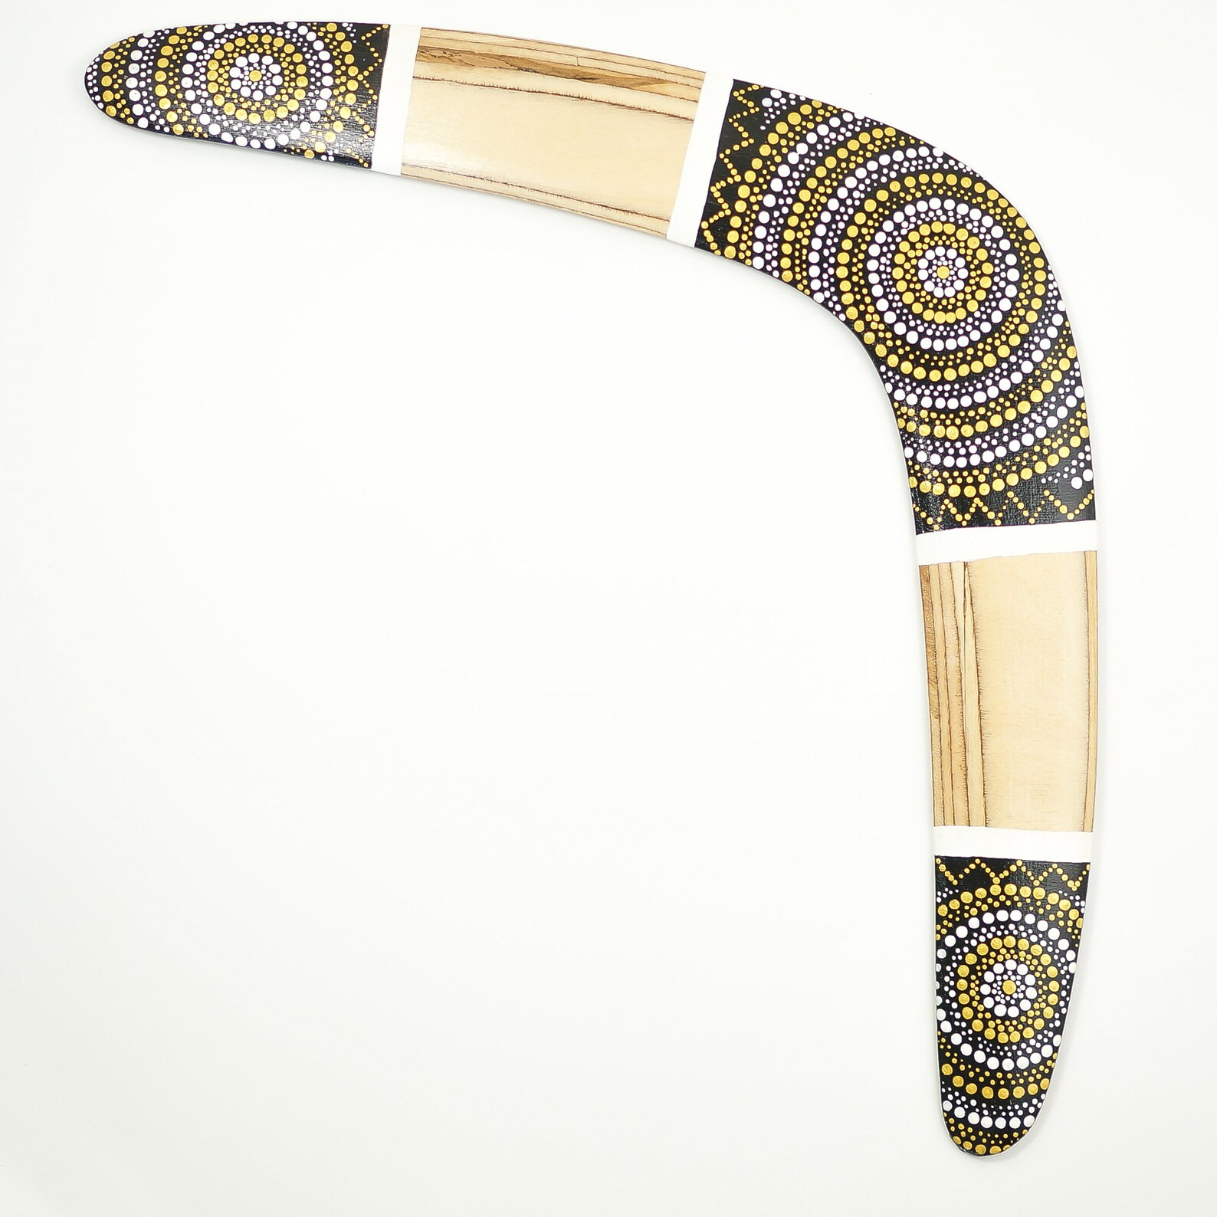
THE BOOMERANG EFFECT
“We know that anyone born of God does not continue to sin; the one who was born of God keeps him safe, and the evil one cannot harm him.”
I John 5:18

Slide 2
THE BOOMERANG EFFECT
“Why Do So Many Christians Struggle Keeping to the Decisions They Make Not to Enter Back into a Habitual Sin?”

Slide 3
I. THE PROJECTION OF WORRY (Matthew 6:25-34)
“Therefore I tell you, do not worry about your life, what you will eat or drink; or about your body, what you will wear. Is not life more important than food, and the body more important than clothes?
26. Look at the birds of the air; they do not sow or reap or store away in barns, and yet your heavenly Father feeds them. Are you not much more valuable than they?
27. Who of you by worrying can add a single hour to his life?
Matthew 6:25-27

Slide 4
I. THE PROJECTION OF WORRY (Matthew 6:25-34)
“28. “And why do you worry about clothes? See how the lilies of the field grow. They do not labor or spin.
29. Yet I tell you that not even Solomon in all his splendor was dressed like one of these.
30. If that is how God clothes the grass of the field, which is here today and tomorrow is thrown into the fire, will he not much more clothe you, O you of little faith?
Matthew 6:28-30

Slide 5
I. THE PROJECTION OF WORRY (Matthew 6:25-34)
“31. So do not worry, saying, ‘What shall we eat?’ or ‘What shall we drink?’ or ‘What shall we wear?’
32. For the pagans run after all these things, and your heavenly Father knows that you need them.
33. But seek first his kingdom and his righteousness, and all these things will be given to you as well.
34. Therefore do not worry about tomorrow, for tomorrow will worry about itself. Each day has enough trouble of its own.”
Matthew 6:31-34

Slide 6
I. THE PROJECTION OF WORRY (Matthew 6:25-34)
“There is scarcely any sin against which our Lord Jesus more warns his disciples, than disquieting, distracting, distrustful cares about the things of this life.”
Matthew Henry’s Concise Commentary

Slide 7
II. THE PERSISTENCE OF WANTING (Philippians 4:19)

Slide 8
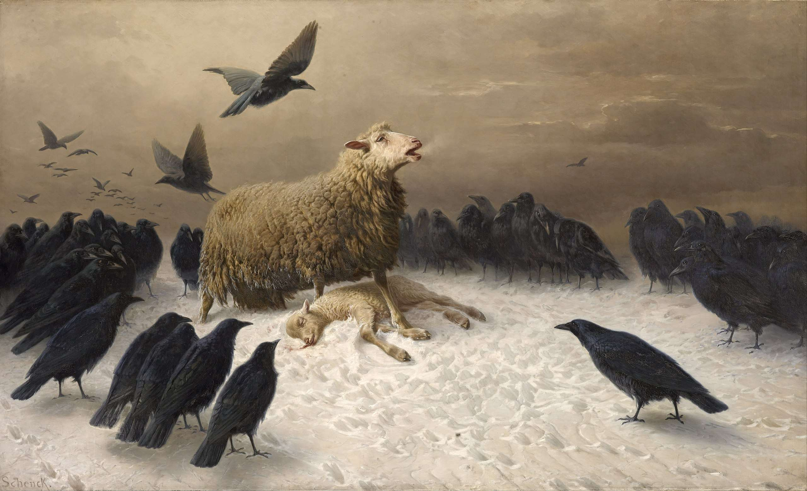
III. THE PATHWAY OF WANDERING (Matthew 18:12-14)

Slide 9
III. THE PATHWAY OF WANDERING (Matthew 18:12-14)

Slide 10
III. THE PATHWAY OF WANDERING (Matthew 18:12-14)
“This is what the LORD says about this people: ‘They greatly love to wander; they do not restrain their feet. So the LORD does not accept them; he will now remember their wickedness and punish them for their sins.’”
Jeremiah 14:10

Slide 11
III. THE PATHWAY OF WANDERING (Matthew 18:12-14)
“‘The days are coming,’ declares the Sovereign LORD, ‘when I will send a famine through the land— not a famine of food or a thirst for water, but a famine of hearing the words of the LORD.
12. Men will stagger from sea to sea and wander from north to east, searching for the word of the LORD, but they will not find it.’”
Amos 8:11,12

Slide 12
III. THE PATHWAY OF WANDERING (Matthew 18:12-14)
“What do you think? If a man owns a hundred sheep, and one of them wanders away, will he not leave the ninety-nine on the hills and go to look for the one that wandered off?
13. And if he finds it, I tell you the truth, he is happier about that one sheep than about the ninety-nine that did not wander off.
14. In the same way your Father in heaven is not willing that any of these little ones should be lost.”
Matthew 18:12-14

Slide 13
III. THE PATHWAY OF WANDERING (Matthew 18:12-14)
“We all like sheep, have gone astray, each of us has turned to his way;”
Isaiah 53:6

Slide 14
III. THE PATHWAY OF WANDERING (Matthew 18:12-14)
“For we were like sheep going astray, but now you have returned to the Shepherd and Overseer of your souls.”
I Peter 2:25

