Slide 1
THE ARMOUR OF GOD PART II The Breastplate of Righteousness
Text: Ephesians 6:14b

Slide 2
Let Us Ask 4 Questions in Order to Better Understand How this Weapon of Our Spiritual Warfare Works.

Slide 3
I. WHO DOES IT PROTECT?
Ephesians 1:1;
Ephesians 2:5;
Ephesians 2:6;
Ephesians 2:10;
Ephesians 2:13;
Ephesians 2:14

Slide 4
I. WHO DOES IT PROTECT?
"no longer foreigners and aliens, but fellow citizens with God's people and members of God's household,
20. built on the foundation of the apostles and prophets, with Christ Jesus himself as the chief cornerstone."
Ephesians 2:19,20

Slide 5
I. WHO DOES IT PROTECT?
Ephesians 4:5;
Ephesians 4:22-24;
Ephesians 5:14, 18,19

Slide 6
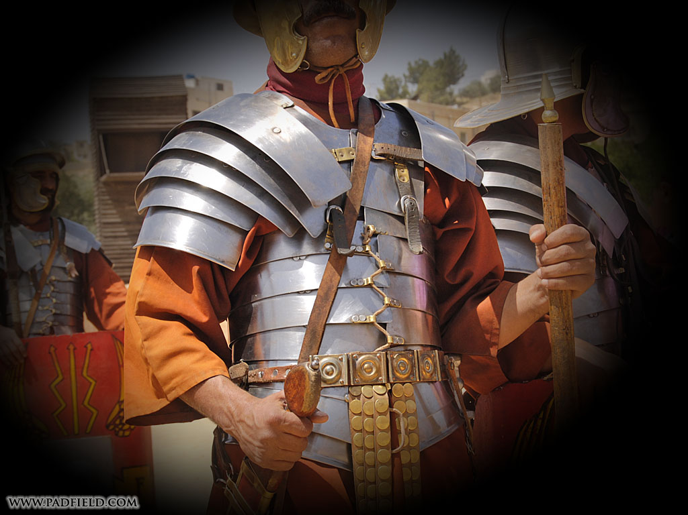
II. WHAT DOES IT PROTECT?

Slide 7
III. WHEN DOES IT PROTECT?
"I cannot go in these," he (David) said to Saul, "because I am not used to them."
I Samuel 17:39b

Slide 8
IV. HOW DOES IT PROTECT?
Philippians 3:8
"Abraham believed God, and it was credited (counted - KJV) to him as righteousness."
Romans 4:3

Slide 9
IV. HOW DOES IT PROTECT?
A. Imputed Righteousness
"and be found in him, not having a righteousness of my own that comes from the law, but that which is through faith in Christ - the righteousness that comes from God and is by faith."
Philippians 3:9

Slide 10
IV. HOW DOES IT PROTECT?
A. Imputed Righteousness
"God made him who had not sin to be sin for us, so that in him we might become the righteousness of God."
II Corinthians 5:21

Slide 11
IV. HOW DOES IT PROTECT?
B. Imparted Righteousness
Ephesians 5:27
"The man with two tunics should share (impart - KJV) with him who has none, and the one who has food should do the same."
Luke 3:11

