Slide 1
THE CHURCH IN FOCUS
Matthew 28:16-20

Slide 2
The PURPOSE of the church is to glorify God. The GOAL of the church is to make disciples, because it brings the greatest glory to God. The PLANS of the church are like road maps directing the people in reaching the goals. The PROGRAMS of the church are the handles we use to get an effective grip on things.
THE CHURCH IN FOCUS

Slide 3
The pivot point for success lies in qualified leadership.
THE CHURCH IN FOCUS

Slide 4
The word “disciple” (Greek - “mathetes”) means “a learner” or one who follows someone’s teaching. A disciple is not simply a pupil but rather an adherent. A disciple becomes an imitator of his/her teacher.
THE CHURCH IN FOCUS

Slide 5
“To the Jews who had believed him, Jesus said, ‘If you hold to my teaching, you are really my disciples.’” John 8:31
THE CHURCH IN FOCUS

Slide 6
“This is my Father’s glory, that you bear much fruit, showing yourselves to be my disciples.” John 15:8
THE CHURCH IN FOCUS

Slide 7
“This is my Father’s glory, that you bear much fruit, showing yourselves to be my disciples.” John 15:8
THE CHURCH IN FOCUS

Slide 8
The full meaning here is not just “Go” BUT “while you go.” There is and never has been a place in God’s kingdom for inactive disciples
THE CHURCH IN FOCUS

Slide 9
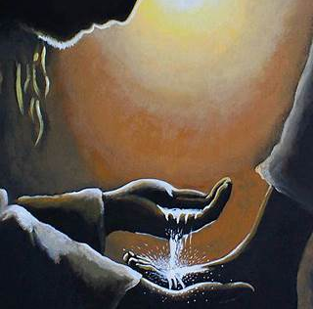
II. MAKE DISCIPLES “Follow my example, as I follow the example of Christ.” I Corinthians 11:1
THE CHURCH IN FOCUS

Slide 10
III. OF ALL NATIONS
THE CHURCH IN FOCUS

Slide 11
IV. BAPTIZING THEM
THE CHURCH IN FOCUS

Slide 12
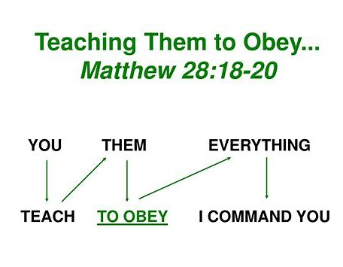
V. TEACHING THEM TO OBEY
THE CHURCH IN FOCUS

Slide 13
V. TEACHING THEM TO OBEY
“Whoever has my commands and obeys them, he is the one who loves me. He who loves me will be loved by my Father, and I too will love him and show myself to him.”
John 14:21
THE CHURCH IN FOCUS

Slide 14
V. TEACHING THEM TO OBEY
“We know that we have come to know him if we obey his commands.”
I John 2:3
THE CHURCH IN FOCUS

Slide 15
V. TEACHING THEM TO OBEY
“To prepare God’s people for works of service, so that the body of Christ may be built up
13. Until we all reach unity in the faith and in the knowledge of the Son of God and become mature, attaining to the whole measure of the fulness of Christ.” Ephesians 4:12,13
THE CHURCH IN FOCUS

Slide 16
V. TEACHING THEM TO OBEY
THE CHURCH IN FOCUS

Slide 17
V. TEACHING THEM TO OBEY
“Then we will no longer be infants, tossed back and forth by the waves, and blown here and there by every wind of teaching and by the cunning and craftiness of men in their deceitful scheming.
15. Instead, speaking the truth in love, we will in all things grow up into him who is the Head, that is, Christ.
16. From him the whole body (family - KJV), joined and held together by every supporting ligament, grows and builds itself up in love, as each part does its work.” Ephesians 4:14-16
THE CHURCH IN FOCUS

