Slide 1
THE CONQUEST OF PROMISE
Joshua 1:3-5

Slide 2
"When the enemy shall come in like a flood the Spirit of the Lord shall lift up a standard against him (put him to flight)."
Isaiah 59:19 KJV
"For he will come like a pent-up flood that the breath of the LORD drives along."
Isaiah 59:19 NIV

Slide 3
"From the west, people will fear the name of the Lord, and from the rising of the sun, they will revere his glory. For he will come like a pent-up flood that the breath of the Lord drives along.
Isaiah 59:19 NIV

Slide 4
How Did Joshua Convince the People to Cross the Jordan River after 40 Years of Wandering in the Wilderness?

Slide 5
I. BY STANDING ON THE PROMISES OF GOD - (Joshua 1:2-3)
"The LORD said to Joshua . . ."
Joshua 1:1

Slide 6
I. BY STANDING ON THE PROMISES OF GOD - (Joshua 1:2-3)
"Do not leave Jerusalem, but wait for the gift my Father promised, which you have heard me speak about."
Acts 1:4

Slide 7
I. BY STANDING ON THE PROMISES OF GOD - (Joshua 1:2-3)
"No matter how many promises God has made, they are "Yes" in Christ."
I Corinthians 1:20

Slide 8
II. BY SURVEYING THE PRECISE BOUNDARIES OF GOD - (Joshua 1:4)
1. The Syrian Desert to the South-East
2. The Euphrates to the East
3. The Hittite Country (Turkey) to the North
4. The Mediterranean Sea to the West

Slide 9
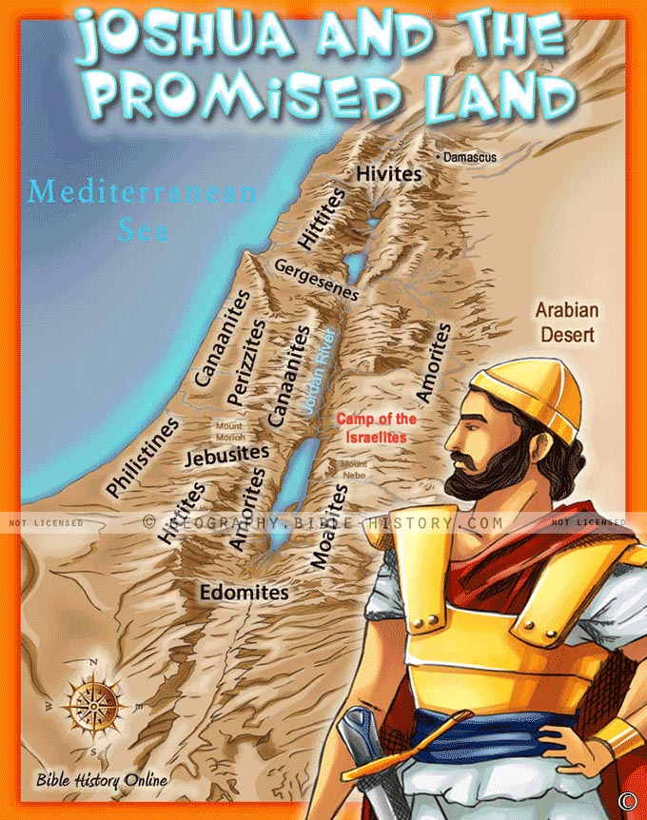
II. BY SURVEYING THE PRECISE BOUNDARIES OF GOD - (Joshua 1:4)

Slide 10
II. BY SURVEYING THE PRECISE BOUNDARIES OF GOD - (Joshua 1:4)
"Then Moses climbed Mount Nebo from the plains of Moab to the top of Pisgah, across from Jericho. There the LORD showed him the whole land - from Gilead to Dan,
2. all of Naphtali, the territory of Ephraim and Manasseh, all the land of Judah as far as the western sea,
Deuteronomy 34:1-2

Slide 11
II. BY SURVEYING THE PRECISE BOUNDARIES OF GOD - (Joshua 1:4)
3. the Negev and the whole region from the valley of Jericho, the City of Palms, as far as Zoar.
4. Then the LORD said to him, "This is the land I promised on oath to Abraham, Isaac and Jacob when I said, 'I will give it to your descendants," I have let you see it with your eyes, but you will not cross over into it."
Deuteronomy 34:1-4

Slide 12
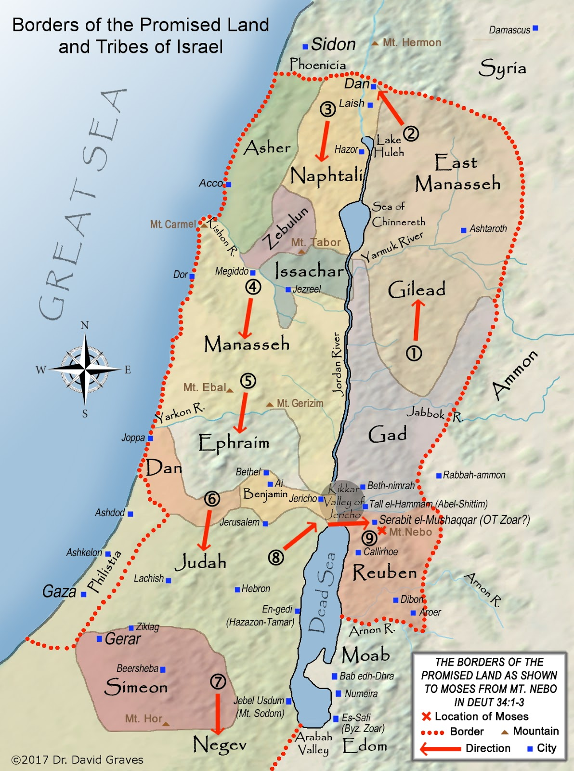
II. BY SURVEYING THE PRECISE BOUNDARIES OF GOD - (Joshua 1:4)

Slide 13
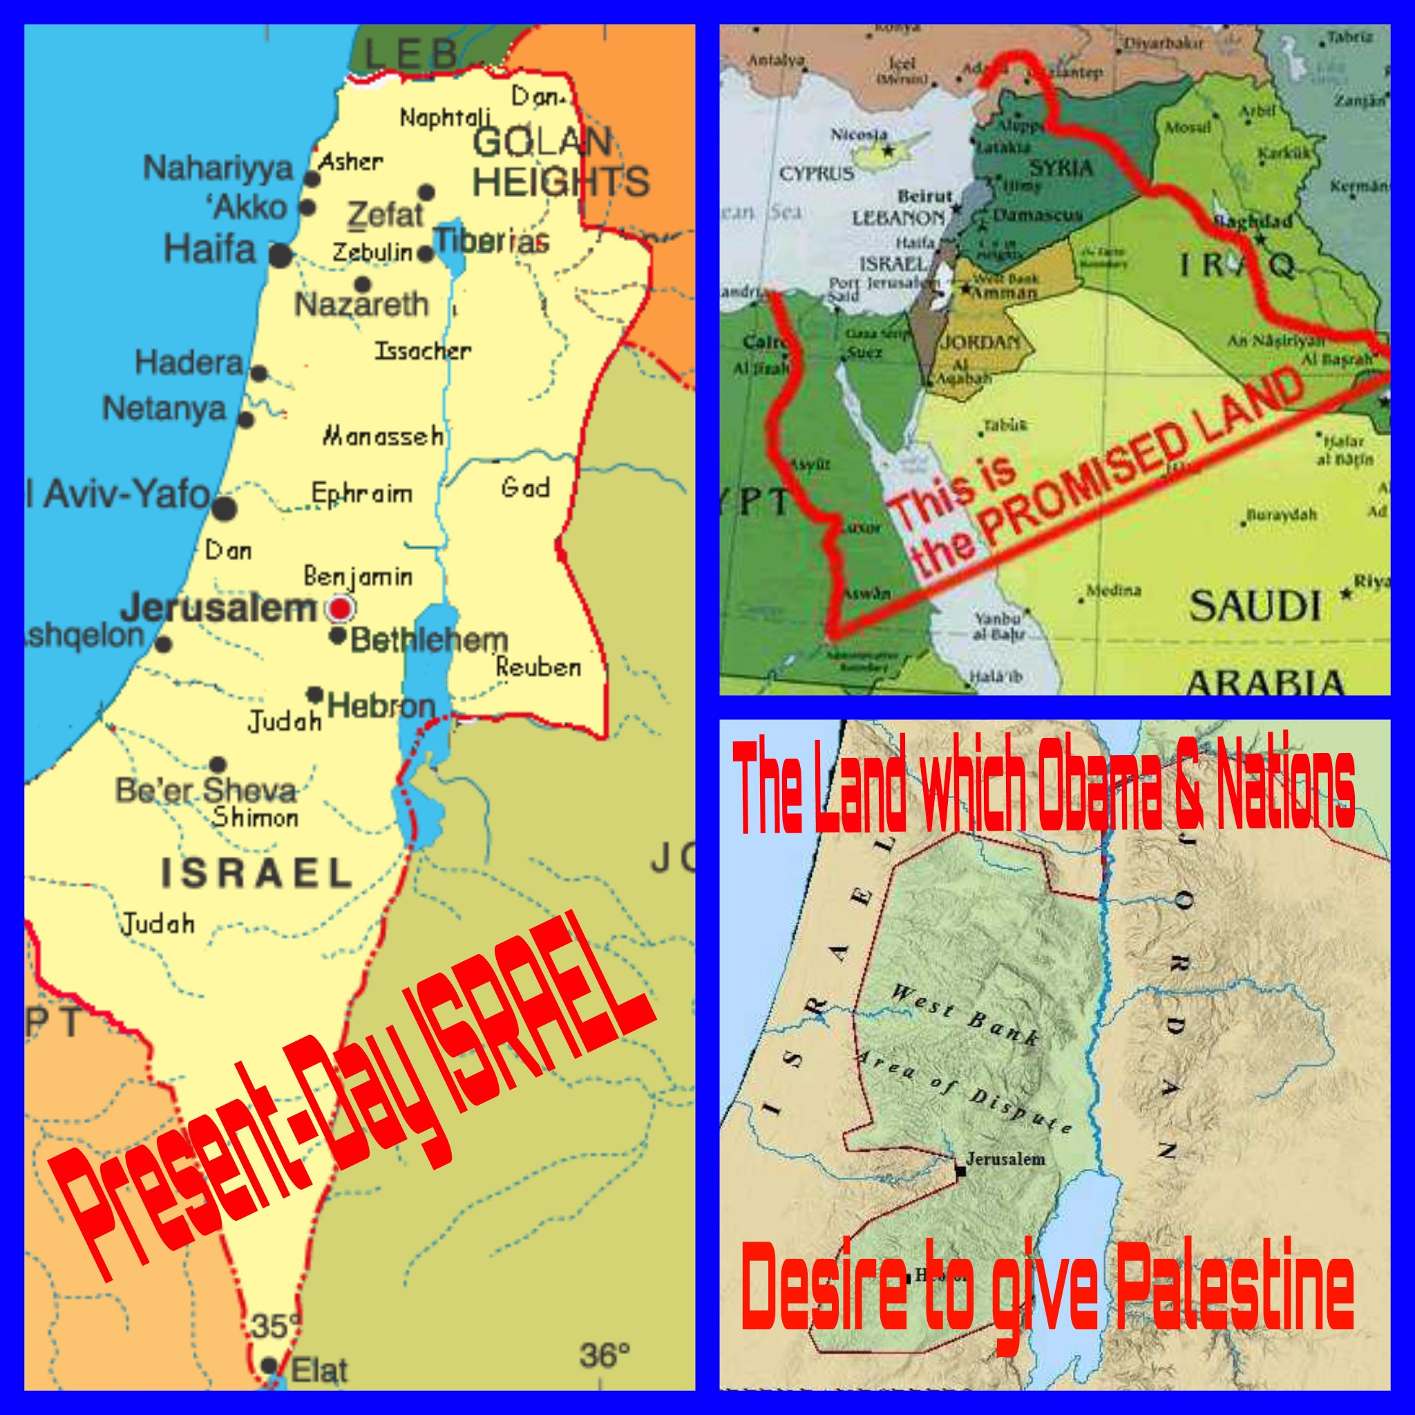
II. BY SURVEYING THE PRECISE BOUNDARIES OF GOD - (Joshua 1:4)

Slide 14
II. BY SURVEYING THE PRECISE BOUNDARIES OF GOD - (Joshua 1:4)
"Judah's leaders are like those who move boundary stones. I will pour out my wrath on them like a flood of water."
Hosea 5:10

Slide 15
III. BY SECURING THE PRESENCE OF GOD - (Joshua 1:5)
"As I was with Moses, so I will be with you; I will never leave you nor forsake you."
Joshua 1:5

Slide 16
III. BY SECURING THE PRESENCE OF GOD - (Joshua 1:5)
"I was young and now I am old, yet I have never seen the righteous forsaken or their children begging bread."
Psalm 37:25

